Slide 1
Viruses, Bacteria, Protist

Slide 2
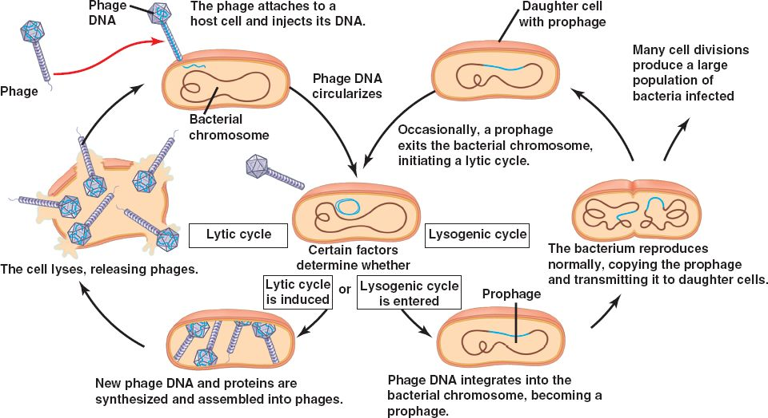
Viruses
Structure: Nucleic Acid, Capsid, Envelope
Lytic Vs. Lysogenic Cycle
Vaccinations
Examples: bacteriophage, retrovirus, flu, herpes

Slide 3
Bacteria
Prokaryotes
Two Domains: Archaebacteria and Eubacteria
Reproduction: Asexual(mitosis) or Sexual
Conjugation
Transformation
Transduction
Antiseptics and Antibiotics
Differences in Gene Regulation
Single point of origin replication
Operons (inducible and repressible)

Slide 4
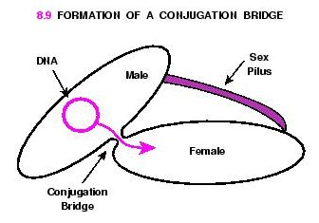

Slide 5
Transduction
Transduction- transport of genes from one cell to another inside a virus particle.

Slide 6
Kingdom Protista (domain Eukarya)
This is a very large, diverse Kingdom
All Eukaryotic
Traditionally thought of as having 3 sub-groups
Protozoa-Animal-like protists (heterotrophic)
Algae-Plant-like protists (autotrophic)
Fungus-like (slime molds)protists (decomposers)
Modern scientists are close to splitting this into several Kingdoms
Many are unicellular, but some are multicellular
Heterotrophic , autotrophic, “mixotrophic,”
They have varied methods of reproduction
The kingdom is therefore divided into 5 Candidate Kingdoms, or Supergroups (Each text lists these differently)
Supergroups are making us re-think the Kingdom system as we know it, as a couple include plants, fungi, and animals
Ecologically Important
Algae-carbon sink
Lichen-symbiosis between algae and fungus
Red Tides- Dinoflagellates
Disease Causing
Malaria, African Sleeping Sickness, Toxoplasmosis

