Slide 1
The Immune System
Pathogen-infectious agent (virus, bacteria, protist, fungus)
Antigen-any molecule that can be recognized as foreign
The immune system protects against pathogens using barriers as well as many specific and non-specific responses
First-line of defense-barriers
Second-line of defense-general fighting of infection
Third-line of defense-cells built to fight specific infections
Organs/Tissues: Spleen, Lymph Nodes, Thymus, Bone Marrow

Slide 2
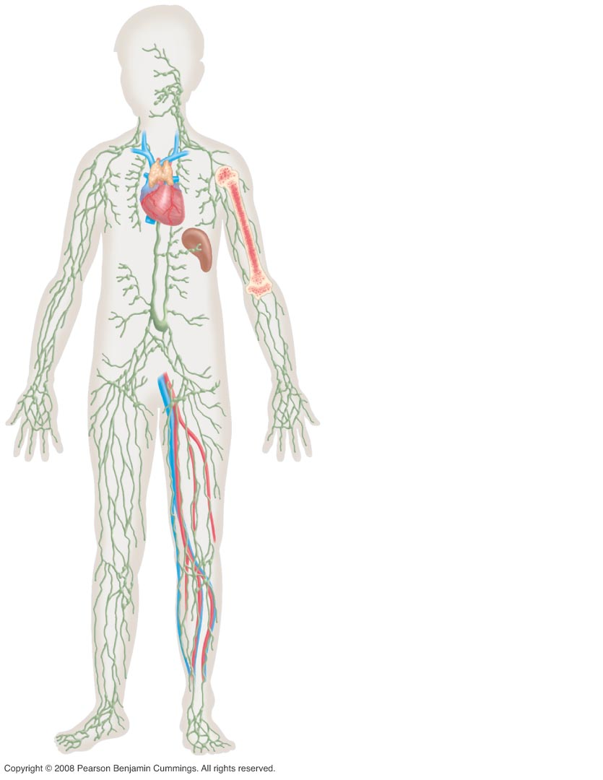
Figure 49-4
Components of the
immune system
Lymphocyte origin:
Bone marrow
Lymphocyte maturation:
Bone marrow (B cells)
Thymus (T cells)
Lymphocyte activation:
Spleen
Lymph nodes
Lymphocyte transport:
Lymphatic ducts
Blood vessels

Slide 3
First Line of Defense (innate/general)
Skin
Cilia-sweep invaders out of respiratory tract
Antimicrobial proteins (lysozymes) in saliva, tears, mucous. Break down walls of bacteria.
Gastric Juice
Symbiotic Bacteria-outcompete harmful bacteria in the gut and vagina

Slide 4
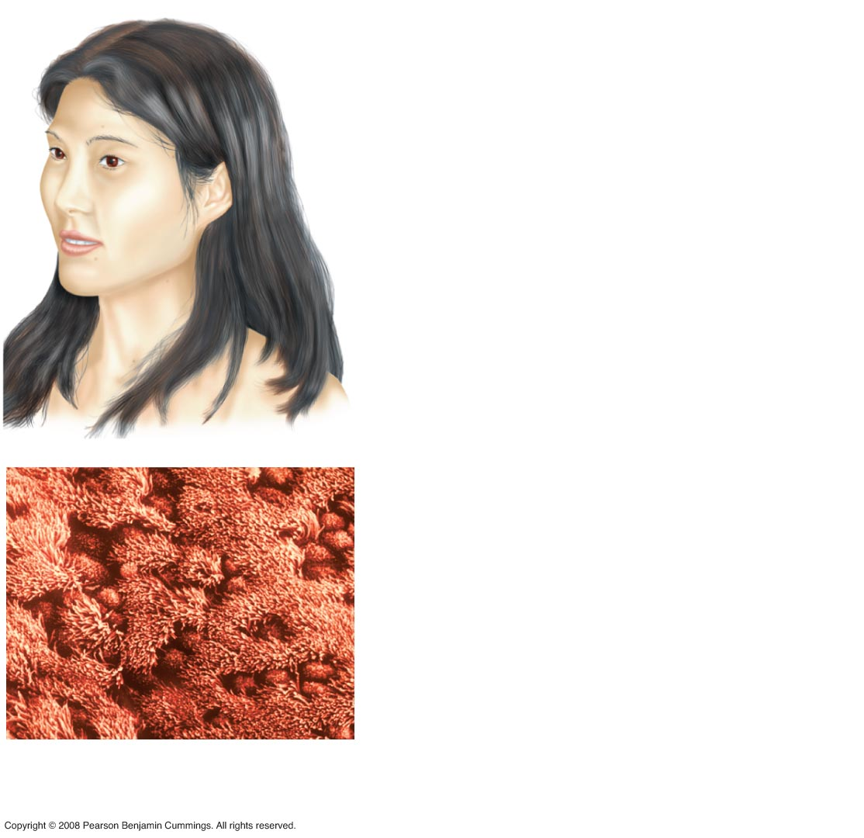
Figure 49-1
Eyes
Blinking wipes tears across
the eye. Tears contain the
antibacterial enzyme lysozyme.
Ears
Hairs and ear wax trap
pathogens in the passageway
of the external ear.
Nose
The nasal passages are lined
with mucus secretions and
hairs that trap pathogens.
Digestive tract
Pathogens are trapped in saliva
and mucus, then swallowed.
Most are destroyed by the low
pH of the stomach.
Airways (lining of trachea)
Instead of reaching the
lungs, most pathogens are
trapped in mucus and swept
up and out of the airway via
the beating of cilia.
Ciliated
cells
Mucus-secreting
cells

Slide 5
Second Line Defenses
Phagocytes (WBCs)-engulf pathogens by phagocytosis
Neutrophils-most abundant phagocytic cells that engulf pathogens; macrophages, first responders, form pus
NK or natural killer cells-Destroy cells that play host to viruses and bacteria
Dendritic cells-become antigen presenting cells (APC) to stimulate more specific immunity
Interferons-proteins produced by infected cells that stimulate neighboring cells to produce proteins to defend against infecting viruses OR call white blood cells.
Inflammatory Response-pain and swelling at an infection site
Mast cells (basophils) in the area burst open and release histamine
Histamine cause nearby blood vessels to dilate, bringing more blood to the infection site.(vasodilation)
Phagocytes are attracted to that area, and release chemical signals that bring more blood to the area

Slide 6
Figure 49-2
Mast cells secrete signals that increase
blood flow.
Neutrophils ingest and kill pathogens.
Macrophages recruit other cells and
ingest and kill pathogens.
Granules
contain signaling
molecules
Vesicles
containing
signaling
molecules
Lysosomes
digest
bacteria
Pseudopodia engulf
bacteria
Nucleus
Multi-lobed
nucleus
Vesicles
secrete cell-
killing toxins
Nucleus

Slide 7
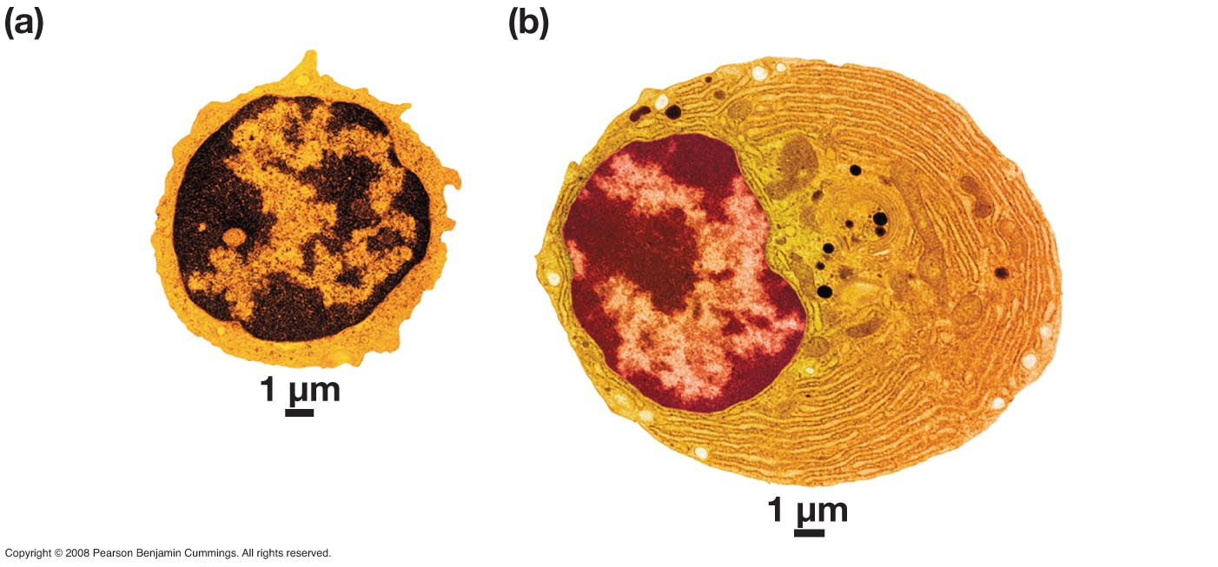
Figure 49-5
Inactive lymphocyte
Activated lymphocyte
Large amount
of rough ER
Nucleus
Nucleus

Slide 8
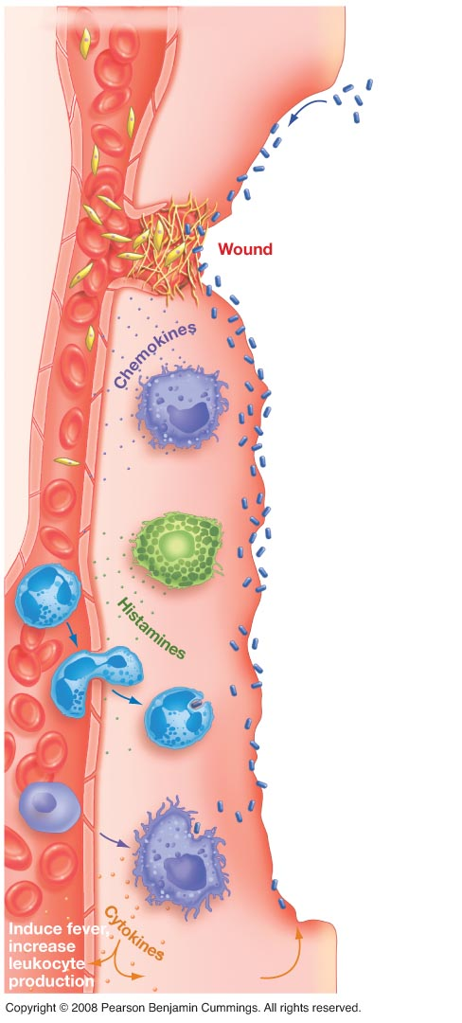
Figure 49-3
THE INFLAMMATORY RESPONSE
Blood vessel
Red blood cell
Platelet
1. Bacteria and
other pathogens
enter wound.
2. Platelets from
blood release
blood-clotting
proteins at
wound site.
3. Injured tissues
and macrophages
at the site release
chemokines, which
recruit immune
system cells to site.
Macrophage
4. Mast cells at
the site secrete
factors that
constrict blood
vessel at wound
but dilate blood
vessels near
wound.
Mast cell
5. Neutrophils
arrive, begin
removing
pathogens by
phagocytosis.
Neutrophil
6. Some newly
arrived leukocytes
mature into
macrophages
that phagocytize
pathogens and
secrete key
cell-cell signals.
Macrophage
Initiate tissue
repair

Slide 9
Third line of defense
Up until now, the immune response has been general and not specific to the pathogen.
Immunity is built specifically to fight a particular antigen (like a toxin from a bacterium, protein coat of a virus, or a molecule unique to a pathogen)
Major histocompatibility complex (MHC) distinguishes between “self” cells and “foreign” cells
This is a collection of glycoproteins on the surfaces of all body cells
These are made from about 20 genes (50 alleles) and each is unique to each person, so it’s unlikely you’ll have the same proteins as someone else

Slide 10
Specific Immune Cells
B Cells-are made and mature in the bone marrow, and respond to antigens. They make antibodies (proteins) against the antigen
Antibodies are specific to the antigen
There are 5 classes of antibodies (immunoblobulins), and each is associated with a particular activity
Each class of antibodies is Y-shaped with constant regions and variable regions. The variable regions give the antibodies specificity for the antigen
Plasma Cells-release antibodies that circulate to an infection site
Memory B Cells-stay after an infection to make you immune to future attacks from the same strain of the infection.

Slide 11
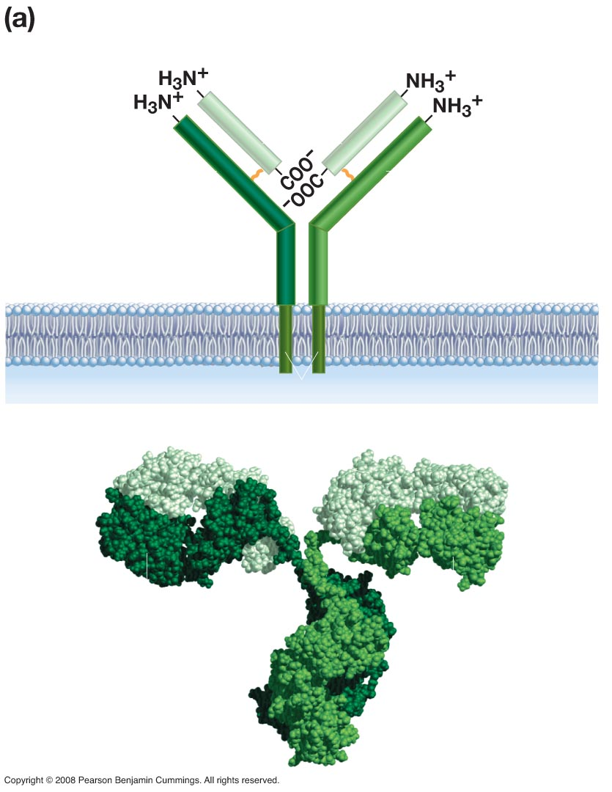
Figure 49-6a
B-cell receptor
Antigen-
binding site
Antigen-
binding site
Light
chain
Heavy chain
Heavy chain
Disulfide bridge
Transmembrane domains
Light chains
Antigen-
binding
site
Antigen-
binding
site
Heavy chain
Heavy chain

Slide 12
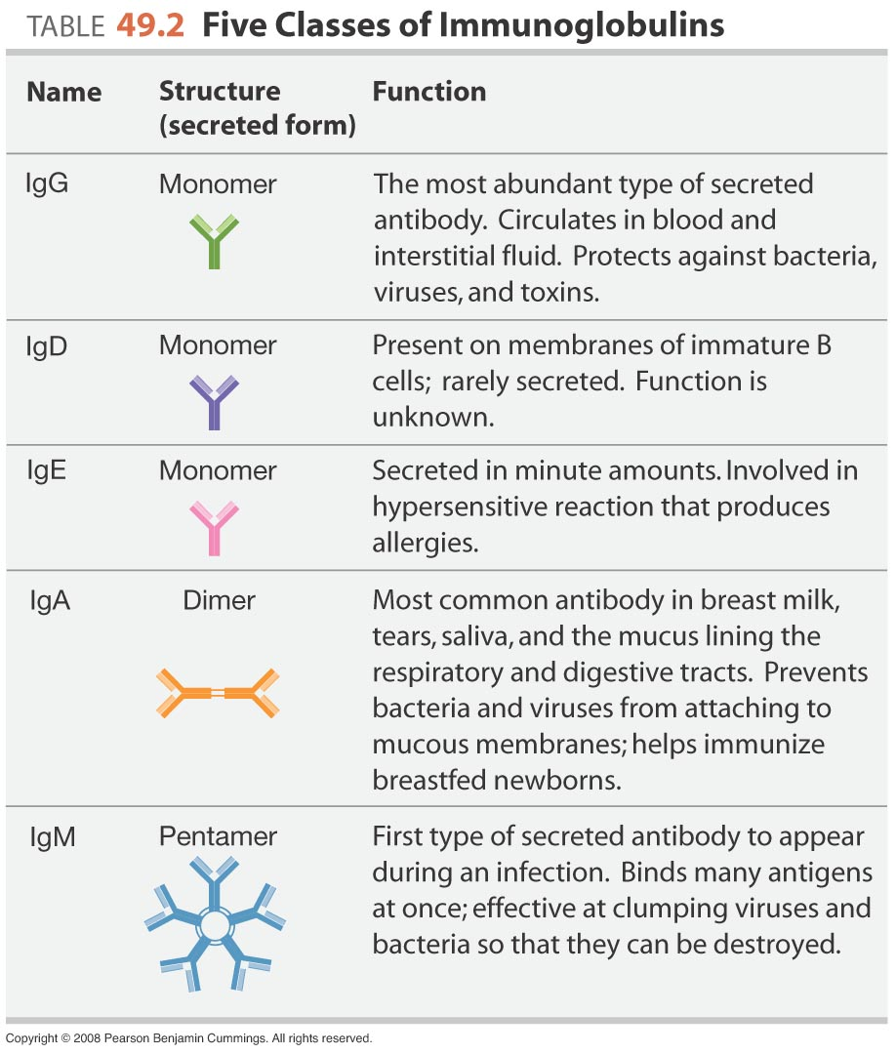
Figure 49-6-Table 49-2

Slide 13
Immune Cells cont.
T Cells-originate in the bone marrow, but mature in the thymus (a gland, hence the “T”)
MHC markers of the T cells distinguish between self and nonself cells
Cancer cells are often recognized as nonself
Cytotoxic T cells-lyse nonself cells by puncturing them (The Killers)
Helper T cells-activate inactive macrophages, stimulate B cell production and stimulate cytotoxic T cells
When an antigen binds to T or B cells, they proliferate, which is called clonal selection, since only cells that match the antigen will be cloned

Slide 14
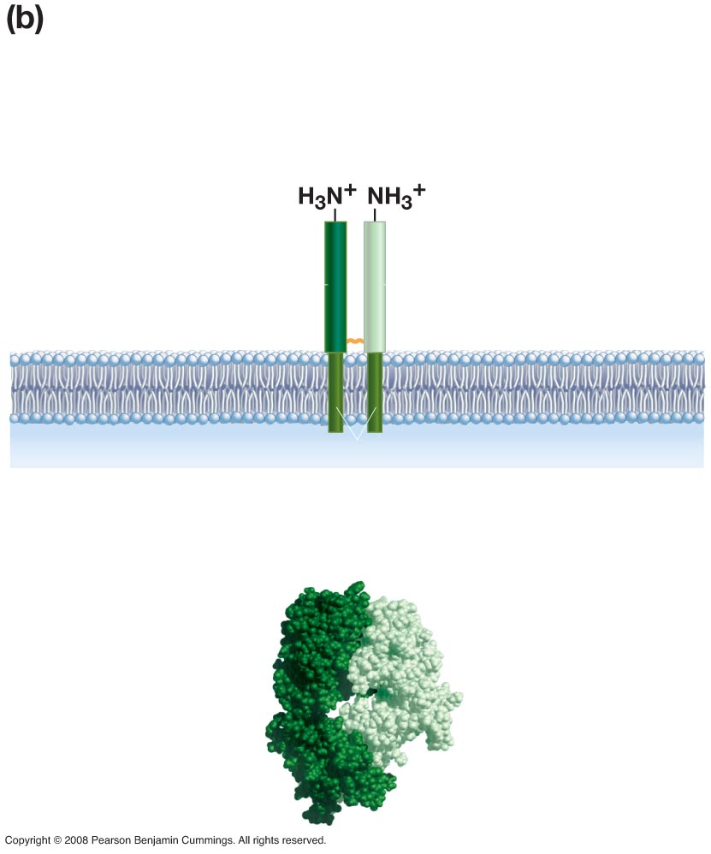
Figure 49-6b
T-cell receptor
Antigen-binding site
α Chain
β Chain
Transmembrane domains
Antigen-binding site
α Chain
β Chain

Slide 15
Types of Immune Response
Cell-mediated response-Mostly T cells respond to nonself cells via clonal selection
Killer T cells are produced
helper T cells that bind to macrophages, which carry nonself markers from the cells they have encountered
Helper T cells produce interleukins to stimulate proliferation of more T and B cells (these make you achy) as well as fever, inflammation, etc.
Respond to invaders acting within the host cells. Ex. Viruses, sometimes cancer
Humoral response (antibody-mediated)-response to antigens or pathogens within the lymph.
Macrophages and helper T cells stimulate B cell production
B cells produce plasma cells, which release antibodies for the antigen
B cells produce memory cells
Respond to invaders acting outside of the cell. Ex. Bacteria

Slide 16
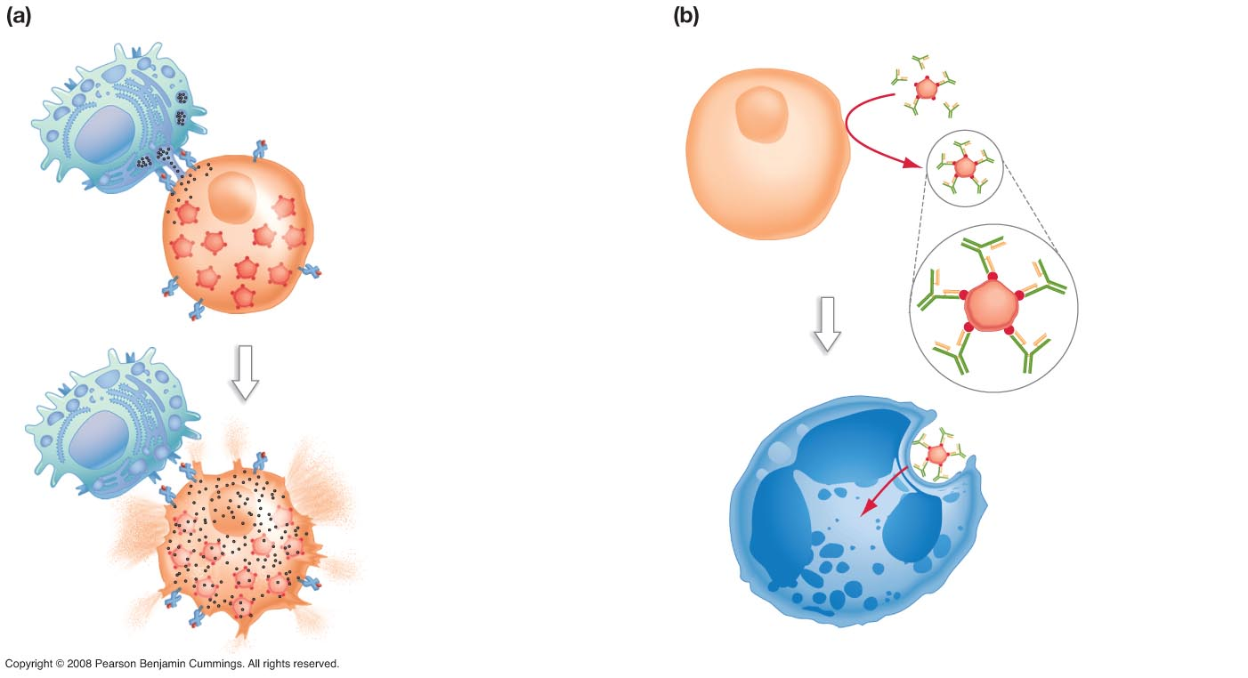
Figure 49-13
CELL-MEDIATED RESPONSE
HUMORAL RESPONSE
1. Cytotoxic T cell
makes contact with
virus-infected cell and
releases granules
(black dots).
1. Antibodies coat
free virus particles.
The virus cannot bind
to the host cell’s
plasma membrane.
Granules
Uninfected
host cell
Cytotoxic T cell
Virus-infected
host cell
Virus particle
Antibody
Antigen
2. Molecules in the
granules induce
infected cell to self-
destruct, killing he
viral particles inside.
2. The antibody-coated
virus is recognized,
phagocytized, and
destroyed by a
neutrophil or
macrophage.
Neutrophil

Slide 17
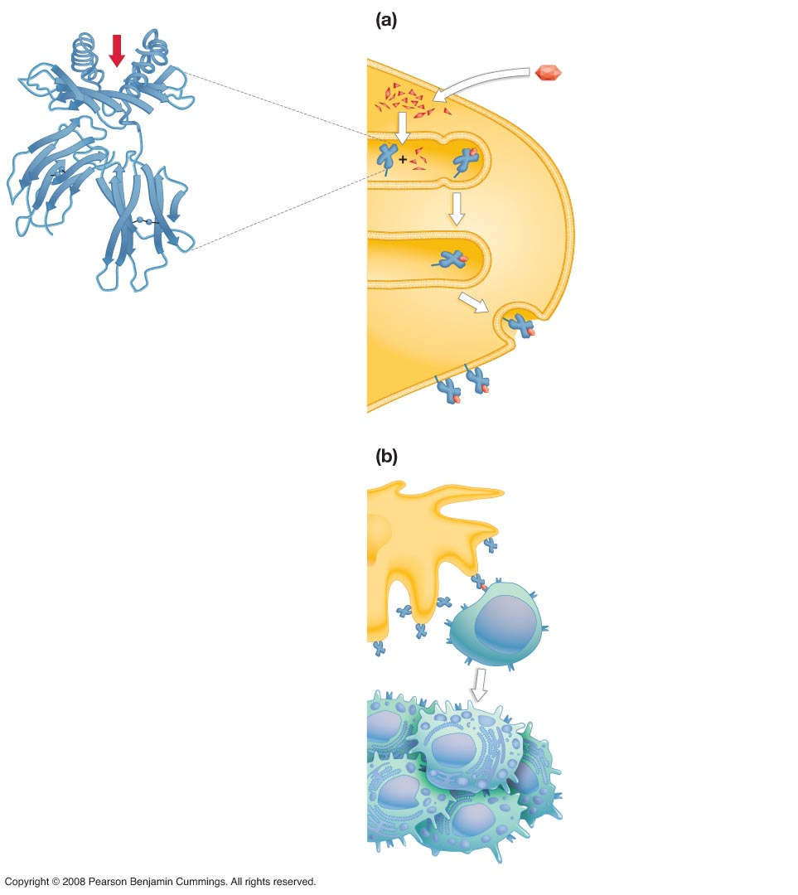
Figure 49-11
Antigen fragment
binding site
ANTIGEN PRESENTATION
Dendritic cell Foreign peptide
1. Dendritic cell
ingests peptide.
2. Enzyme complex
inside cell breaks
peptide into pieces.
Major
histocompatibility
(MHC) protein
3. Peptide pieces bind
to MHC Class I protein
inside endoplasmic
reticulum.
ER
4. The MHC-peptide
complex is transported
to the cell surface via
the Golgi apparatus.
Golgi
apparatus
MHC
5. The MHC Class I
protein presents the
peptide on the surface
of the cell membrane.
Piece of
foreign
peptide
T-CELL ACTIVATION (CD8⁺ T cells)
Dendritic cell
1. T-cell receptor binds
to peptide presented
on MHC protein on
surface of dendritic cell.
Complex activation
process begins,
involving interactions
among many proteins
on the surfaces of the
two cells.
MHC
Antigen
CD8⁺
T cell
Clonal expansion
2. Activated CD8⁺
T cells multiply and
differentiate. Effector
T cells that result leave
lymph node and
enter blood.
Cytotoxic T cells

Slide 18
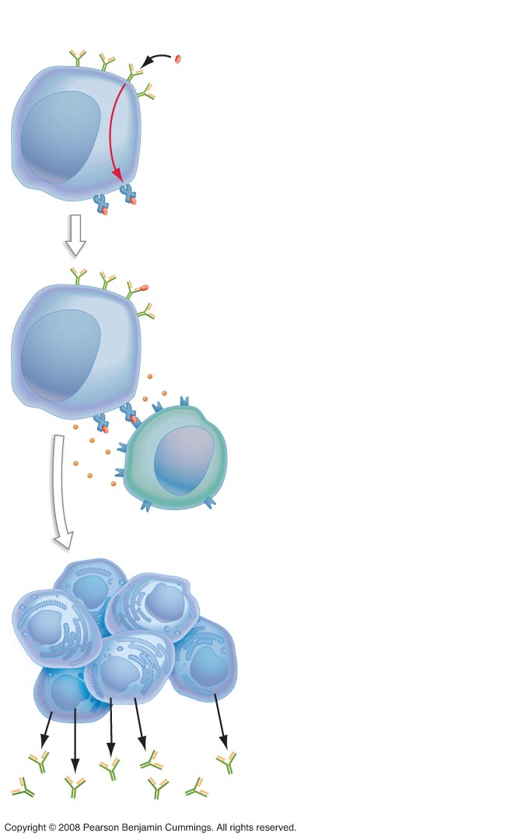
Figure 49-12
B-CELL ACTIVATION
Foreign
peptide
1. B cell encounters and
binds to foreign peptide
in lymph or blood. The
peptide is internalized,
processed, and presented
on the surface by an
MHC Class II protein.
B-cell
receptors
B-cell
MHC
Class II
protein
2. The MHC-peptide
complex interacts with
complementary receptors
on a helper T cell,
activating it.
B cell
3. Cytokines from the
activated helper T cell
activate the B cell.
Activation
Cytokines
Helper T cell
4. The activated B cell
begins to divide. Some
daughter cells
differentiate into plasma
cells which produce
large quantities of
antibodies.
Plasma
cells
Antibodies will bind to
antigens and mark
them for destruction
Antibodies

Slide 19
Fighting Infection
Antibiotics-fight bacteria only
Vaccines-preventative, containing only antigen-portions or dead/weak strains of pathogens in order to stimulate memory cell production
Active immunity (everything we have discussed so far)
Passive immunity-when antibodies are given to you. Usually via the placenta or breast milk

Slide 20
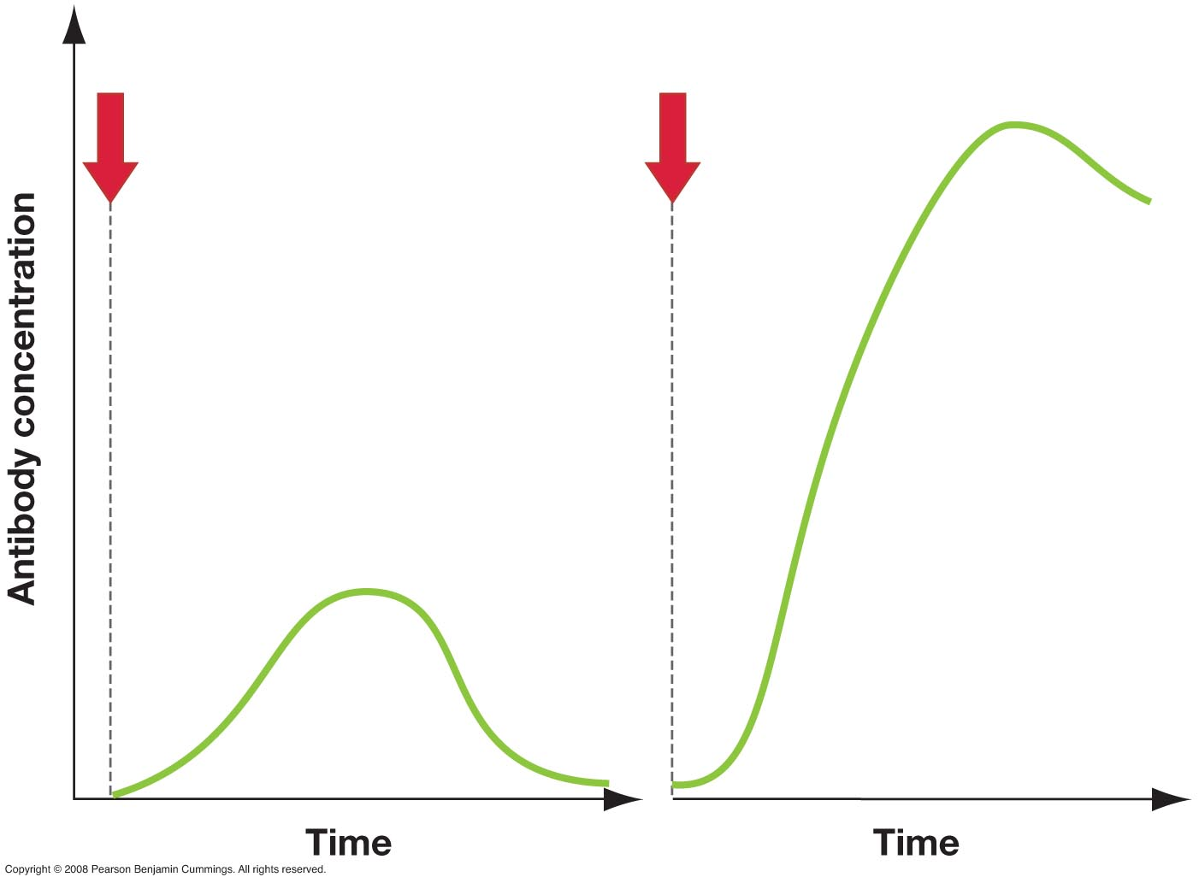
Figure 49-14
Initial exposure to antigen
Second exposure to antigen
Secondary
immune
response
Response
is larger
Primary immune
response
Response
is faster

Slide 21
Immune Disorders
Allergies-hypersensitive responses to antigens called allergens. IgE class antibodies are produced
Autoimmune Diseases-loss of self-tolerance
Stress and exertion-exercise improves the immune system, stress supresses it
Immunodeficiency Diseases
HIV
Severe combined immunodeficiency (SCD)- white blood cells are rare or absent
Transfusions, transplants, skin graphs
Blood Typing Chart

Slide 22
Immunity Pogil Continued…
Model 3 and 4 40 minutes
Allergy Video w/Questions

