Slide 1
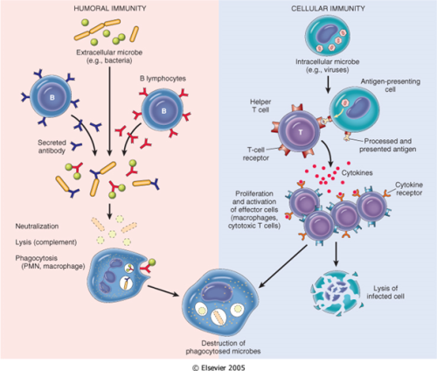

Slide 2
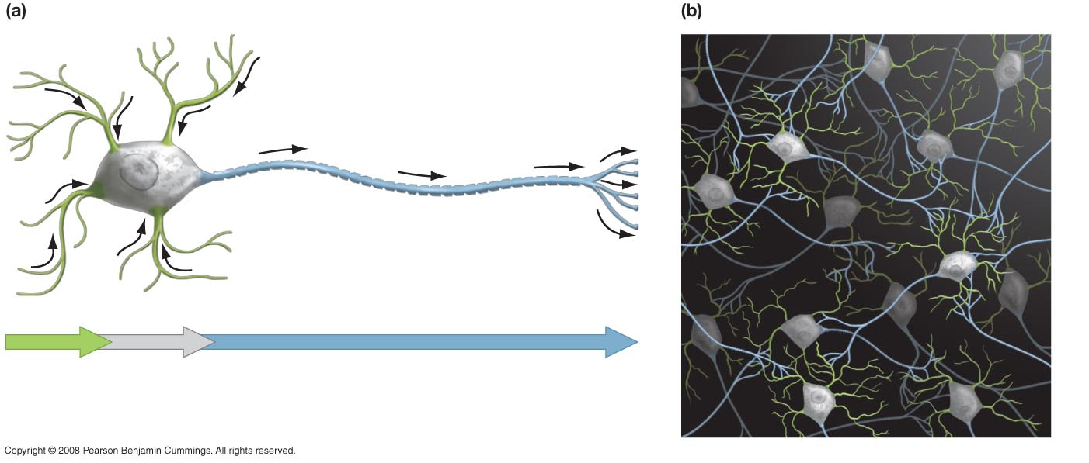
Figure 45-3
Information flow through neurons
Neurons form networks for information flow
Nucleus
Dendrites
Collect
electrical
signals
Cell body
Integrates incoming signals
and generates outgoing
signal to axon
Axon
Passes electrical signals
to dendrites of another
cell or to an effector cell

Slide 3
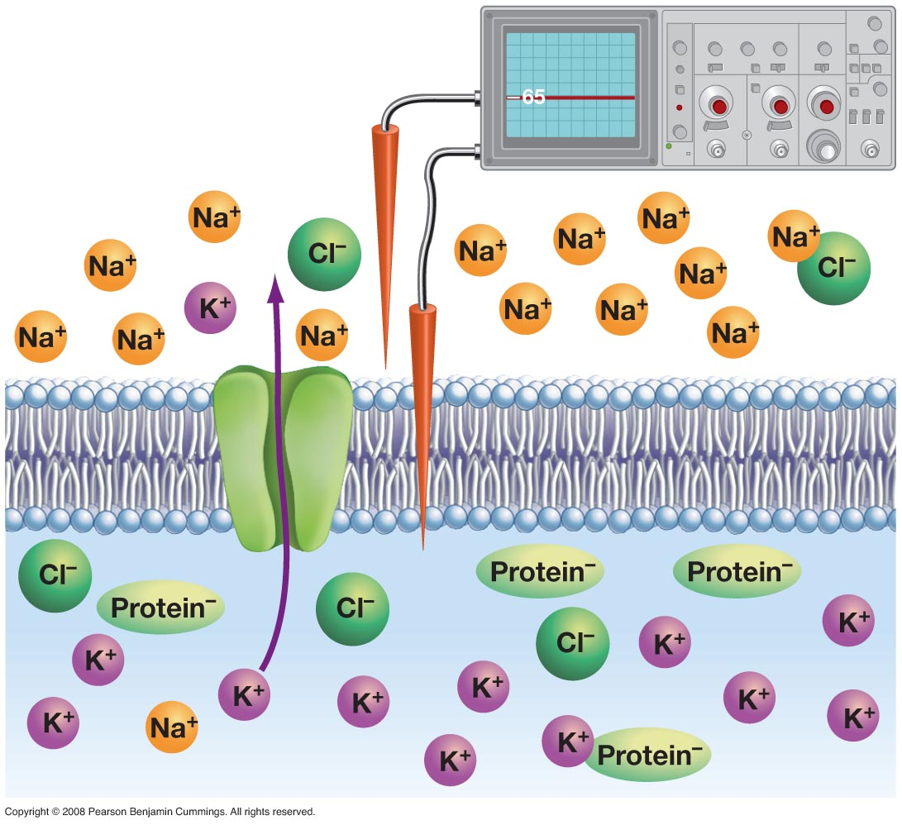
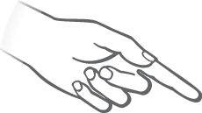
Figure 45-4
Instrument
records voltage
across membrane
Outside of cell
Microelectrode
0 mV
K⁺ channel
– 65 mV
Inside of cell

Slide 4
Propagating the Impulse
In response to a stimulus, gated ion channels open and allow Na+ to rush into the cell, meaning that the cell depolarizes.
If the impulse is strong enough to get above the threshold level, more ion channels open, causing action potential (complete depolarization), which stimulates neighboring channels to open
In response, other channels open to allow K+ outside of the cell to repolarize the cell

Slide 5
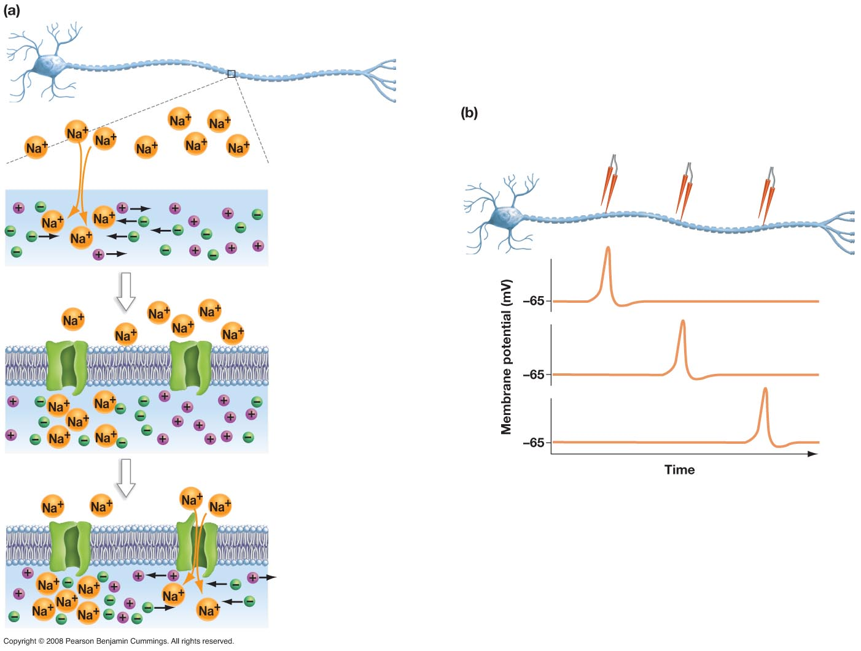
Figure 45-11
PROPAGATION OF ACTION POTENTIAL
Axon
Neuron
Action potential spreads as a wave of depolarization.
Electrode
A
Electrode
B
Electrode
C
1. Na⁺ enters axon.
Neuron
A
B
2. Charge spreads;
membrane
“downstream”
depolarizes.
C
Depolarization at
next ion channel
3. Voltage-gated
channel opens in
response to
depolarization.

Slide 6
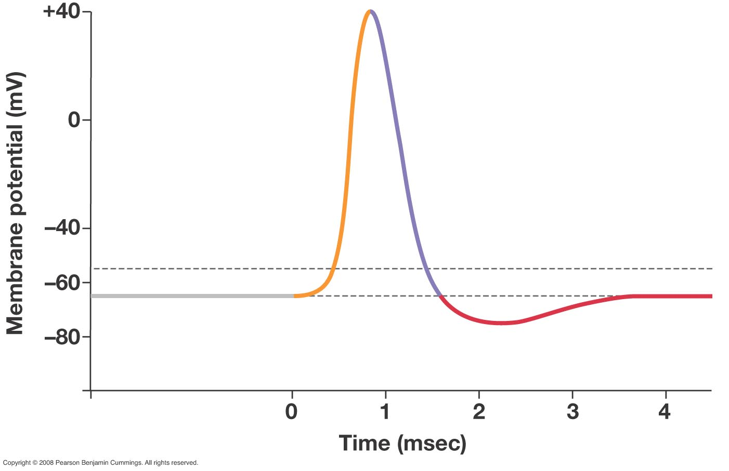
Figure 45-6
1. Depolarization
phase
2. Repolarization
phase
Threshold potential
Resting potential
3. Hyperpolarization phase

Slide 7
Refractory Period
The neuron cannot now respond to a new stimulus b/c K+ and Na+ are on the wrong sides of the membrane
Sodium/Potassium pumps must now reestablish resting potential so that the neuron can react to a new stimulus

Slide 8
Myelinzation
Some neurons are myelinized (covered with a sheath of Schwann cells), which insulate the nerve’s impulse
Breaks in this sheath are called nodes of Ranvier.

Slide 9
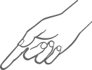
Figure 45-12a
Action potentials jump down axon.
Action potential jumps
from node to node
Nodes of Ranvier
Schwann cells (glia)
wrap around axon,
forming myelin sheath
Axon
Schwann cell membrane
wrapped around axon

Slide 10
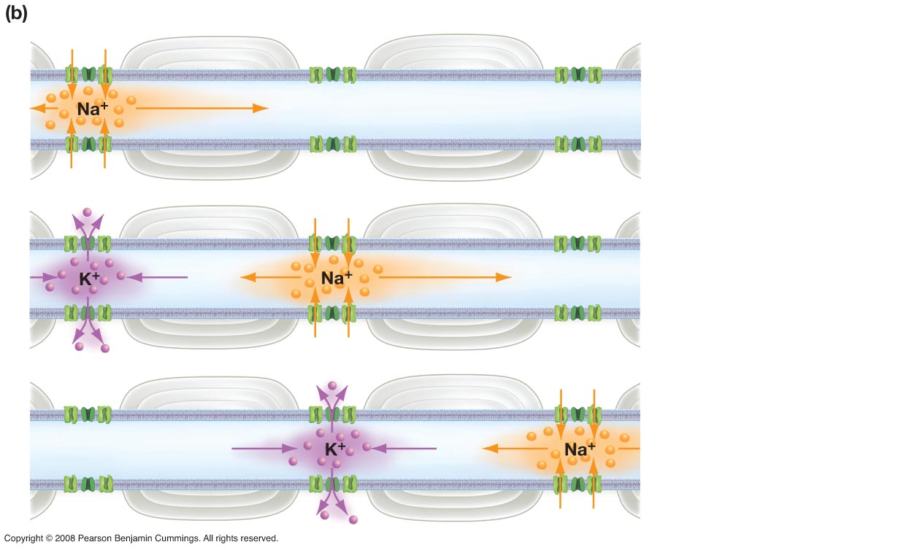
Figure 45-12b
WHY ACTION POTENTIALS JUMP DOWN MYELINATED AXONS
Schwann cell
1. As charge spreads down
an axon, myelination (via
Schwann cells) prevents
ions from leaking out across
the plasma membrane.
Node of
Ranvier
2. Charge spreads
unimpeded until it reaches
an unmyelinated section of
the axon, called the node
of Ranvier, which is packed
with Na⁺ channels.
3. In this way, electrical
signals continue to jump
down the axon much faster
than they can move down
an unmyelinated cell.

Slide 11
At the Synapse (electrical changes to chemical)
The impules reaches a presynaptic dead-end, but still needs to be carried to the postsynaptic cell
Chemicals are needed to bridge that gap and transmit information between these cells
Calcium gates open, letting Ca+2 ion into the presynaptic cell
Synaptic vessicles on the presynaptic cell release neurotransmitter substances
Neurotransmitters bind with postsynaptic cell receptors
Neurotransmitters are degraded and recycled by enzymes in the synaptic cleft and picked up by the presynaptic cell to be re-used

Slide 12
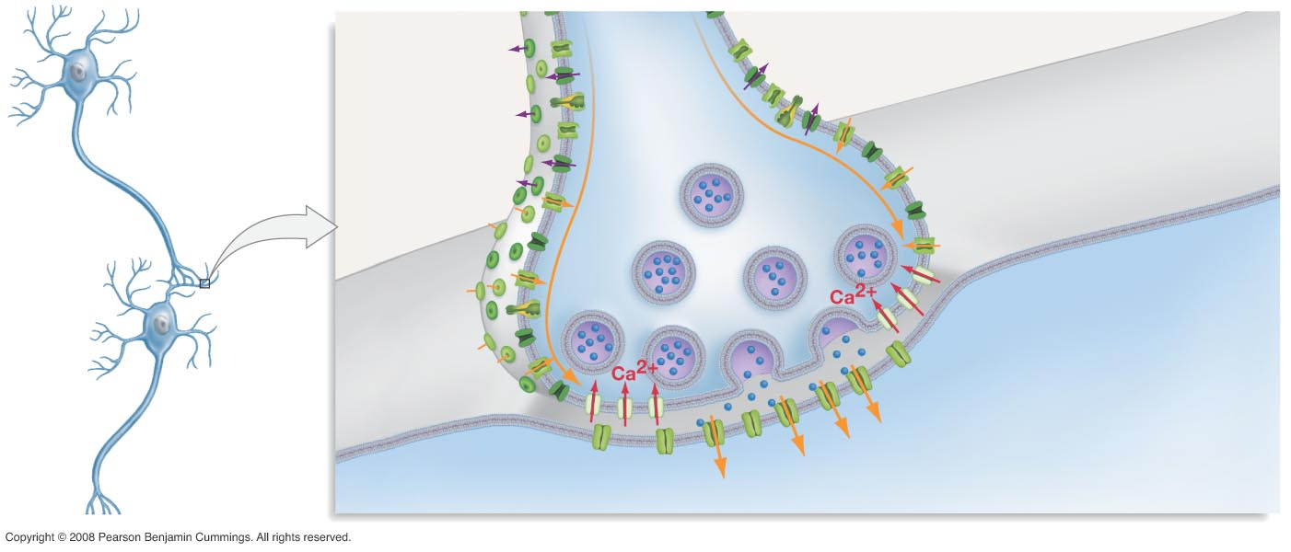
Figure 45-15
ACTION POTENTIAL TRIGGERS RELEASE OF NEUROTRANSMITTER
Na⁺ and K⁺
channels
1. Action potential arrives;
triggers entry of Ca²⁺.
Action
potentials
Presynaptic
neuron
Presynaptic
membrane
(axon)
2. In response to Ca²⁺, synaptic
vesicles fuse with presynaptic
membrane, then release
neurotransmitter.
3. Ion channels open when
neurotransmitter binds; ion
flows cause change in
postsynaptic cell potential.
Postsynaptic
membrane
(dendrite or
cell body)
Postsynaptic
neuron
4. Ion channels will close as
neurotransmitter is broken
down or taken back up by
presynaptic cell (not shown).
Synaptic
cleft

Slide 13
Regulation and Control
Endocrine System-is a series of hormone-producing glands throughout the body which are circulated through the blood and influence target cells

Slide 14
AP-Pertinent Endocrine Info
Anterior Pituitary-produces tropic hormones (hormones that target other glands)
Growth Hormone, Follicle-stimulating Hormone(gonadotrophin), Adrenocorticoptropic Hormone, Prolactin, Thyroid Stimulating Hormone
Posterior Pituitary – stores/regulates hormones made in other glands
Antidiuretic Hormone, Oxytocin
Pancreas
Islets of Langerhans have 2 cell types (producing antagonistic hormones)
Alpha cells-secrete glucagon into the blood when blood sugar drops, stimulating the liver to release glucose
Beta cells-secrete insulin, stimulating the liver to take up glucose and convert it to glycogen or fat

Slide 15
How hormones work
Method 1: (for steroid hormones)
The hormone diffuses through the pm and heads for the nucleus.
It binds to a receptor protein in the nucleus, which activates the DNA to turn on a specific gene
Method 2: (for protein hormones)
The hormone binds to a receptor on the plasma membrane (receptor-mediated endocytosis), which stimulates a second messenger
2nd messengers could be cAMP, which triggers an enzyme that makes cellular changes, or Inositol triphosphate (IP3) that triggers the release of calcium ion from the ER, that triggers enzymes to make cellular changes

Slide 16
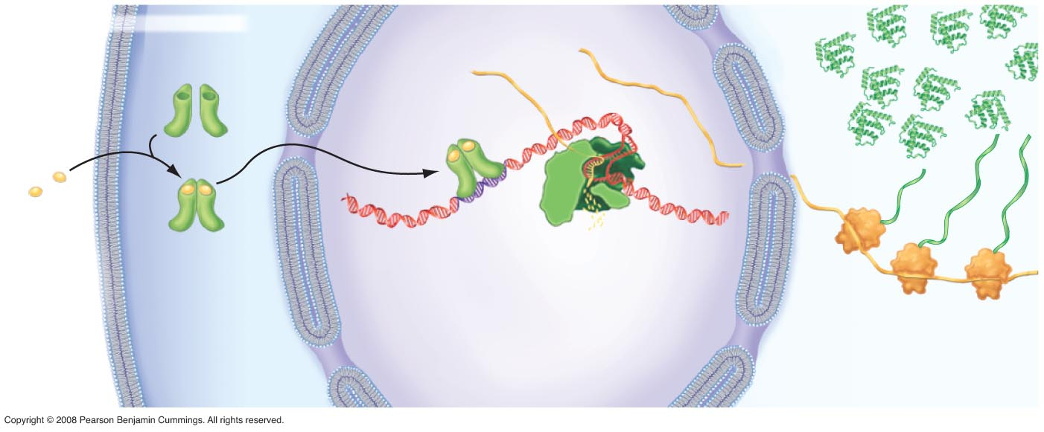
Figure 47-18
STEROID HORMONE ACTION
Nucleus
Hormone
receptor
mRNA
Proteins
Steroid
hormone
DNA
Hormone-receptor
complex
Hormone-
response
element
RNA
polymerase
3. Hormone-receptor
complex enters
nucleus and binds
to DNA, induces
start of transcription.
4. Many mRNA
transcripts are
produced,
amplifying
the signal.
Ribosome
1. Steroid
hormone
enters
target cell.
2. Hormone binds
to receptor, induces
conformational
change.
5. Each transcript is
translated many times,
further amplifying the
signal.

Slide 17
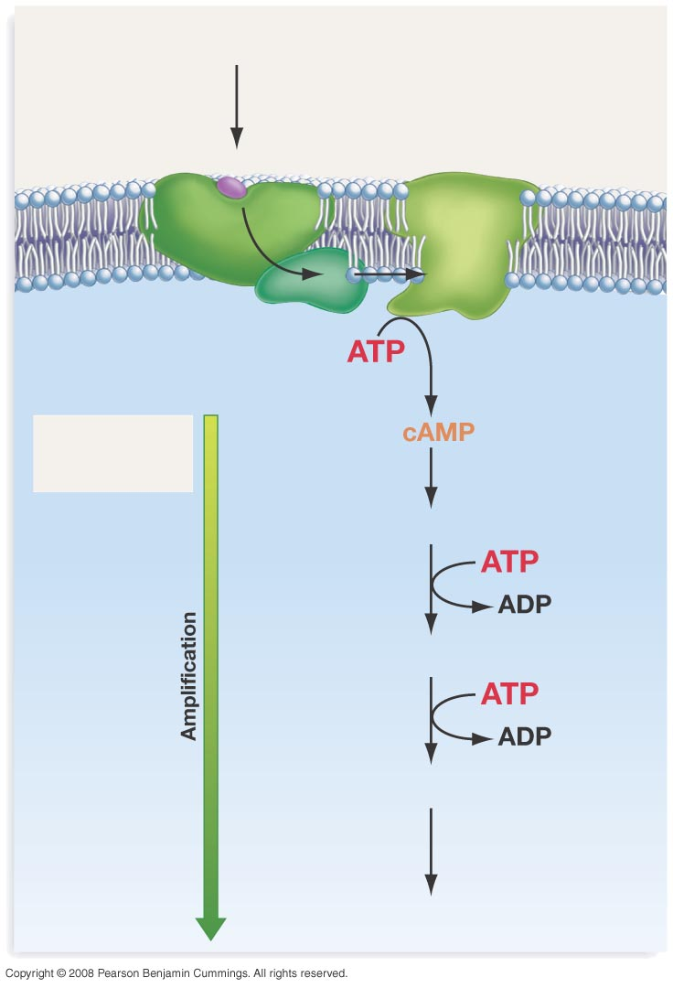
Figure 47-21
MODEL FOR EPINEPHRINE ACTION
1. Epinephrine
binds to receptor
Epinephrine
Receptor
Adenylyl
cyclase
2. Activation
of G protein
3. Activated
adenylyl cyclase
catalyzes
formation of
cAMP
Transmission of
message from
cell surface
4. Activation of cAMP-dependent protein
kinase A
5. Activation of phosphorylase kinase
6. Activation of phosphorylase
7. Production of glucose from glycogen

Slide 18
Feedback Loops
Positive
Increases an already present response.
“good job, keep going”
Oxytocin during labor increases contractions. As the baby’s head presses on the uterus the oxytocin increases.
Negative
Maintains balance by turning off a hormone when it is no longer needed.
High levels of thyroxin “turn off” the hypothalamus and pituitary glands. They “turn on” when levels are low.

