Slide 1
Photosynthesis & Respiration

Slide 2
Energy
Capacity to cause change
Kinetic
Energy associated with relative motion of objects
Thermal Energy
Energy associated w/ random movement of atoms or molecules
Potential
Energy that matter possesses b/c of location or structure
Chemical Energy
Potential energy available for release in a chemical reaction
“Free” Energy
Portion of system's energy that can perform work when temp/pressure are uniform

Slide 3
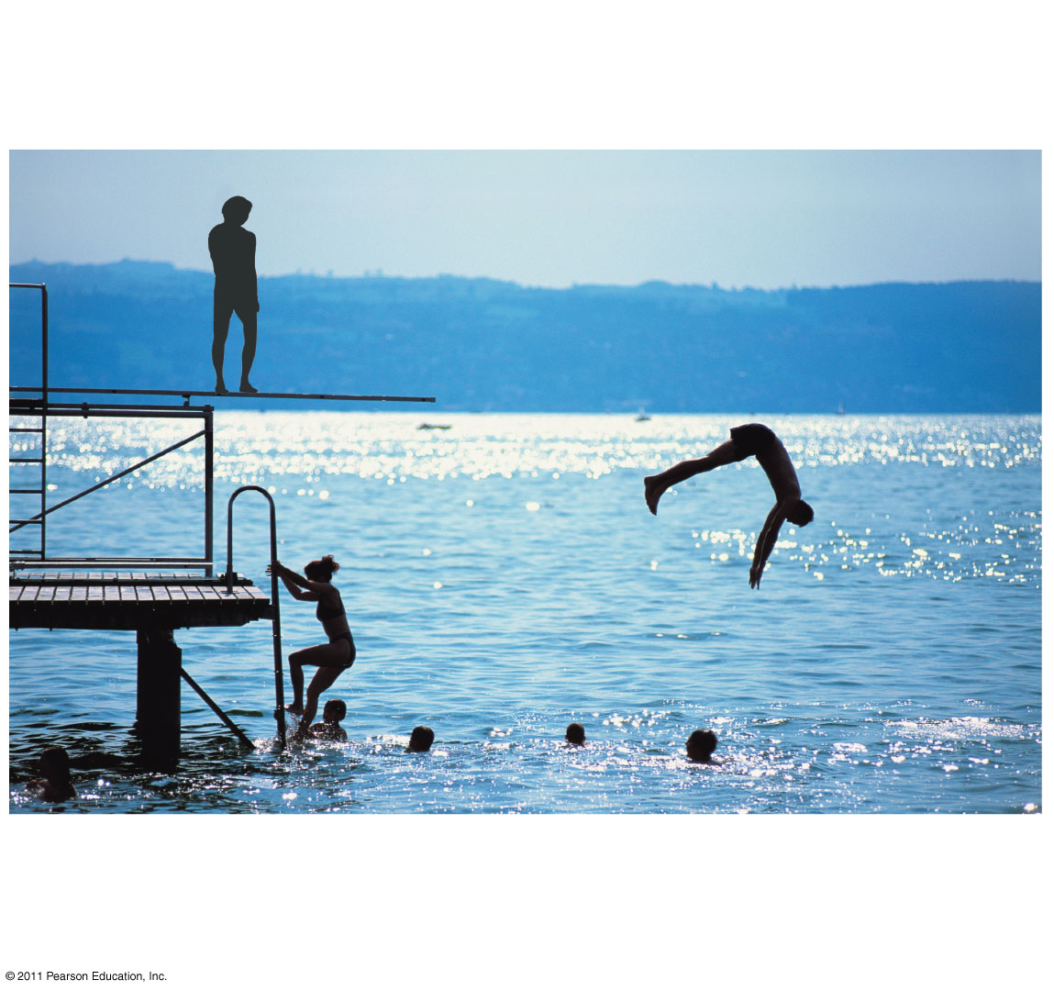
Figure 8.2
A diver has more potential energy on the platform than in the water.
Diving converts potential energy to kinetic energy.
Climbing up converts the kinetic energy of muscle movement to potential energy.
A diver has less potential energy in the water than on the platform.
Notes:
Figure 8.2 Transformations between potential and kinetic energy.

Slide 4
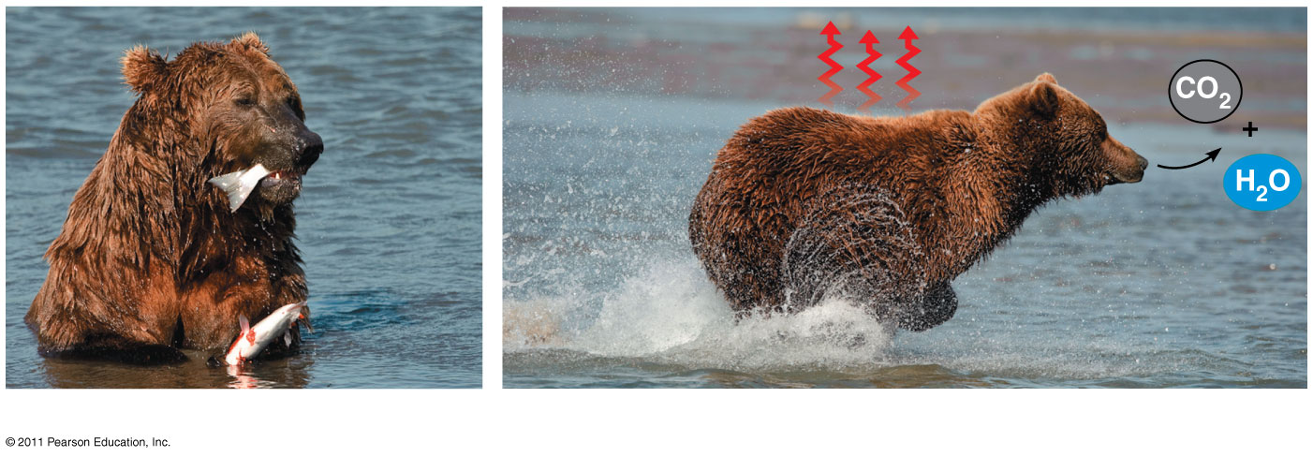
Laws of Thermodynamics
1st Law:
Energy is constant-can be neither created or destroyed
Can be converted from one form to another

Slide 5
Metabolism, Catabolic Pathways and Energy
Metabolism manages material & energy resources of the cell
Breaks down complex molecules & puts together simple molecules
Some molecules have more potential energy because of the arrangement of their atoms
Breaking these molecules down (catabolism) releases this energy
Exergonic reactions
Has net release of free energy
Ex: cellular respiration
Opposite would be endergonic (absorbs free energy)
Ex: Photosynthesis
Together they maintain order

Slide 6
Capturing & storing free energy
Autotrophs=
Photosynthetic-capture energy from sunlight
Chemosynthetic-capture energy from small inorganic molecules
Heterotrophs=
Metabolize carbs, lipids & proteins
Fermentation-produces alcohol & lactic acid (organic molecules)

Slide 7
Energy Equation Review / Energy
Use the cards at your table to complete the activity as a table or duo.
Answer all questions (front and back) and paste this page into your notebook after the Energy Notes.
25 minutes

Slide 8
About Light and Pigments
Light occurs in waves along an electromagnetic spectrum
Wavelength is the distance between crests of the wave
Visible light spectrum lies between 380 and 750 nm and is responsible for color
Light can be absorbed, reflected, or transmitted
Pigments absorb light for photosynthesis, but absorb best at different wavelengths, which broadens the spectrum for photosynthesis.
Chlorophyll a-primary pigment for photosynthesis (blue green)
Chlorophyll b-accessory pigment (olive green)
Carotenoids-accessory pigment (yellow and orange)

Slide 9
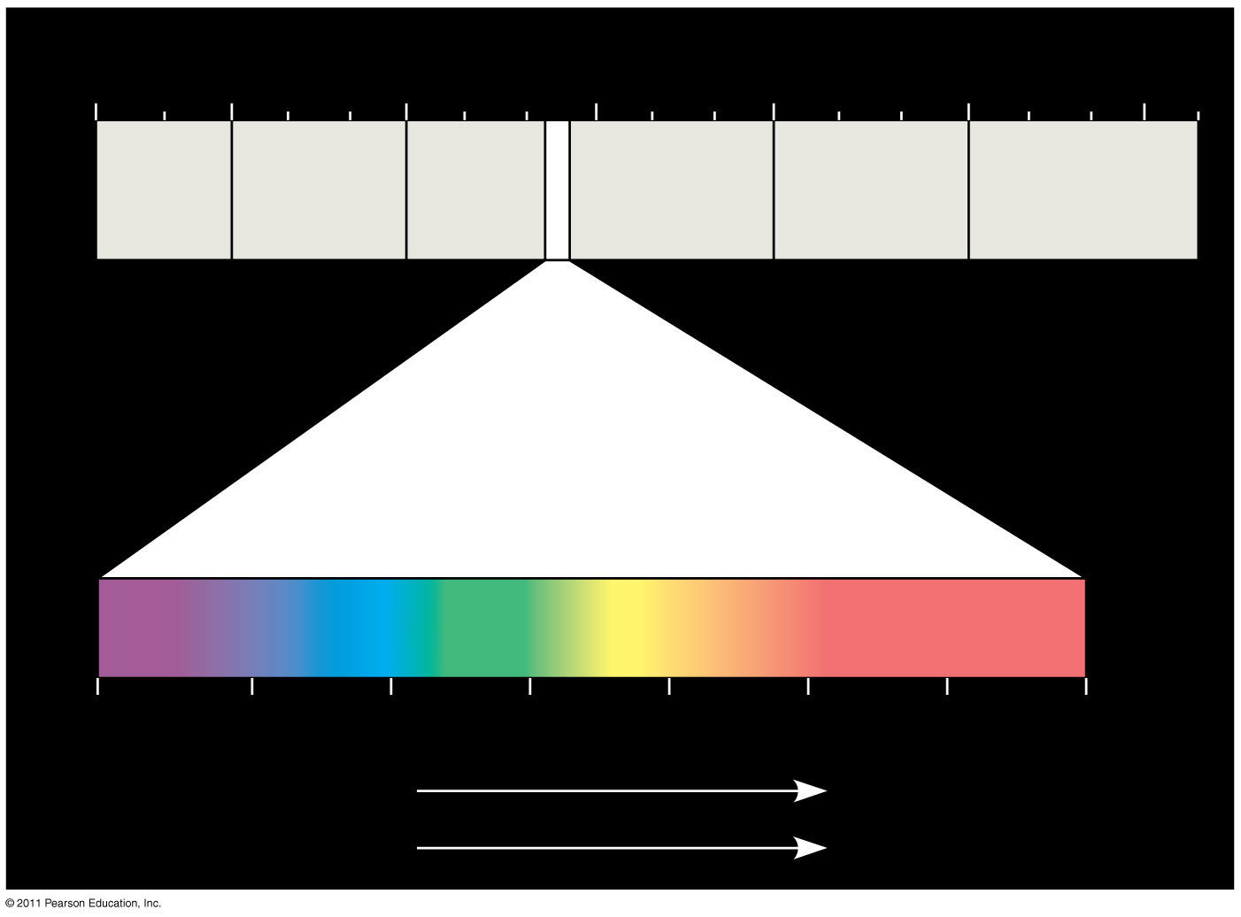
Figure 10.7
1 m
10⁻⁵ nm
10⁻³ nm
1 nm
10³ nm
10⁶ nm
(10⁹ nm)
10³ m
Gamma rays
Micro- waves
Radio waves
X-rays
UV
Infrared
Visible light
380
450
500
550
600
650
700
750 nm
Shorter wavelength
Longer wavelength
Higher energy
Lower energy
Notes:
Figure 10.7 The electromagnetic spectrum.

Slide 10
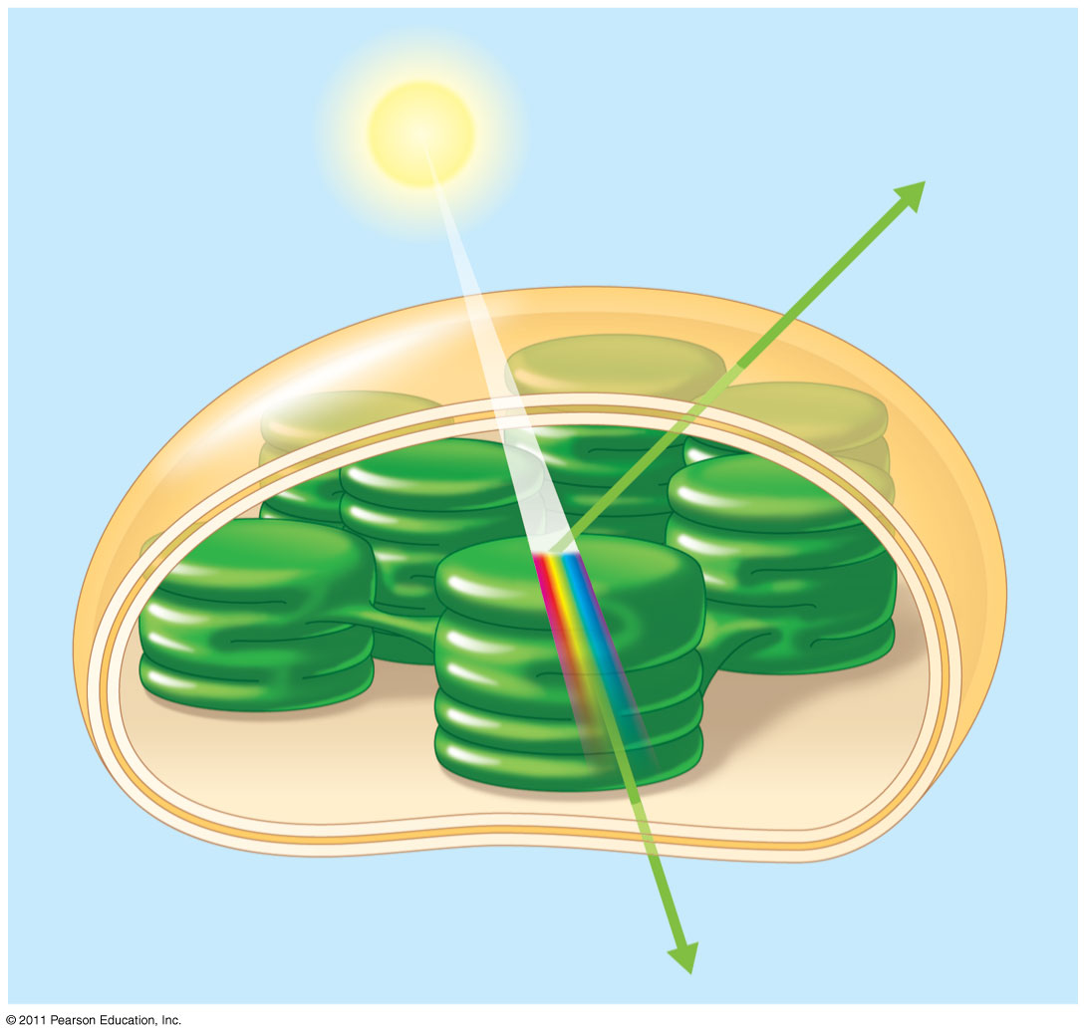
Figure 10.8
Light
Reflected light
Chloroplast
Absorbed light
Granum
Transmitted light
Notes:
Figure 10.8 Why leaves are green: interaction of light with chloroplasts.

Slide 11
Photosynthesis
The process where autotrophs convert light energy from the sun to chemical energy (in carbohydrates) for the heterotrophs in the food chain
Done exclusively in the chloroplast
Thylakoids-membrane discs that are stacked in grana (site of the 1st stage of photosynthesis)
Stroma-fluid that surrounds thylakoids (site of the 2nd stage of photosynthesis)
You know the equation

Slide 12
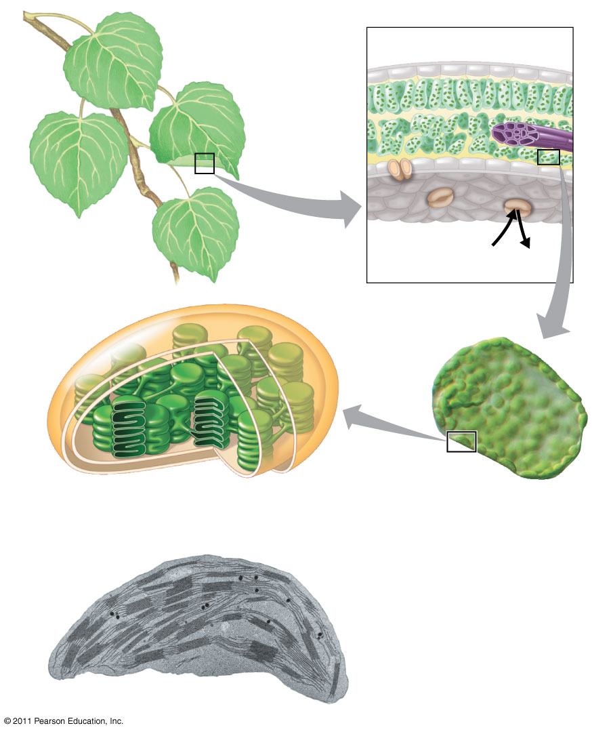
Figure 10.4
Leaf cross section
Chloroplasts
Vein
Mesophyll
Stomata
CO₂
O₂
Chloroplast
Mesophyll cell
Outer membrane
Thylakoid
Intermembrane space
Stroma
Granum
Thylakoid space
20 μm
Inner membrane
1 μm
Notes:
Figure 10.4 Zooming in on the location of photosynthesis in a plant.

Slide 13
Leaf Cross-Section (in your notes)
Color the leaf cross section based on the color key at the bottom of the diagram.
Use your electronic devices and/or a textbook to write the function of each colored structure on the diagram.
Write out the equation for photosynthesis. Under each reactant, write the plant anatomy that responsible for taking in and/or transporting that reactant.
Stamp after 15 minutes.

Slide 14
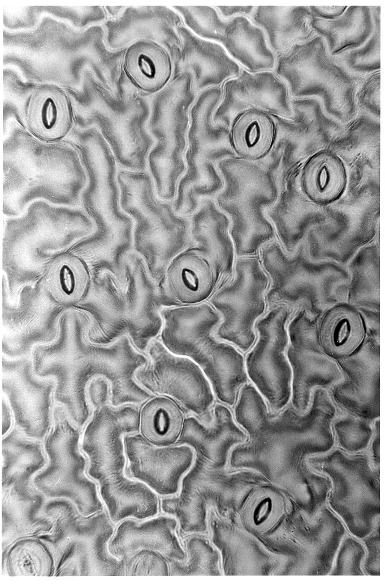
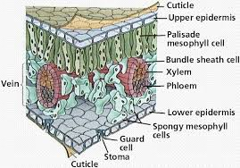
Floating Disk Lab - Background

Slide 15
Overview-the easy version
Photosynthesis has two parts: Light reaction and dark reaction.
The light reaction:
Uses sunlight to break a water and make ATP for the dark reaction. NADP accepts a H+ to carry to the dark reaction. Oxygen is released as a waste.
Occurs in the thylakoid.
The dark reaction (Calvin Cycle):
Carbon dioxide is changed into glucose(food) using ATP and the NADPH from the light reaction as energy.
Occurs in stroma.

Slide 16
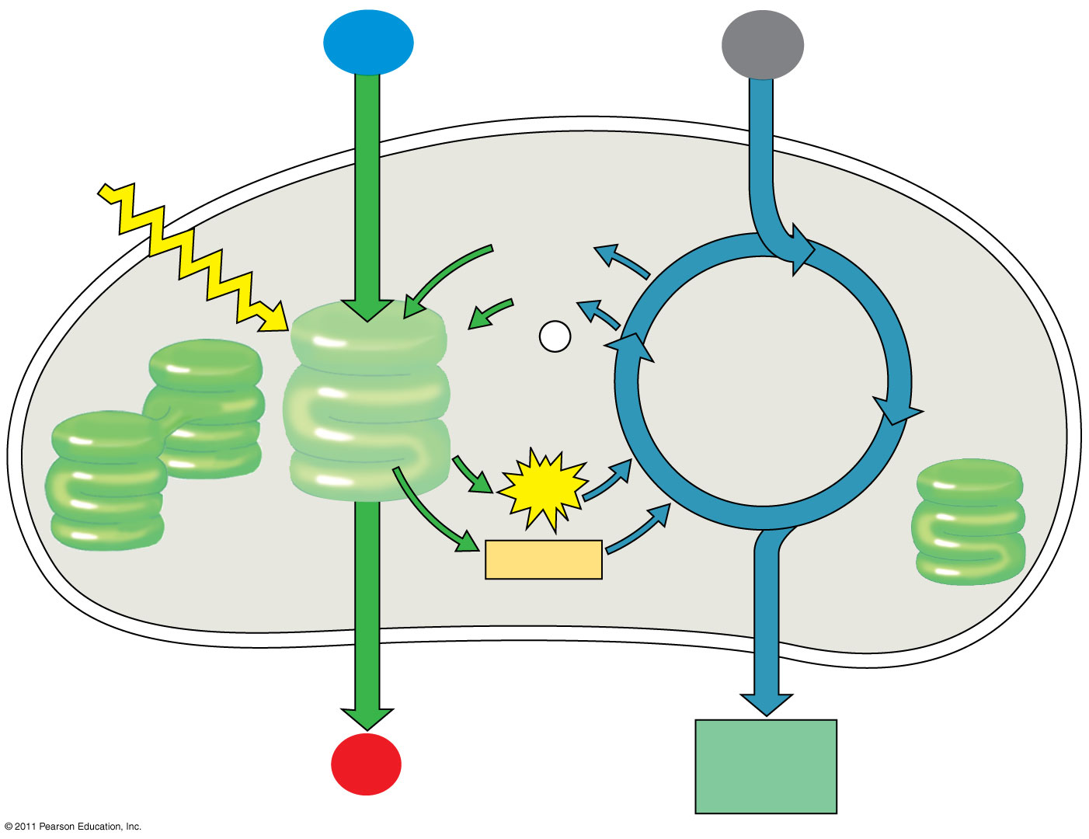
Figure 10.6-4
H₂O
CO₂
Light
NADP⁺
ADP
+ P _{i}
Calvin Cycle
Light Reactions
ATP
NADPH
Chloroplast
O₂
[CH₂O] (sugar)
Notes:
Figure 10.6 An overview of photosynthesis: cooperation of the light reactions and the Calvin cycle.

Slide 17
The stages of Photosynthesis
Light (dependent) Reactions (On the Thylakoid membrane)
Is an electron transport chain that harnesses light energy into ATP and NADPH to power production of organic molecules
Uses light and water

Slide 18
Figure 10.6-4
H₂O
CO₂
Light
NADP⁺
ADP
+ P _{i}
Calvin Cycle
Light Reactions
ATP
NADPH
Chloroplast
O₂
[CH₂O] (sugar)
Notes:
Figure 10.6 An overview of photosynthesis: cooperation of the light reactions and the Calvin cycle.

Slide 19
The Light Reactions (ETC)
Photosystem II: (purpose: to make ATP)
Photolysis occurs, splitting water to give off Oxygen, Hydrogen and e- (where did the energy come from to do this?)
Chlorophyll uses sunlight energy to energize the electron.
Establishes proton gradient as H+ ions are pumped into thylakoid
The buildup of H+ will eventually drive the synthesis of ATP from ADP using a concentration gradient and ATP synthase.
The electron moves along through the Electron Transport Chain to Photosystem I.
Oxygen from the water is not necessary so it becomes a product.

Slide 20
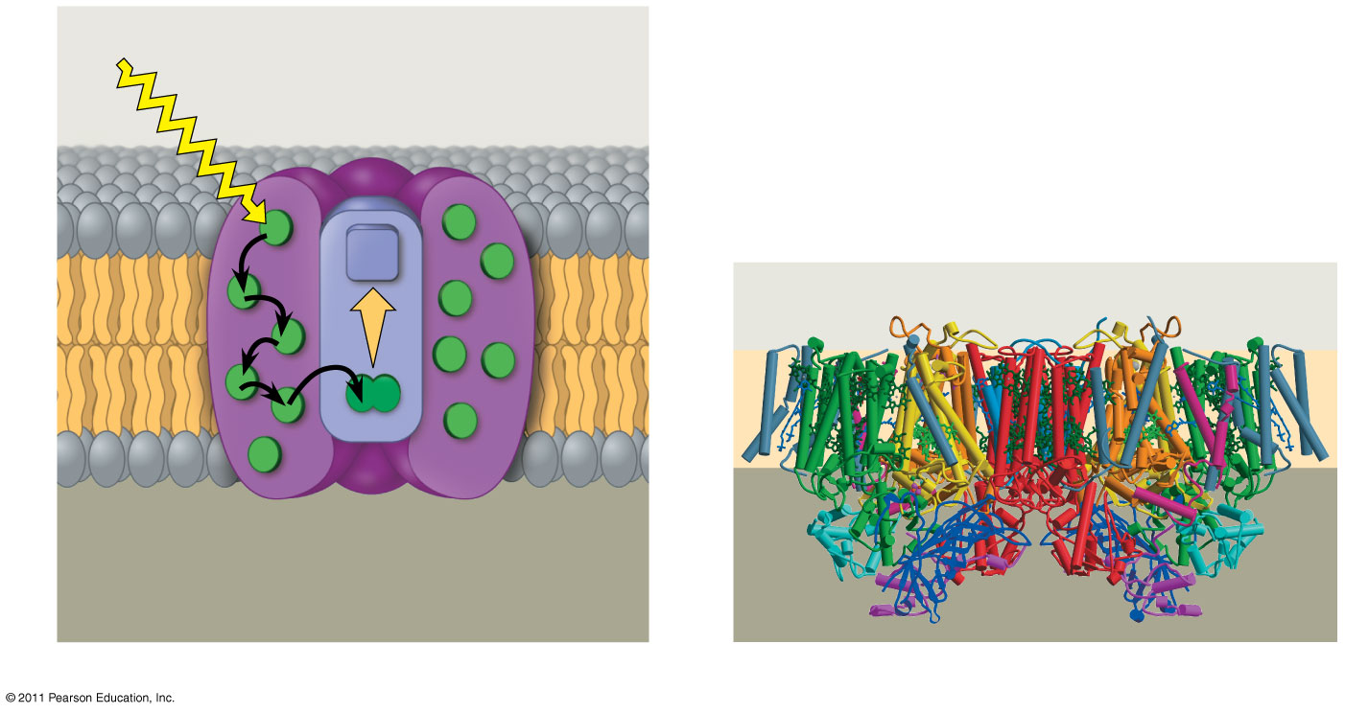
Figure 10.13
Photosystem
STROMA
Photon
Light- harvesting complexes
Reaction- center complex
Primary electron acceptor
Chlorophyll
STROMA
e⁻
Thylakoid membrane
Thylakoid membrane
Transfer of energy
Special pair of chlorophyll a molecules
Pigment molecules
THYLAKOID SPACE (INTERIOR OF THYLAKOID)
Protein subunits
THYLAKOID SPACE
(a) How a photosystem harvests light
(b) Structure of photosystem II
Notes:
Figure 10.13 The structure and function of a photosystem.

Slide 21
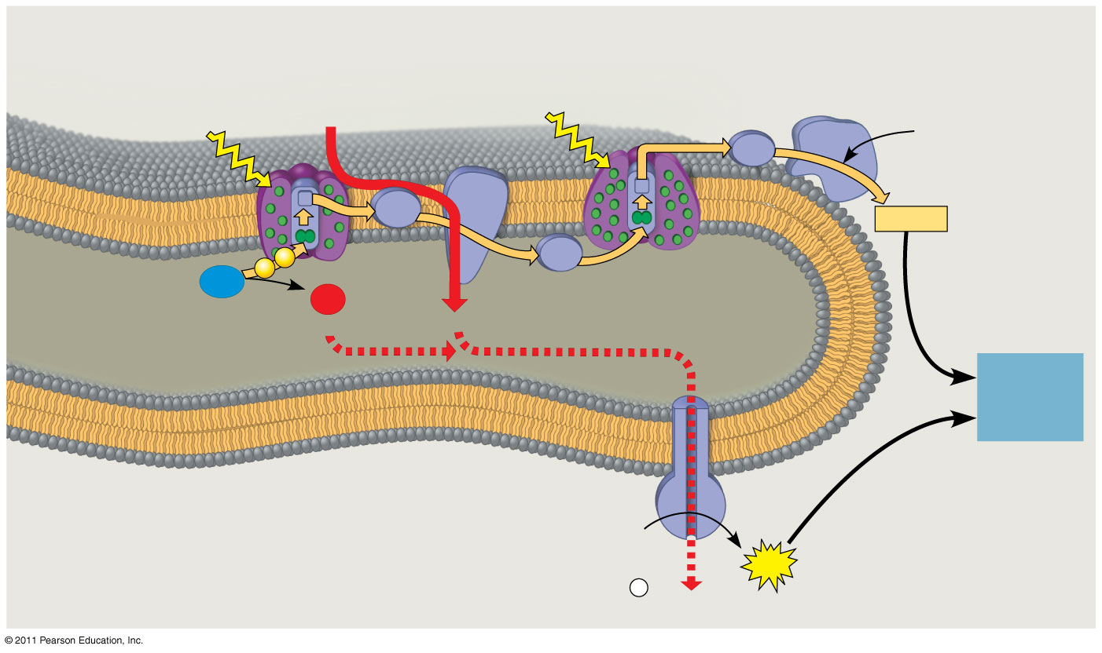
Figure 10.18
STROMA (low H⁺ concentration)
Cytochrome complex
NADP⁺ reductase
Photosystem II
Light
Photosystem I
Light
4 H⁺
3
NADP⁺ + H⁺
Fd
Pq
NADPH
2
Pc
H₂O
O₂
1
¹/₂
THYLAKOID SPACE (high H⁺ concentration)
+2 H⁺
4 H⁺
To Calvin Cycle
Thylakoid membrane
ATP synthase
ADP + P _{i}
STROMA (low H⁺ concentration)
ATP
H⁺
Notes:
Figure 10.18 The light reactions and chemiosmosis: the organization of the thylakoid membrane.

Slide 22
Light Reaction cont’d
Photosystem I (purpose: to make NADPH)
Second protein contains a pair of chlorophyll molecules that excite the electron again with sunlight energy.
At the end of the ETC, NADP+ accepts the electrons and an H+ to become NADPH
The NADPH formed here along with the ATP from inside the chloroplast power the Calvin Cycle (dark)

Slide 23
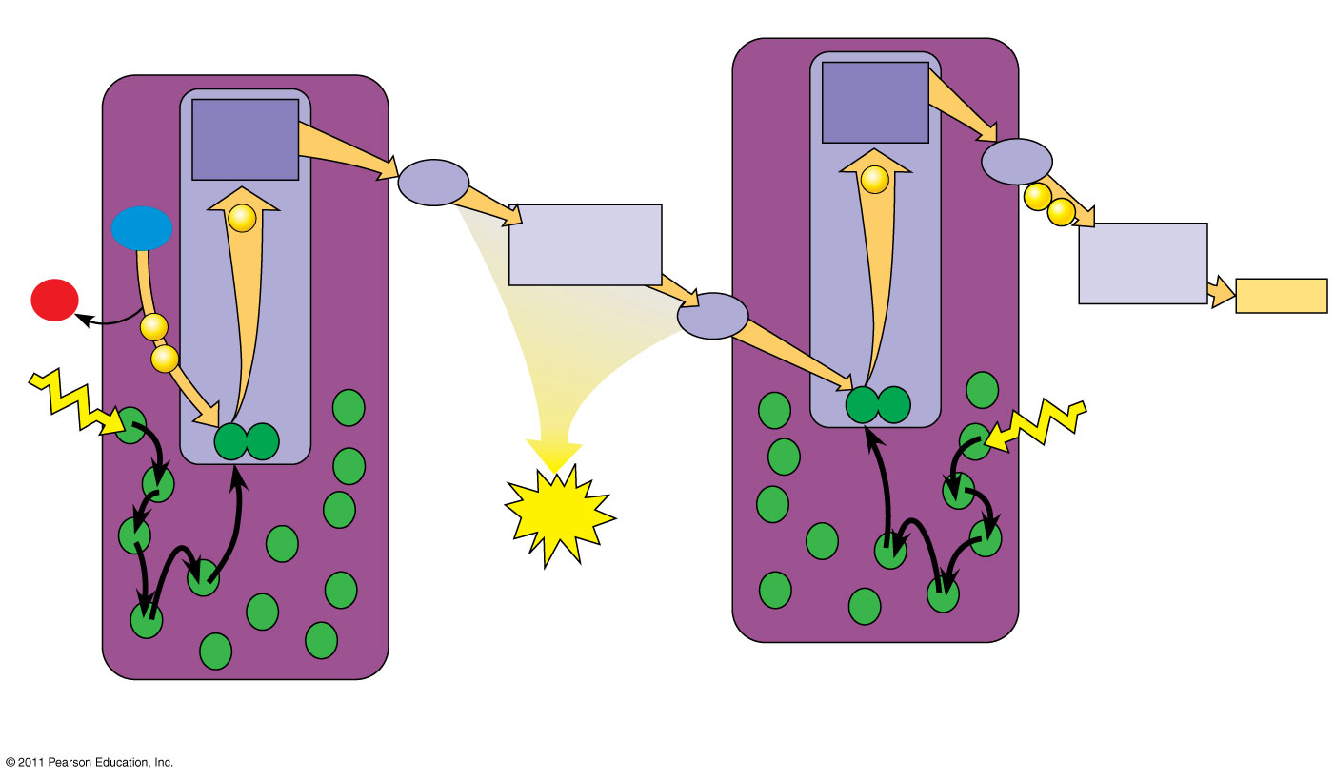
Figure 10.14-5
Electron transport chain
Primary acceptor
Primary acceptor
4
7
Pq
Electron transport chain
e⁻
Fd
2
e⁻
e⁻
8
H₂O
e⁻
Cytochrome complex
NADP⁺
2 H⁺
NADP⁺ reductase
+ H⁺
+
3
^{1/2}
O₂
Pc
NADPH
e⁻
e⁻
P700
P680
5
Light
1
Light
6
ATP
Pigment molecules
Photosystem I (PS I)
Photosystem II (PS II)
Notes:
Figure 10.14 How linear electron flow during the light reactions generates ATP and NADPH.

Slide 24
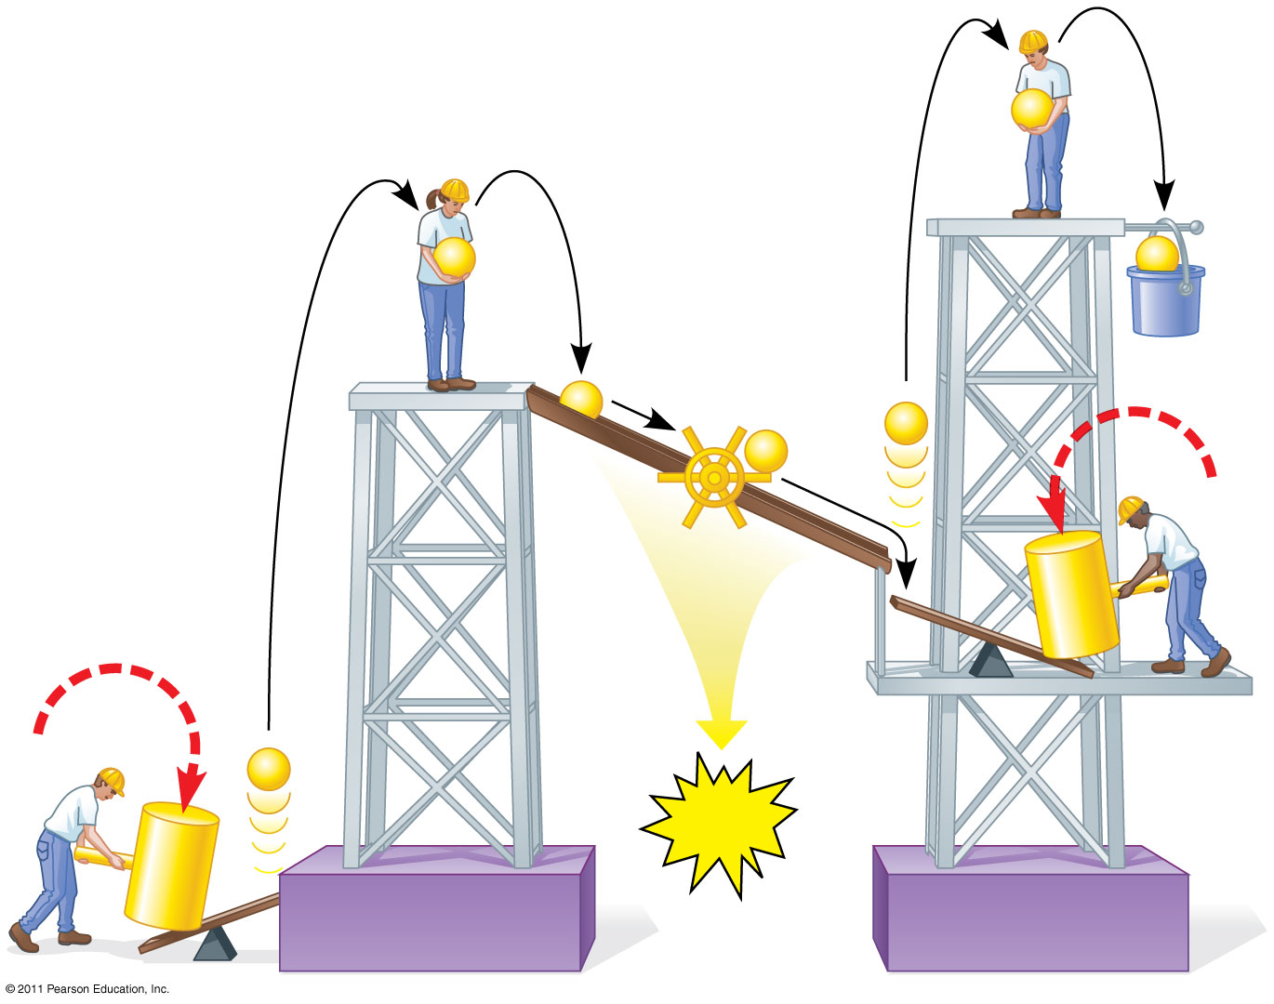
Figure 10.15
e⁻
e⁻
e⁻
Mill makes ATP
NADPH
e⁻
e⁻
e⁻
Photon
e⁻
ATP
Photon
Photosystem II
Photosystem I
Notes:
Figure 10.15 A mechanical analogy for linear electron flow during the light reactions.

Slide 25
Figure 10.18
STROMA (low H⁺ concentration)
Cytochrome complex
NADP⁺ reductase
Photosystem II
Light
Photosystem I
Light
4 H⁺
3
NADP⁺ + H⁺
Fd
Pq
NADPH
2
Pc
H₂O
O₂
1
¹/₂
THYLAKOID SPACE (high H⁺ concentration)
+2 H⁺
4 H⁺
To Calvin Cycle
Thylakoid membrane
ATP synthase
ADP + P _{i}
STROMA (low H⁺ concentration)
ATP
H⁺
Notes:
Figure 10.18 The light reactions and chemiosmosis: the organization of the thylakoid membrane.

Slide 26
What about photosynthetic prokaryotes?
Bacteria use an alternate pathway.
Light receptors are embedded in the cell membrane.
Produces ATP, but no NADPH and only very little oxygen.

Slide 27
The Calvin Cycle
The ATP and NADPH generated by the Light Reactions are used here in the stroma (or cytoplasm of bacteria)
CO₂ used here to make glucose as final product of photosynthesis
This is called “Carbon Fixing”
Remember: Eventhough ATP energy is produced in photosynthesis, it is used up in photosynthesis (Calvin Cycle).
There is NO NET ATP PRODUCTION!

Slide 28
Activity
White Board Groups
Use the boards and markers to draw the steps of photosynthesis.
Make sure you represent the reactants and products, parts of the chloroplast, process.

Slide 29
Floating Disk Lab-Background
Regroup to form your photosynthesis groups.
Watch the video for Lesson 7. Make notes on your homework sheet. (fast forward through the musical floating portion)
Discuss the procedure and what exactly is happening at each step. Can you find where all of the reactants and products come into play for the lab?
When you have finished. Gather the materials you will need for the lab from the back table and place them at one of the lamps for tomorrow. Set your light 8inches from the top of the stand.

Slide 30
Floating Disk Lab - Background

Slide 31
Light + CO2 + H2O C 6 H12 O6 + O2

Slide 32
Control vs. Experimental groups
Control: Spinach leaves with .2% bicarbonate water
Variables: Type of leaf, Color of light, Intensity of light
Are these independent or dependent variables?
Make a hypothesis with your group. How do you think your lab will react differently compared to the ‘control group’? WRITE THIS ON YOUR CARD. If you are setting up the control group, select a different group’s variable to use for a hypothesis.
Use an if/then statement.
Create a data table on your own paper to record your dependent variable over the next 20 minutes.
Start your lab!

Slide 33
What are some possible variables?
Type of leaf, Color of light, Concentration of Carbon Dioxide, Temperature of water……….
Are these independent or dependent variables?
We will use .2% bicarbonate solution and spinach leaves as our control group.
Make a hypothesis with your group. How do you think your lab will react differently compared to the ‘control group’? WRITE THIS ON YOUR CARD. If you are setting up the control group, select a different group’s variable to use for a hypothesis.
Use an if/then statement.

Slide 34
Create a data table to record your dependent variable over the course of 20 minutes.

Slide 36
Cellular Respiration-Overview
Series of enzyme catalyzed reactions that harvest free energy from simple carbohydrates
3 steps:
Glycolysis-glucose is halved to form 2 pyruvic acid molecules, which will lose a Carbon and be attached to Coenzyme A, becoming Acetyl CoA (cytosol)
Kreb’s (Citric Acid) Cycle-For each acetyl CoA, this is a series of reactions generating 1 ATP and Hydrogen carriers (mitochondrial matrix)
Electron Transport chain-Hydrogen Carriers will be stripped of their H+ and e-, causing the synthesis of mass quantities of ATP by phosphorylation.
(inner mitochondrial membrane)

Slide 37
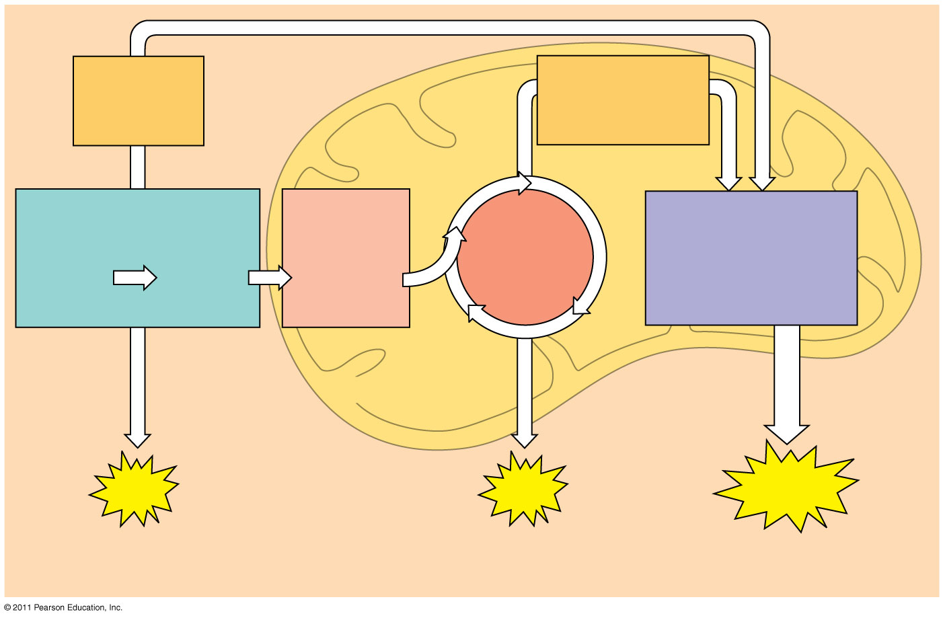
Figure 9.6-3
Electrons carried via NADH
Electrons carried via NADH and FADH₂
Pyruvate oxidation
Oxidative phosphorylation: electron transport and chemiosmosis
Glycolysis
Citric acid cycle
Glucose
Pyruvate
Acetyl CoA
CYTOSOL
MITOCHONDRION
ATP
ATP
ATP
Substrate-level phosphorylation
Substrate-level phosphorylation
Oxidative phosphorylation
Notes:
Figure 9.6 An overview of cellular respiration.

Slide 38
Glycolysis
Literally means “sugar-splitting”
Occurs in cytosol (cytoplasm)
Glucose is cleaved to form pyruvate
Bonds are rearranged
2 ATP are consumed in the process
4 ATP are generated
The yield is a net gain of 2 ATP
Not all potential energy in glucose is converted to ATP
Rest is lost as heat, helps us maintain body temperature

Slide 39
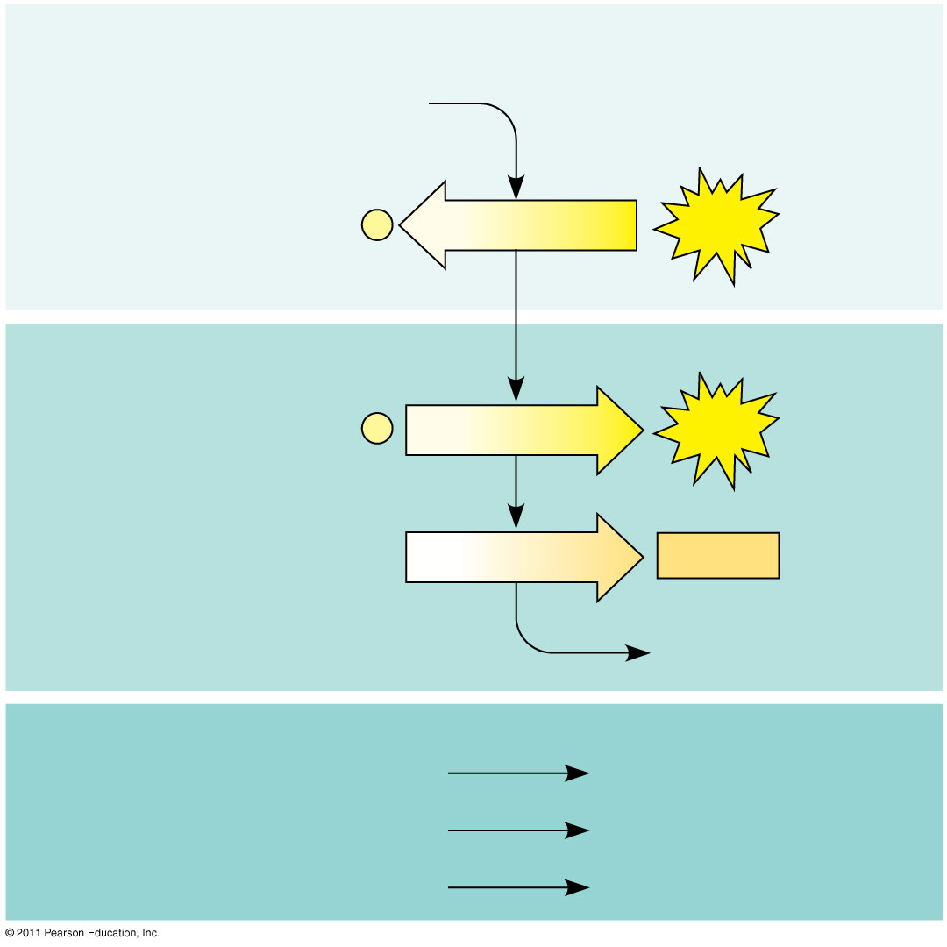
Figure 9.8
Energy Investment Phase
Glucose
2 ADP + 2 P
2 ATP used
Energy Payoff Phase
4 ADP + 4 P
4 ATP formed
2 NAD⁺ + 4 e⁻ + 4 H⁺
2 NADH + 2 H⁺
2 Pyruvate + 2 H₂O
Net
Glucose
2 Pyruvate + 2 H₂O
4 ATP formed − 2 ATP used
2 ATP
2 NAD⁺ + 4 e⁻ + 4 H⁺
2 NADH + 2 H⁺
Notes:
Figure 9.8 The energy input and output of glycolysis.

Slide 40
The Krebs Cycle
Also called the citric acid cycle
In eukaryotes, happens in the mitochondrial matrix
The carboxyl group is removed from the pyruvate and oxidized to form NADH and FADH.
By the end of this, we are done oxidizing glucose. We have made hydrogen and electron carriers. The rest of respiration is about generating ATP with these molecules.

Slide 41
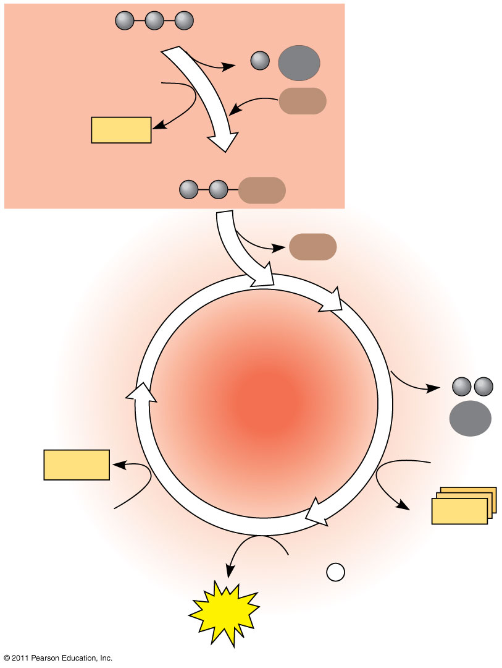
Figure 9.11
Pyruvate
CO₂
NAD⁺
CoA
NADH
+ H⁺
Acetyl CoA
CoA
CoA
Citric acid cycle
2 CO₂
FADH₂
3 NAD⁺
FAD
3 NADH
+ 3 H⁺
ADP + P _{i}
ATP
Notes:
Figure 9.11 An overview of pyruvate oxidation and the citric acid cycle.

Slide 42
Electon Transport Chain (ETC)
Collection of molecules embedded in the inner membrane of the mitochondria
Captures free energy from electrons in series of reactions that establishes electrochemical gradient
NADH and FADH₂ drop off their Hydrogens, which pass electrons to these embedded molecules. (energy)
H+ builds up outside of the membrane which drives chemiosmosis as it powers the ATP synthase rotor to generate ATP (gradient)
Final e-/H+ acceptor is Oxygen

Slide 43
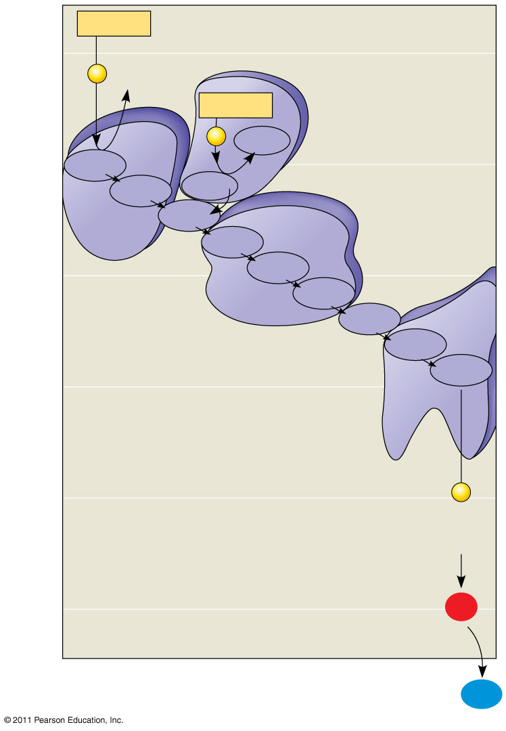
Figure 9.13
NADH
50
2 e⁻
NAD⁺
FADH₂
2 e⁻
FAD
Multiprotein complexes
40
FMN
I
Fe•S
II
Fe•S
Q
III
Cyt b
30
Fe•S
Cyt c₁
IV
Free energy (G) relative to O₂ (kcal/mol)
Cyt c
Cyt a
20
Cyt a₃
10
2 e⁻
(originally from NADH or FADH₂)
0
2 H⁺ + ¹/₂ O₂
H₂O
Notes:
Figure 9.13 Free-energy change during electron transport.

Slide 44
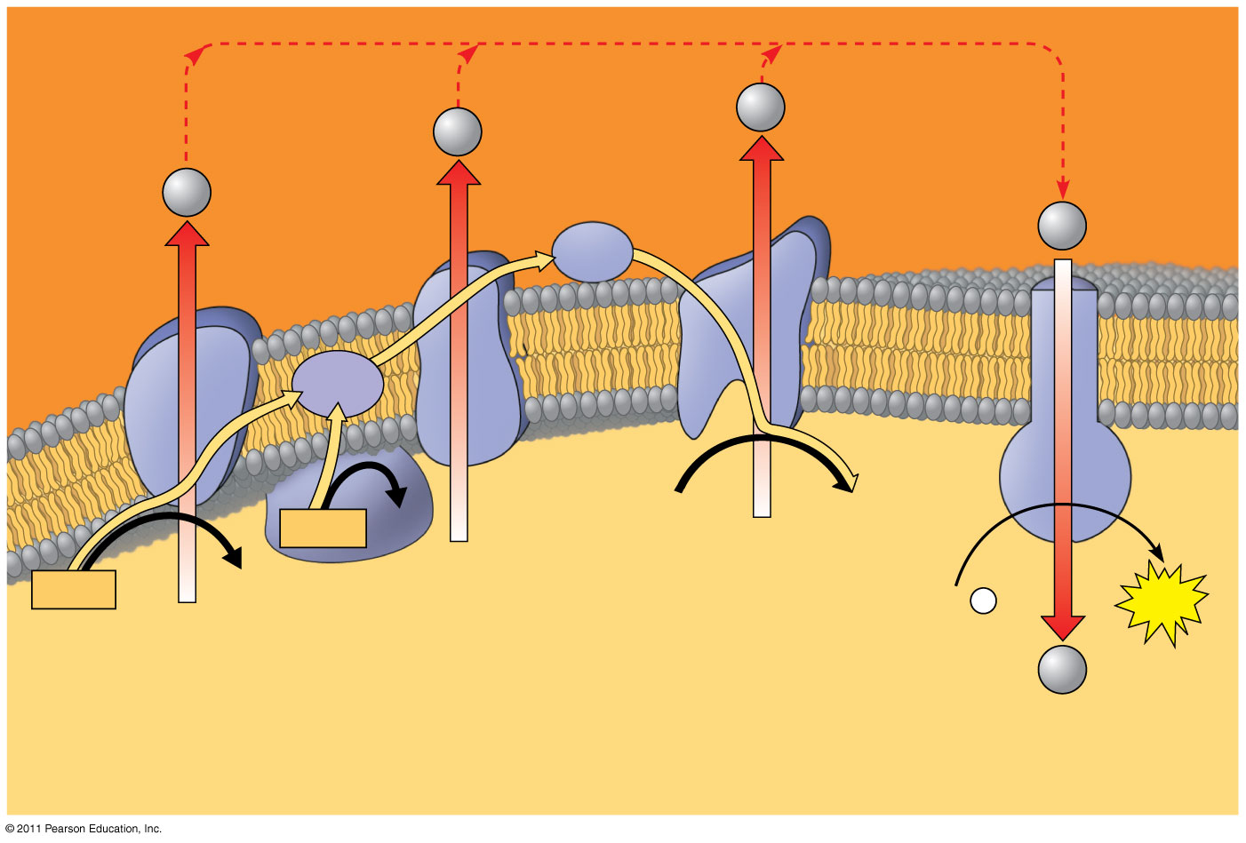
Figure 9.15
H⁺
H⁺
Protein complex of electron carriers
H⁺
H⁺
Cyt c
IV
Q
III
I
ATP synth- ase
II
FADH₂
FAD
2 H⁺ + ¹/₂O₂
H₂O
NADH
NAD⁺
ADP + P _{i}
ATP
(carrying electrons from food)
H⁺
1
Electron transport chain
2
Chemiosmosis
Oxidative phosphorylation
Notes:
Figure 9.15 Chemiosmosis couples the electron transport chain to ATP synthesis.

Slide 45
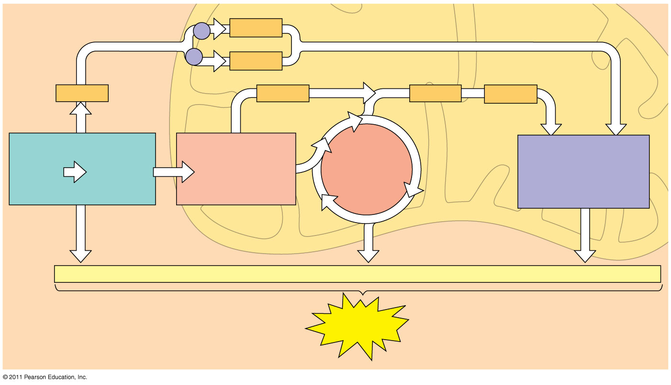
Figure 9.16
Electron shuttles span membrane
MITOCHONDRION
2 NADH
or
2 FADH₂
2 NADH
2 NADH
6 NADH
2 FADH₂
Glycolysis
Pyruvate oxidation
Oxidative phosphorylation: electron transport and chemiosmosis
Citric acid cycle
Glucose
2 Pyruvate
2 Acetyl CoA
+ 2 ATP
+ 2 ATP
+ about 26 or 28 ATP
Maximum per glucose:
About 30 or 32 ATP
CYTOSOL
Notes:
Figure 9.16 ATP yield per molecule of glucose at each stage of cellular respiration.

Slide 46
ANIMATIONS!

Slide 47
Reactants and Products
 | Glycolysis | Krebs Cycle | ETC
Use Glucose?
Use Oxygen?
Create ATP?
Create Carbon Dioxide?
Create Water?

Slide 48
Respirometers

Slide 49
Respirometers

Slide 50
Anaerobic respiration
When Glycolysis occurs, the presence or absence of oxygen determines whether or not the Krebs cycle will proceed.
In the absence of oxygen, fermentation occurs instead
Less efficient, only 2 ATP produced
Plants=alcoholic fermentation
Animals=lactic acid fermentation

Slide 51
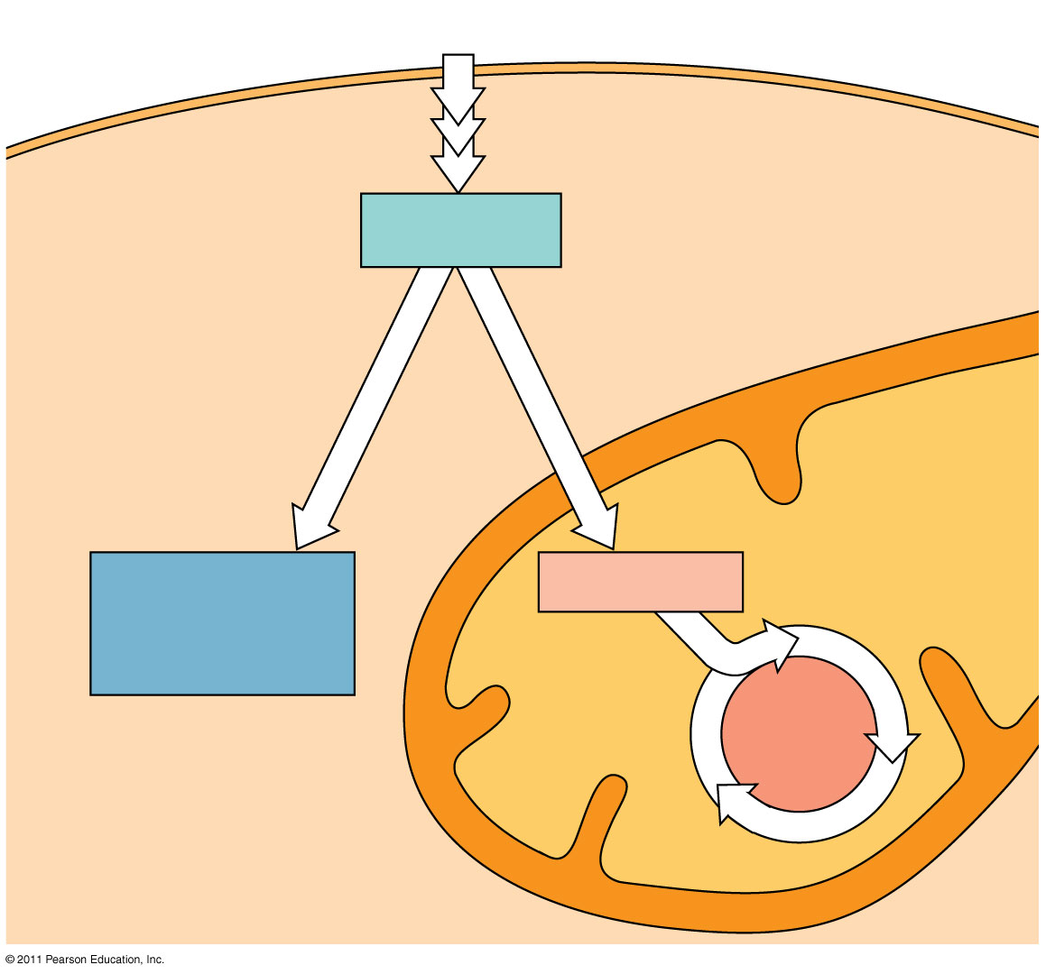
Figure 9.18
Glucose
Glycolysis
CYTOSOL
Pyruvate
No O₂ present: Fermentation
O₂ present: Aerobic cellular respiration
MITOCHONDRION
Ethanol, lactate, or other products
Acetyl CoA
Citric acid cycle
Notes:
Figure 9.18 Pyruvate as a key juncture in catabolism.

Slide 52
Respiration Observation Lab / Energy
We will post both energy labs together on our lab sites.
Posting instructions will be shared after the photosynthesis lab.
Record all observations, questions, graphs in your notebook today.

