Slide 1
Enzymes as catalysts
Most enzymes are proteins
Catalyst=changes the rate of the reaction but is not consumed (used up) by the reaction
Enzymes lower the activation energy of the reaction (activation energy or free energy of activation is usually in the form of heat and is required to make the molecules interact or break)
Enzymes are specific to their substrate (reactant) because the shape of the active site (only region of enzyme that binds to substrate) conforms to the shape of the substrate (induced fit)
Like a clasping handshake or lock & key

Slide 2
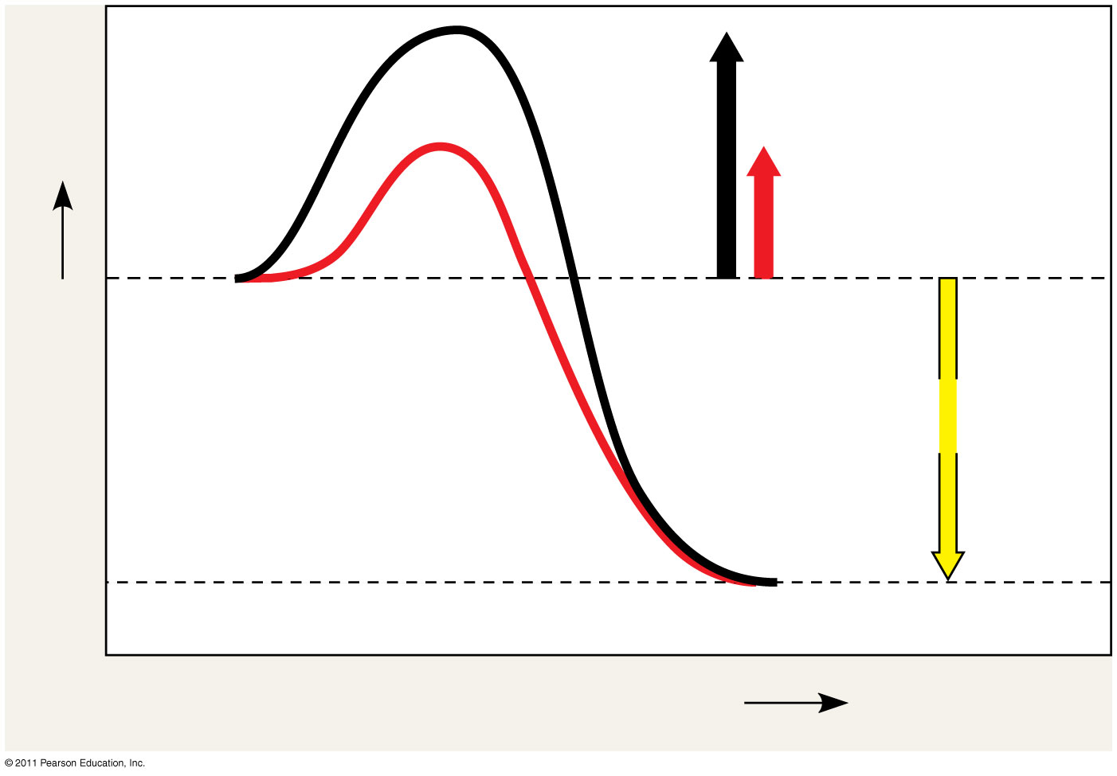
Figure 8.13
Course of reaction without enzyme
E_{A} without enzyme
E_{A} with enzyme is lower
Reactants
Free energy
Course of reaction with enzyme
ΔG is unaffected by enzyme
Products
Progress of the reaction
Notes:
Figure 8.13 The effect of an enzyme on activation energy.

Slide 3
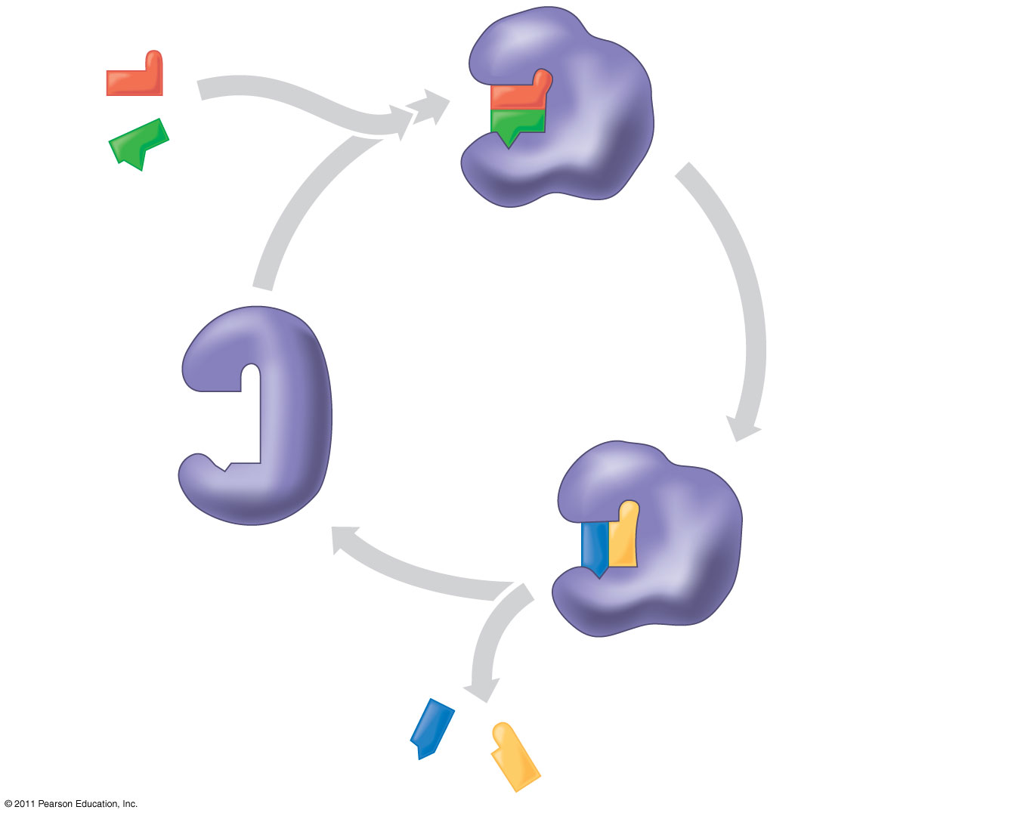
Figure 8.15-3
1
Substrates enter active site.
2
Substrates are held in active site by weak interactions.
Substrates
Enzyme-substrate complex
Active site can lower E_{A} and speed up a reaction.
3
6
Active site is available for two new substrate molecules.
Enzyme
5
Products are released.
Substrates are converted to products.
4
Products
Notes:
Figure 8.15 The active site and catalytic cycle of an enzyme.

Slide 4
Enzyme controls
Denaturation due to pH or temperature changes
Cofactors=non-protein attachments to the enzyme’s active site that help maintain it’s shape
Ex: vitamins

Slide 5
Enzyme Controls cont’d
Inhibition
Competitive=mimics the substrate and blocks the active site
Non-competitive inhibition=binds to another section on the enzyme, causing the shape of the active site to change
Ex: toxins & poisons
Allosteric regulation=noncompetitive inhibition is a type of allosteric regulation.
either causes activation by stabilizing the enzyme shape, or can cause inhibition by destabilizing the enzyme shape (usually at the junction of the polypeptide chains of the enzyme)
Cooperativity=enzymes can have multiple active sites, so induced fit at one active site may cause stabilization of other active sites on the enzyme

Slide 6
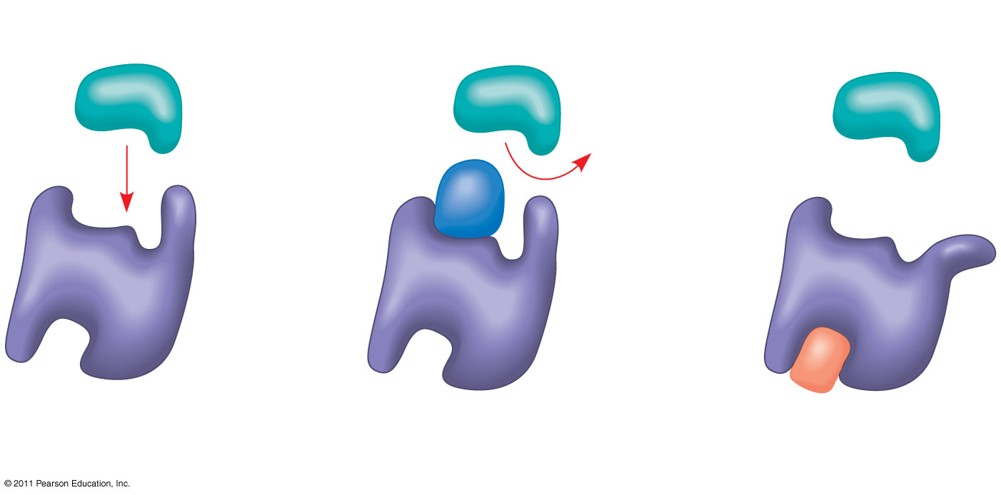
Figure 8.17
(a) Normal binding
(b) Competitive inhibition
(c) Noncompetitive inhibition
Substrate
Active site
Competitive inhibitor
Enzyme
Noncompetitive inhibitor
Notes:
Figure 8.17 Inhibition of enzyme activity.

Slide 7
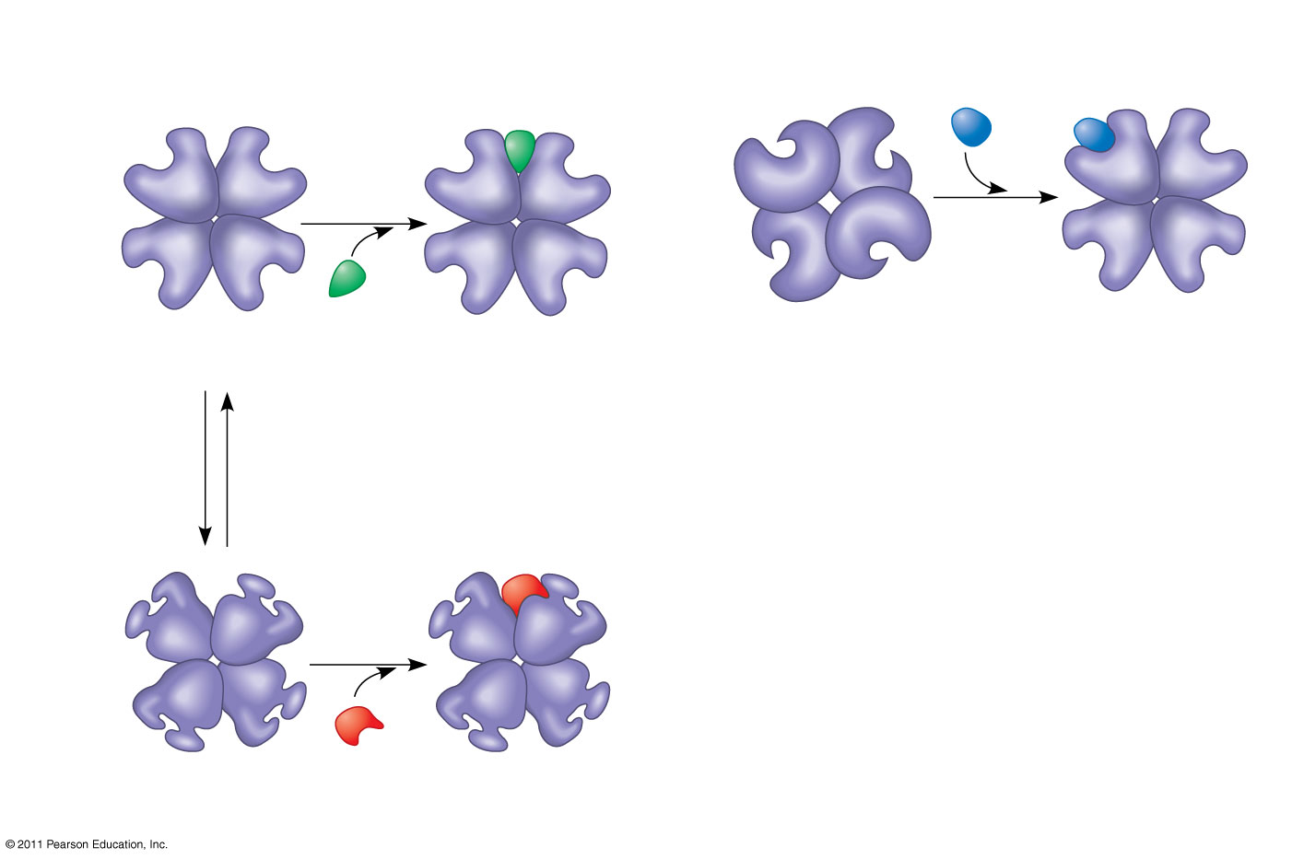
Figure 8.19
(a) Allosteric activators and inhibitors
(b) Cooperativity: another type of allosteric activation
Allosteric enzyme with four subunits
Active site (one of four)
Substrate
Regulatory site (one of four)
Activator
Inactive form
Stabilized active form
Active form
Stabilized active form
Oscillation
Non- functional active site
Inactive form
Inhibitor
Stabilized inactive form
Notes:
Figure 8.19 Allosteric regulation of enzyme activity.

Slide 8
Metabolic pathways and enzymes
Series of chemical reactions in which the products of each step are reactants for the next step
Feedback inhibition of enzymes occurs when the end product of a pathway acts as an enzyme inhibitor

Slide 9
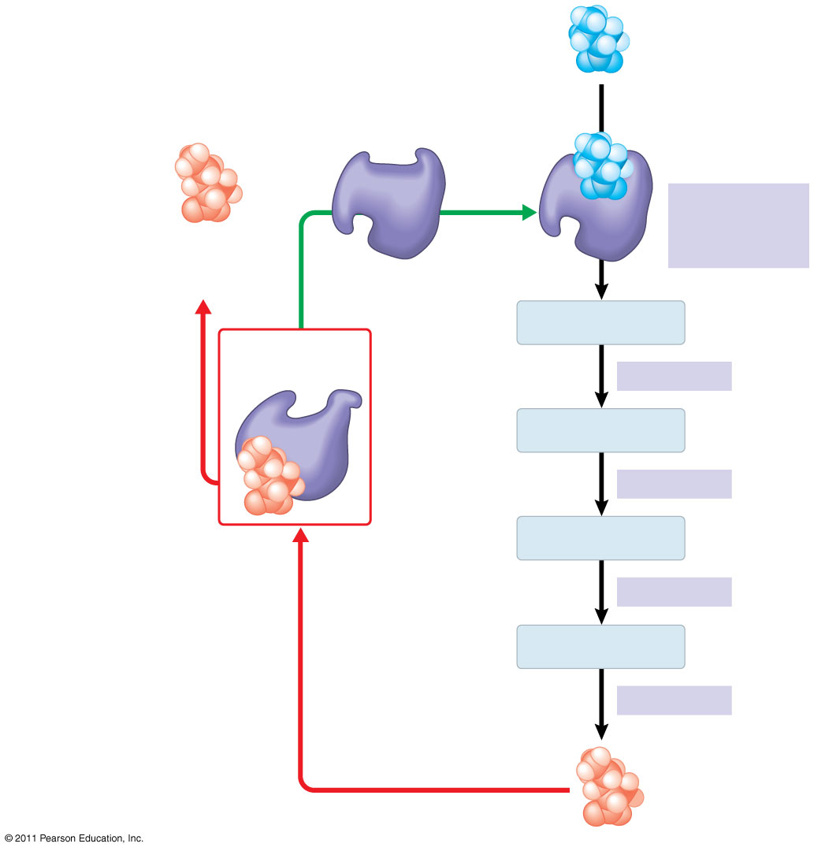
Figure 8.21
Initial substrate (threonine)
Active site available
Threonine in active site
Enzyme 1 (threonine deaminase)
Isoleucine used up by cell
Active site of enzyme 1 is no longer able to catalyze the conversion of threonine to intermediate A; pathway is switched off.
Intermediate A
Feedback inhibition
Enzyme 2
Intermediate B
Enzyme 3
Intermediate C
Isoleucine binds to allosteric site.
Enzyme 4
Intermediate D
Enzyme 5
End product (isoleucine)
Notes:
Figure 8.21 Feedback inhibition in isoleucine synthesis.

Slide 10
Enzyme and Catalase Articles
Read the articles at your table.
Discuss what you read with your tablemates.
10 minutes
Questions:
Define metabolism and relate the term to enzymes and enzyme activity.
What enzyme breaks down fats?
What family of biochemical does catalase belong to?
What is the substrate for the enzyme catalase?
Why is catalase important in the human body? Is it also important to plants? Explain why or why not.
How is catalase used in the food industry and cosmetology

