Slide 1
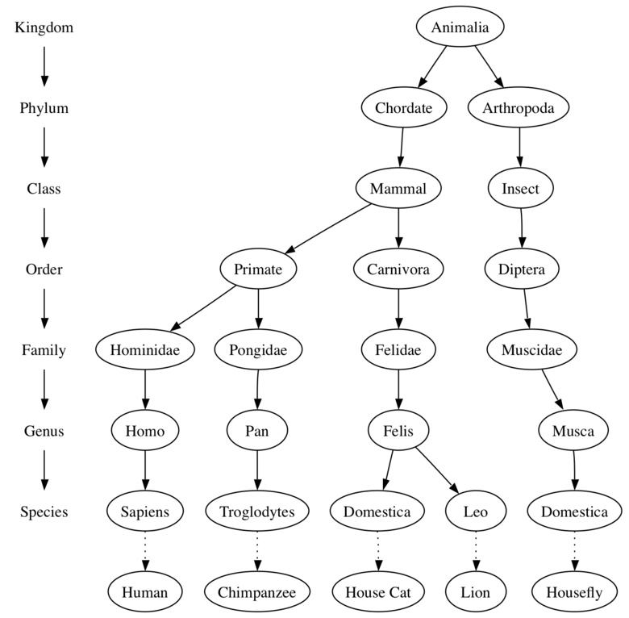
Classification
Recall that in Biology, you learned the 7-step hierarchical classification scheme: KPCOFGS

Slide 2
Who is most closely related?

Slide 3
Evidence: Fossils, biogeography, morphology, vestigial organs, embryology, biomolecular evidence.
Modern scientists have added a step to the front of this scheme: Domain
3 domains
Archea: contains only the archaebacteria
Bacteria: contains only the eubacteria
Eukarya: contains the other 4 kingdoms; Protista, Fungi, Plantae, and Animalia (all are eukaryotic)
Also recall that this is simply a modernization of Linnaeus’ scheme. We still use his Binomial Nomenclature for scientific names
Genus species or G. species, and that scientific names use Latin/Greek roots

Slide 4
Classification
Recall that in Biology, you learned the 7-step hierarchical classification scheme: KPCOFGS

Slide 5
Practice!!!
1.Quercas alba is most closely related to which of the following?
a. Quercas rubra
b. Folia albicans
2. Bacillus antraxis is a type of bacteria. What genus does it belong to? What species?

Slide 6
Dichotomous Keys
Used to identify organisms.
Dichotomous = Two choices.
Example

Slide 7
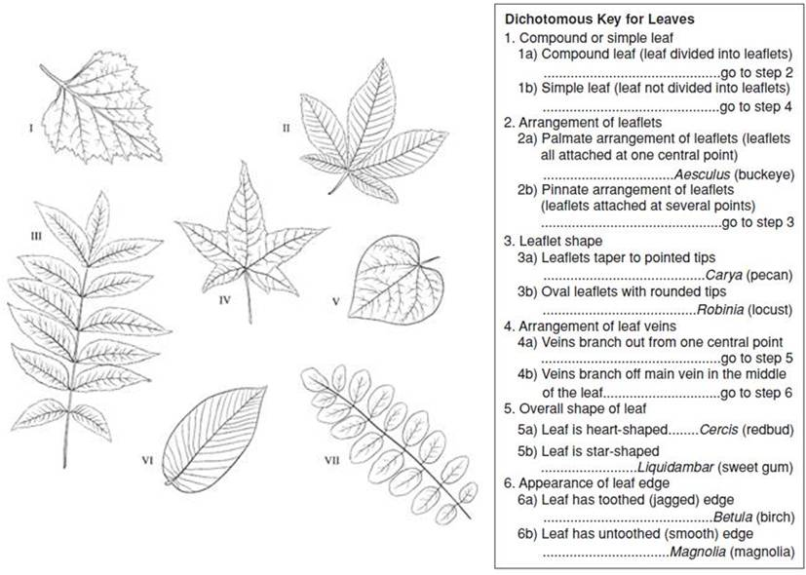

Slide 8
Dichotomous Keys
Practice with one of the keys (alien, salamander, fish)
Create a dichotomous key with items from your bag!

Slide 9
Kingdoms
 | Archaebacteria | Eubacteria | Protista | Fungi | Plantae | Animalia
Prokaryote Or Eukaryote
Multi- Or Unicellular
Heterotroph Or Autotroph
Examples

Slide 10
Phylogeny vs. Cladistics
Phylogeny is the study of an organism’s evolutionary history
This is traced on phylogenetic trees, which are based on all known data for classification and branch according to the hierarchical system of classification
Time is included on the tree
Sometimes difficult to tell the evolutionary relationships between certain taxa (like families) on phylogenetic trees
We cannot necessarily infer that an organism directly evolved from the taxon next to it on the tree
Cladistics is a different approach that uses common ancestory and derived characters to determine relationships.
This is used to construct Cladograms, graphic representations of the relationships between Clades (a group containing the ancestral species and all of its descendants)
Cladograms are constructed using Derived Characters, which are new characteristics that appear with each branch on a cladogram.

Slide 11
Phylogenetic Tree- graphic representation of a classification system based on evolutionary relationships and when things evolved.
Created using several lines of evidence.
Ex. Morphology, embryology, fossil evidence, DNA.
May show multiple splits
General time is included on trees

Slide 12
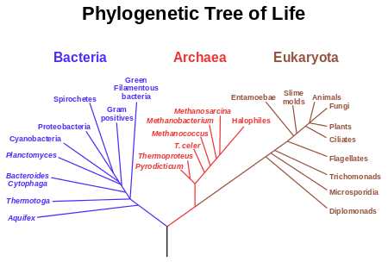

Slide 13
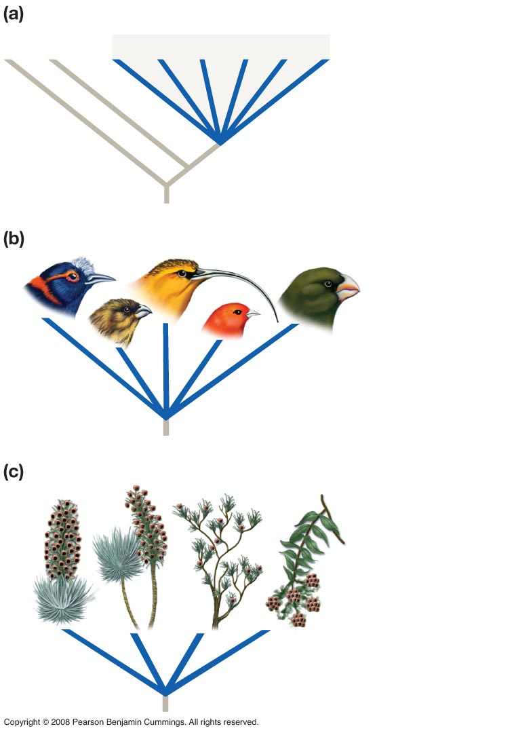
Figure 27-11
Adaptive radiations produce star phylogenies.
Star phylogeny (a large polytomy)
Rapid
speciation
Hawaiian honeycreepers underwent adaptive radiation.
Hawaiian silverswords underwent adaptive radiation.

Slide 14
Phylogenetic Tree Problem
Draw a phylogenetic tree to describe the following scenario:
Dingles were present just 1,000 years ago, when they first evolved. Whozits and Whatzits quickly evolved from Dingles (100 years later), when the Dingles became extinct. The Whozit line continued unchanged until the present, while the Whatzits formed 3 other species before dying off; Floogles, Naks, and Surps (300 years before today).

Slide 15
Cladogram-graphic representation of the evolutionary relationships between a small group or fewer groups of organisms.
Relationship based on the presence of certain derived characteristics. Ex. Presence of feathers in birds or # of amino acids in mammals.
Only branches into two (bifurcations)

Slide 16
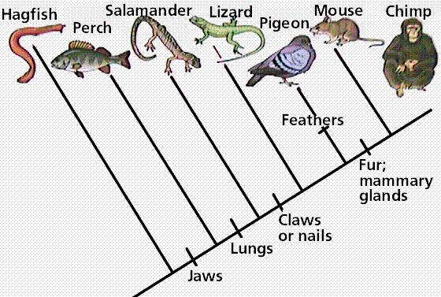

Slide 17
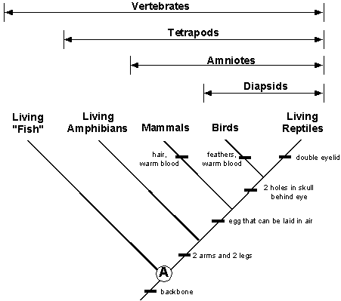

Slide 18
Cladogram Activity
Complete ONE of the following activities:
Hardware Organism Key/Cladogram
OR
Cytochrome c Lab (chart, cladogram, questions #1-5)
Write a paragraph summarizing your results, your activity and the other activity. *See Questions*

