Slide 1
AP Biology Unit 3
Cells

Slide 2
Cell Theory
http://learn.genetics.utah.edu/content/begin/cells/scale/
All living things are composed of cells.
The cell is the basic unit of organisms.
Cells come from preexisting cells.
Q. Where did the first cells come from?
A. Remember Miller – Urey?

Slide 3
Where did cells come from????
Remember: cells are composed of the 4 families of biochemicals. If we know how the biochemicals were formed we can figure out how cells formed!
Scientists Miller and Urey developed an experiment to test Oparin’s hypothesis that the environment of early earth could produce biochemicals.
Biochemicals create Cells

Slide 6
2 Main Cell Types
Prokaryotes
No nucleus or membrane-bound organelles
Has a region called the nucleoid for its genetic material
Only Archaeabacteria and Bacteria are prokaryotic
Eukaryotes
Have a nucleus and an array of membrane-bound organelles
Because of the membrane system, cell parts are compartmentalized and division of labor is more efficient. All organelles work together to help the cell function.

Slide 7
Endosymbiont Theory
Anaerobic prokaryotes worked together to create larger, more advanced cells (future eukaryotes)
Evidence for this includes:
Structure of organelles such as mitochondria and chloroplasts: size, membrane, DNA.
Organelles such as mitochondria and chloroplast reproduce separately from the cell.

Slide 8
Cells Background
Until the advent of the electron microscope, only the nucleus and membrane were really known
Chemical analysis and cell fractionation gave us some clue as to the chemical make up of cells
The human eye is unable to detect things smaller than .1mm
Eukaryotic cells range from 10-100 micrometers
Prokaryotic cells run from 1-10 micrometers, but the smallest are almost 100 nm
Most cellular organelles are about the size of bacteria, however, a few, like the ribosome, are smaller still
http://learn.genetics.utah.edu/content/begin/cells/scale/

Slide 9
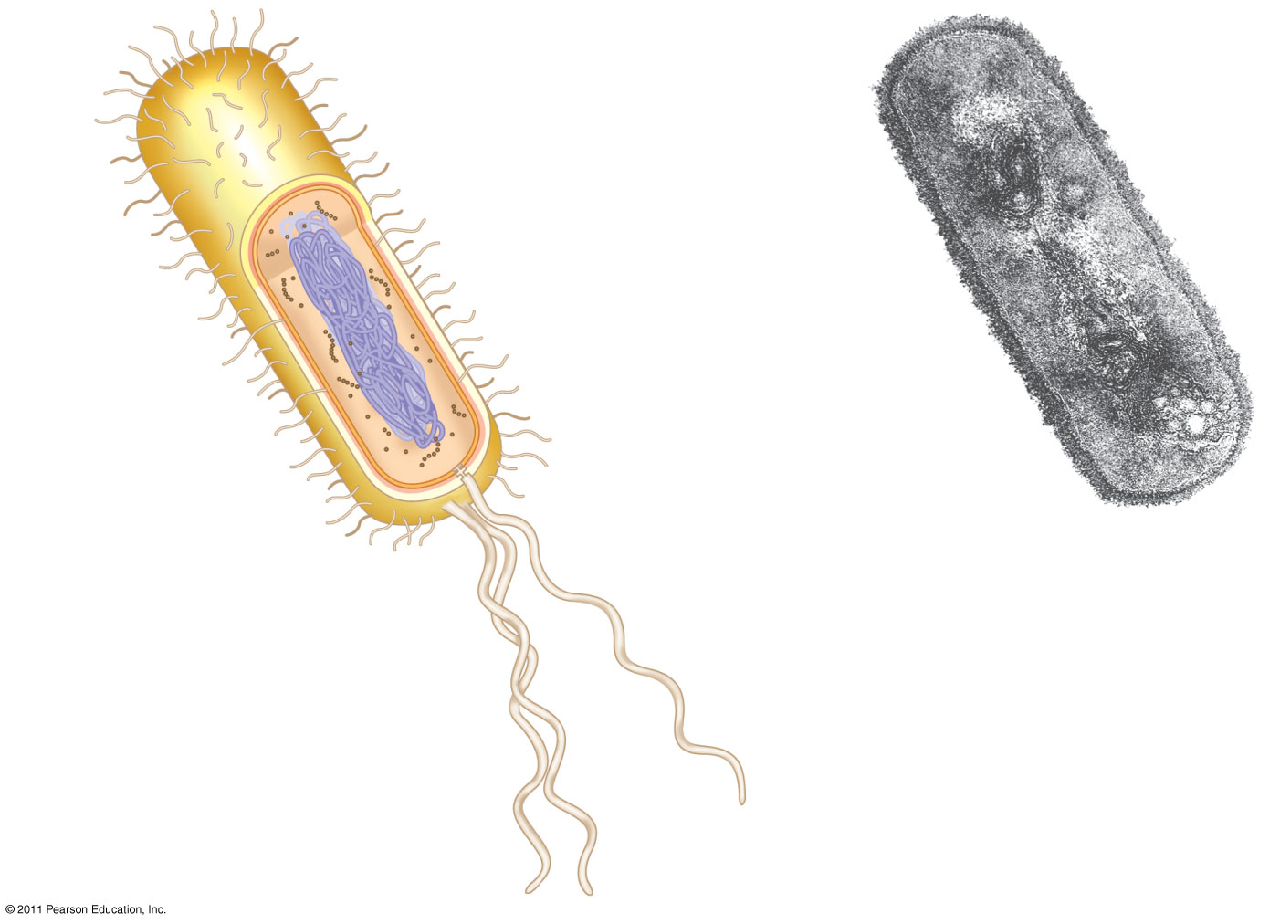
Figure 6.5
Fimbriae
Nucleoid
Ribosomes
Plasma membrane
Bacterial chromosome
Cell wall
Capsule
0.5 μm
(a)
A typical rod-shaped bacterium
Flagella
(b)
A thin section through the bacterium Bacillus coagulans (TEM)
Notes:
Figure 6.5 A prokaryotic cell.

Slide 12
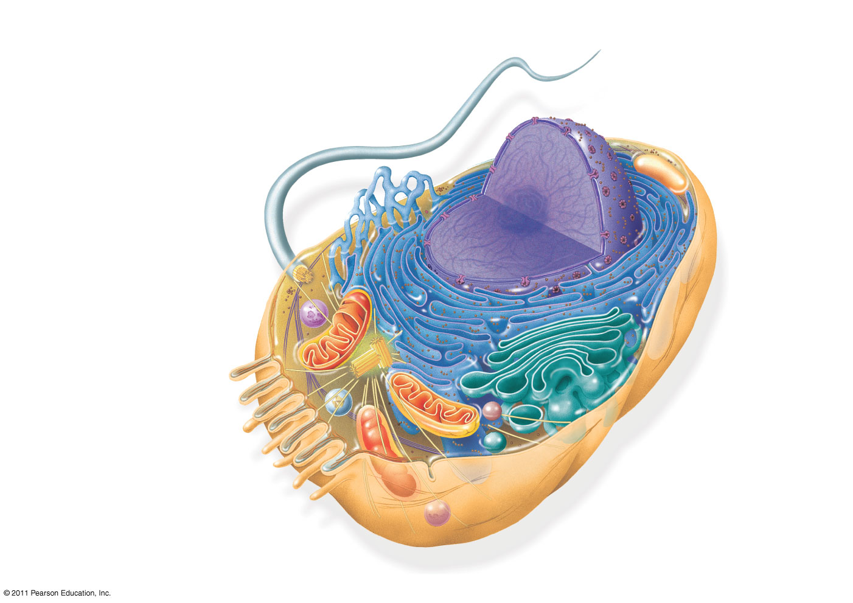
Figure 6.8a
ENDOPLASMIC RETICULUM (ER)
Smooth ER
Nuclear envelope
Rough ER
Flagellum
NUCLEUS
Nucleolus
Chromatin
Centrosome
Plasma membrane
CYTOSKELETON:
Microfilaments
Intermediate filaments
Microtubules
Ribosomes
Microvilli
Golgi apparatus
Peroxisome
Mitochondrion
Lysosome
Notes:
Figure 6.8 Exploring: Eukaryotic Cells

Slide 13
Nucleus
Contains the genes responsible for cell function (chromatin-uncoiled, tangled, DNA mass)
Contains Nucleolus which makes the rRNA & ribosomes
Nuclear pores in the nuclear envelope allow RNA and ribosomes to pass to the cytoplasm for making proteins

Slide 14
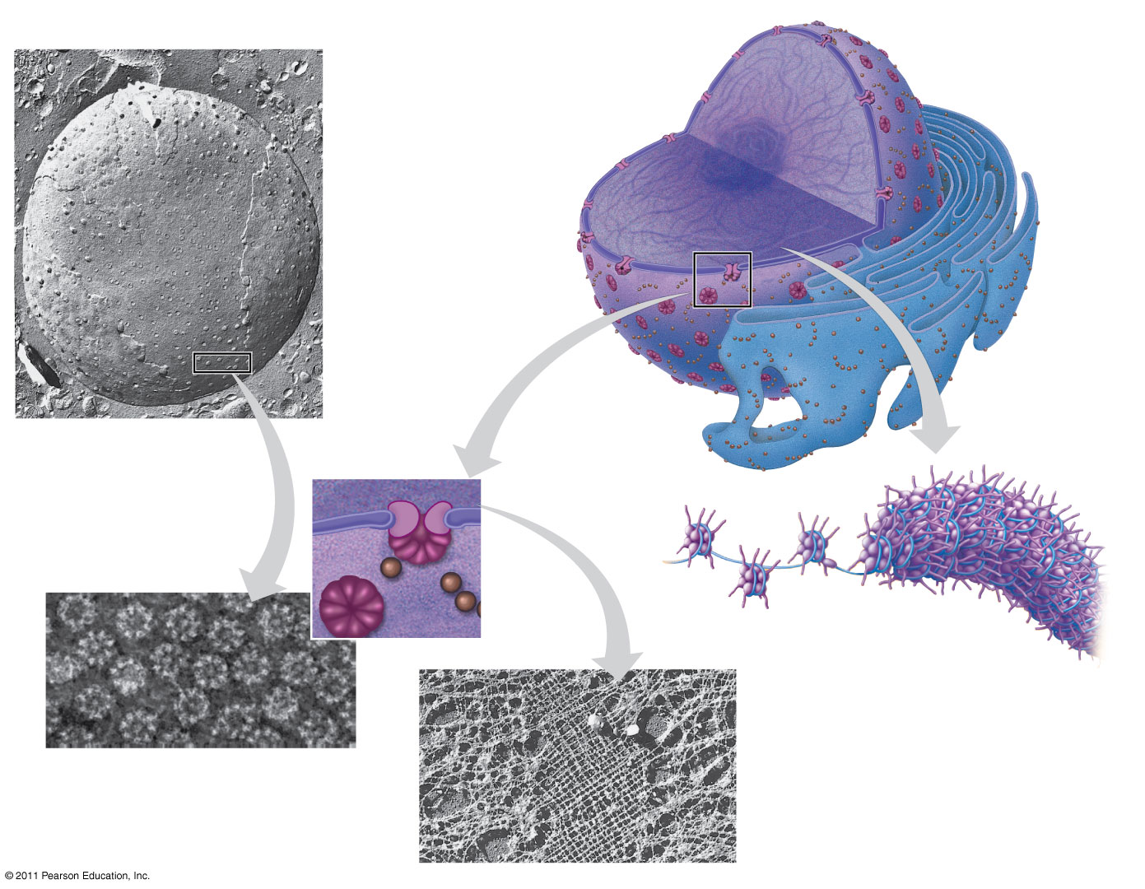
Figure 6.9
1 μm
Nucleus
Nucleolus
Chromatin
Nuclear envelope:
Inner membrane
Outer membrane
Nuclear pore
Rough ER
Pore complex
Surface of nuclear envelope
Ribosome
Close-up of nuclear envelope
0.25 μm
Chromatin
1 μm
Pore complexes (TEM)
Nuclear lamina (TEM)
Notes:
Figure 6.9 The nucleus and its envelope.

Slide 15
The Endomembrane System – membrane bound pathway of organelles/compartments that work to break down, create, transport materials.
1. Nuclear Membrane/Envelope
2. Endoplasmic Reticulum (ER)
Vast network of membrane and sacs called cisternae
Consists of approximately ½ of the total membrane of the cell
Smooth=no bound ribosomes, synthesizes lipids, begins to break down glucose and detoxifies drugs/poisons
Rough=bound ribosomes, thread emerging proteins they make through the cisternal (foldy) space into the internal part of the ER, release secretory proteins to the Golgi apparatus.

Slide 16
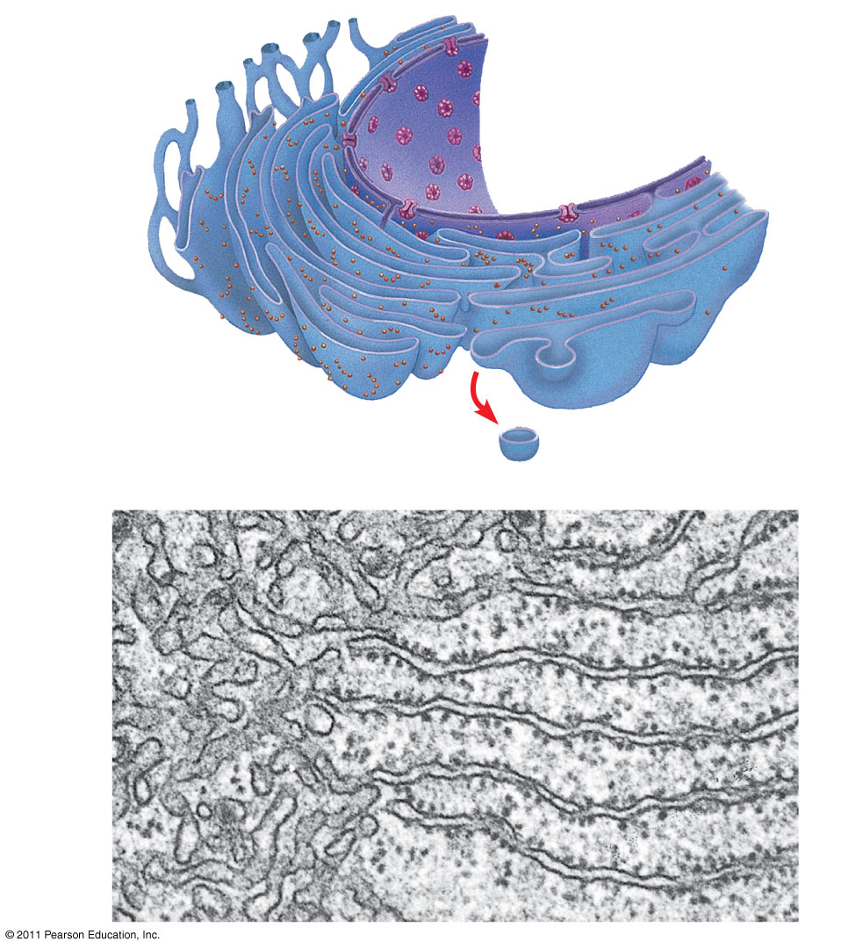
Figure 6.11
Smooth ER
Nuclear envelope
Rough ER
ER lumen
Cisternae
Transitional ER
Ribosomes
Transport vesicle
200 nm
Smooth ER
Rough ER
Notes:
Figure 6.11 Endoplasmic reticulum (ER).

Slide 17
3. Golgi Apparatus
Part of the endomembrane system that consists of flattened membranous sacs (cisternae)
“Warehouse”: sorts, modifies, packages, and ships the products of the ER (primarily proteins)
Synthesizes some polysaccharides & lysosomes

Slide 18
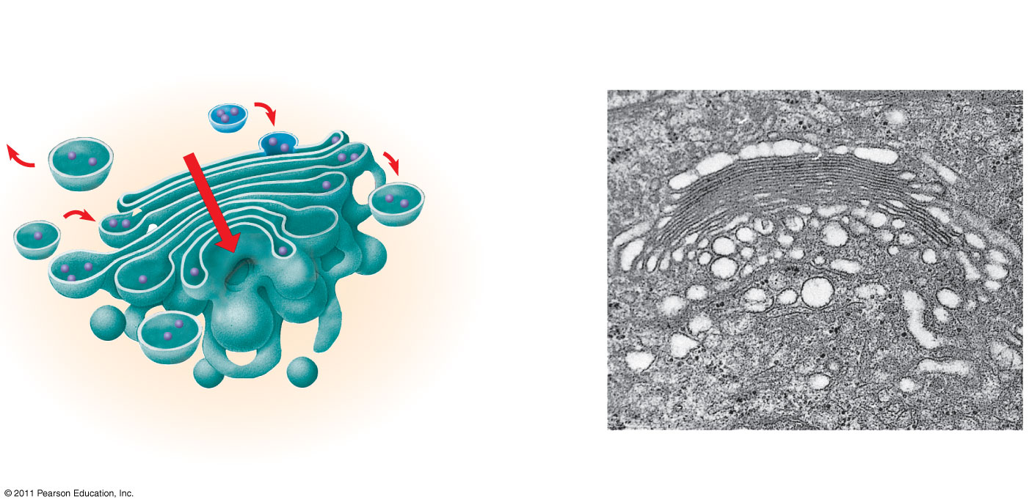
Figure 6.12
cis face (“receiving” side of Golgi apparatus)
0.1 μm
Cisternae
trans face (“shipping” side of Golgi apparatus)
TEM of Golgi apparatus
Notes:
Figure 6.12 The Golgi apparatus.

Slide 19
4. Lysosomes and Vacuoles
Lysosomes are sacs for storage of hydrolytic enzymes
Can digest external elements that are brought into the cell (intracellular digestion) or can digest old, worn-out cell components (autophagy/apoptosis)
Tay-Sachs disease-occurs when lysosomes lack a lipid-digesting enzyme and causes brain impairment
Vacuoles are membrane sacs for general storage
Food vacuoles (part of intracellular digestion)
Contractile vacuoles (pump water out of the cell)
Central vacuole (in plants)

Slide 20
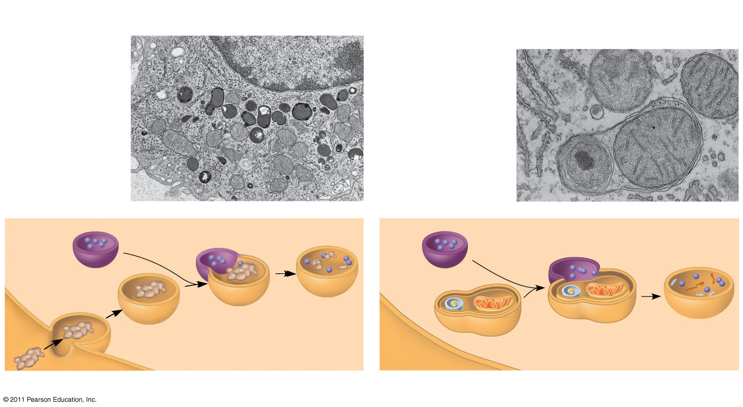
Figure 6.13
1 μm
Vesicle containing two damaged organelles
Nucleus
1 μm
Mitochondrion fragment
Lysosome
Peroxisome fragment
Digestive enzymes
Lysosome
Lysosome
Peroxisome
Plasma membrane
Digestion
Food vacuole
Mitochondrion
Digestion
Vesicle
(a) Phagocytosis
(b) Autophagy
Notes:
Figure 6.13 Lysosomes.

Slide 21
How is a protein made?
A polypeptide enters the cell. How does a cell turn that into a protein to export?
Use specific organelles!!!
8 min.
Have your neighbor check your answer!

Slide 22
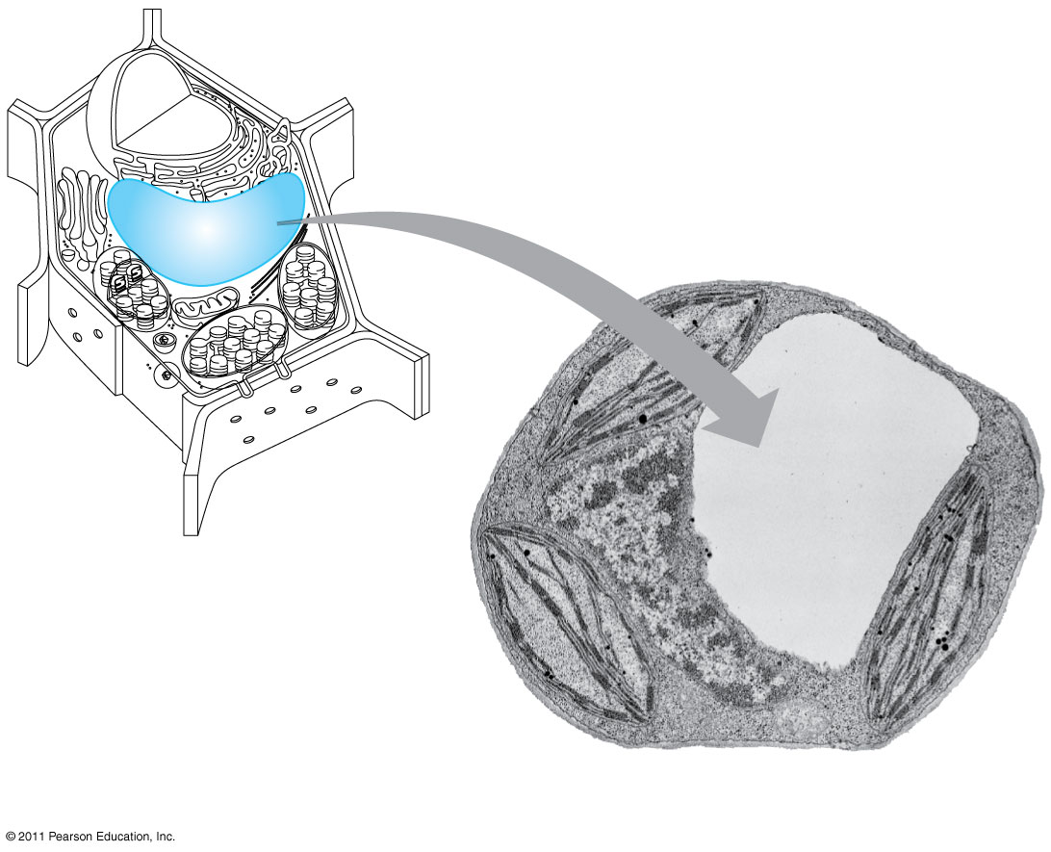
Figure 6.14
Central vacuole
Cytosol
Central vacuole
Nucleus
Cell wall
Chloroplast
5 μm
Notes:
Figure 6.14 The plant cell vacuole.

Slide 23
Ribosomes
Made of rRNA & protein
Carry out protein synthesis
Can be free floating or attached to ER

Slide 24
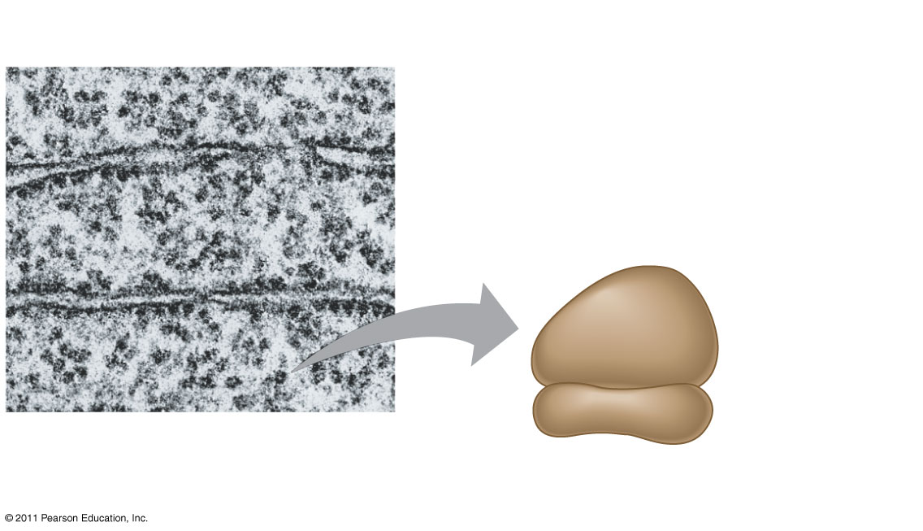
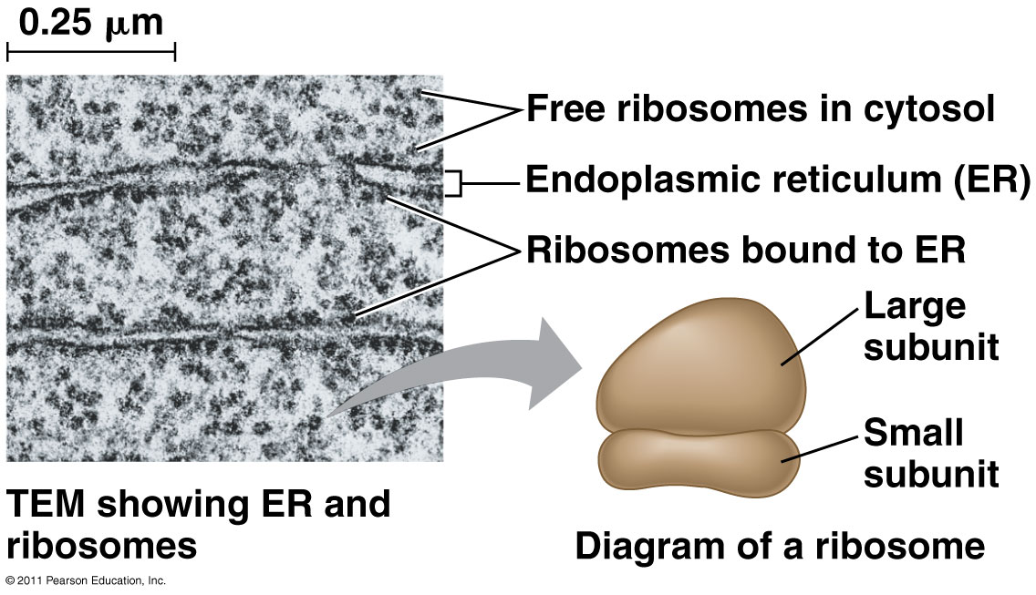
Figure 6.10
0.25 μm
Free ribosomes in cytosol
Endoplasmic reticulum (ER)
Ribosomes bound to ER
Large subunit
Small subunit
TEM showing ER and ribosomes
Diagram of a ribosome
Notes:
Figure 6.10 Ribosomes.

Slide 25
Energy Organelles-skip for now…..
Mitochondria
Generates ATP during the last 2 stages of aerobic cellular respiration
Consists of 2 membranes. Outer membrane smooth. Inner membrane folded into cristae, one compartment called the intermembrane space, inside part called the matrix,
Contain enzymes needed for ATP production
Folds increase surface area & increase productivity of the cell
Number depends on cell’s level of metabolic activity
Chloroplasts
Capture light energy & convert it to chemical energy (photosynthesis)
Contain chlorophyll (green plant pigment, type a is most common)
Double outer membrane
Contains membranous discs called thylakoids that are stacked into grana-chlorophyll is embedded on the thylakoid membranes
Contains fluid called stroma that surrounds the thylakoids

Slide 26
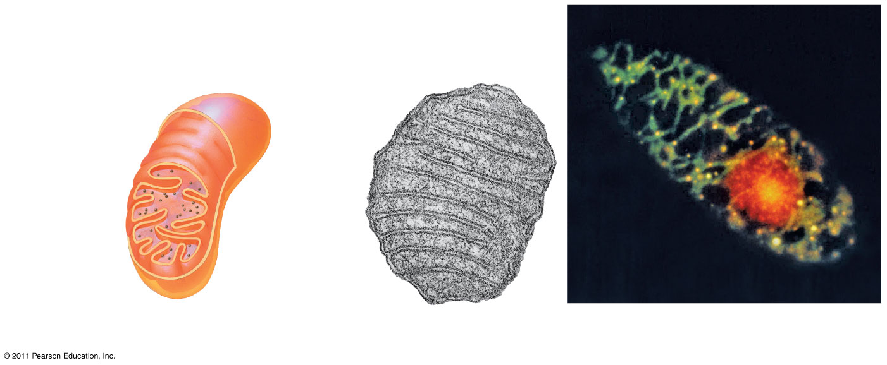
Figure 6.17
10 μm
Intermembrane space
Outer
Mitochondria
membrane
DNA
Inner
Mitochondrial DNA
Free ribosomes in the mitochondrial matrix
membrane
Cristae
Matrix
Nuclear DNA
0.1 μm
(a) Diagram and TEM of mitochondrion
(b)
Network of mitochondria in a protist cell (LM)
Notes:
Figure 6.17 The mitochondrion, site of cellular respiration.

Slide 27
Figure 6.18
Ribosomes
50 μm
Stroma
Inner and outer
membranes
Granum
Chloroplasts (red)
DNA
Thylakoid
Intermembrane space
1 μm
(a) Diagram and TEM of chloroplast
(b) Chloroplasts in an algal cell
Notes:
Figure 6.18 The chloroplast, site of photosynthesis.

Slide 28
Cell Surfaces
Cell Wall
Structural
In plant cells, made of cellulose
Fungi, some Protists and some Bacteria also have cell walls
In plants, the cell walls have plasmodesmata (channels) to allow for cytoplasmic exchange between cells.
Cell Membrane
ALL CELLS have a cell membrane or plasma membrane (same thing)
Regulation

Slide 29
Plasma(Cell) Membrane - Structure
Phospholipids are the primary membrane molecules
They contain a phosphate (hydrophilic) head and 2 fatty acid tails (hydrophobic)-amphipathic (has both hydrophilic and phobic parts)
Form bilayers so that the lipid tails are always isolated from water.
Chemical analysis reveals that proteins are present as well. It was originally believed that the proteins coated the inner and outer surfaces of the P.M.
However current understanding is that proteins of the plasma membrane are embedded.

Slide 30
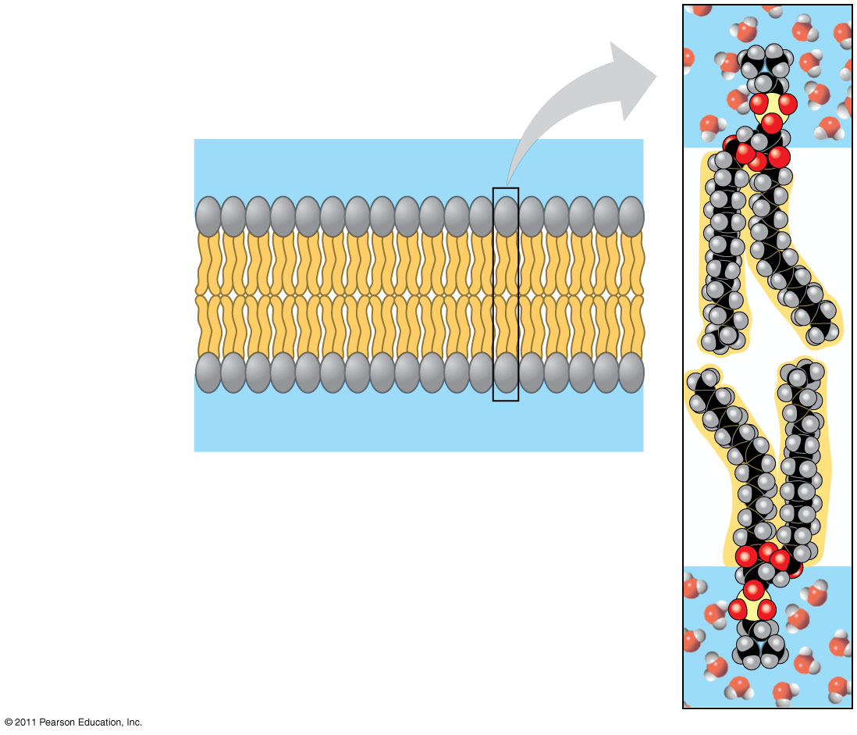
Figure 7.2
WATER
Hydrophilic head
Hydrophobic tail
WATER
Notes:
Figure 7.2 Phospholipid bilayer (cross section).

Slide 31
The Fluid Mosaic Model of the membrane.
Phospholipids within the P.M. are not static, they shift laterally past one another because the interactions of these molecules are weak
= Fluid
Proteins appear to be directed by the cytoskeleton below the PM
Besides phospholipids and proteins, cholesterol is also embedded in the membrane = Mosaic
This lends stability to the membrane by reducing the fluid nature of the membrane at high temps and keeps the phospholipids from compacting at low temperatures and solidifying-this would reduce its permeability
Glycoproteins & Glycolipids also part of structure = Mosaic
Carbohydrates covalently bonded with proteins or lipids
Used for attachment, recognition, communication

Slide 32
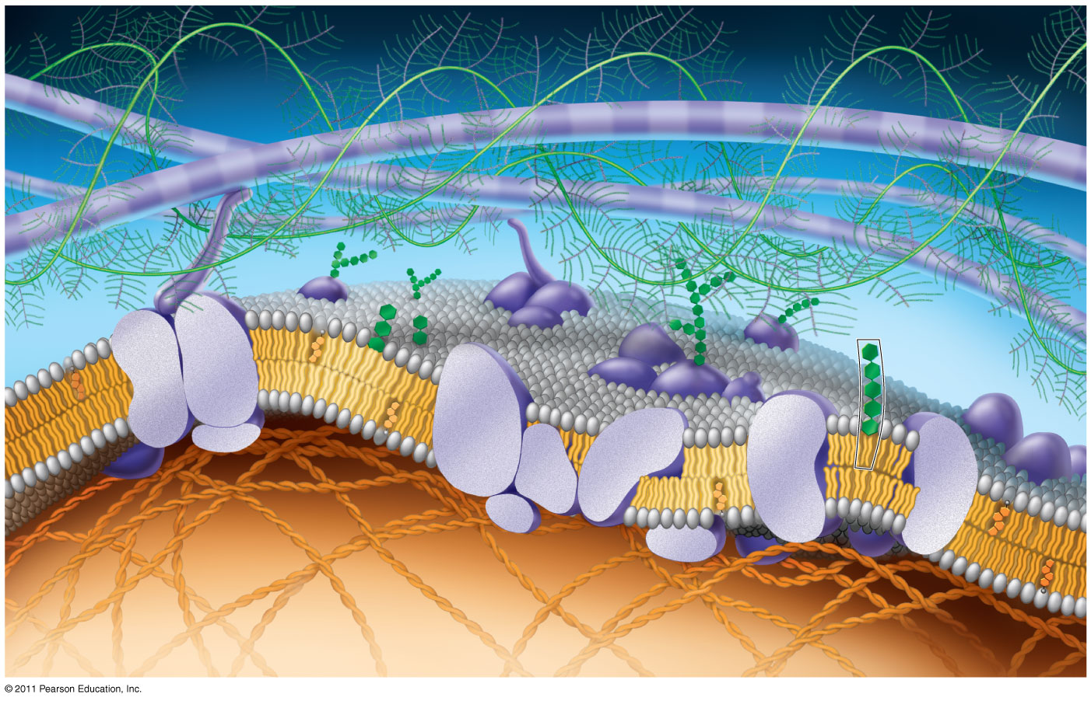
Figure 7.5
Fibers of extra- cellular matrix (ECM)
Glyco- protein
Carbohydrate
Glycolipid
EXTRACELLULAR SIDE OF MEMBRANE
Cholesterol
Microfilaments of cytoskeleton
Peripheral proteins
Integral protein
CYTOPLASMIC SIDE OF MEMBRANE
Notes:
Figure 7.5 Updated model of an animal cell’s plasma membrane (cutaway view).

Slide 33
Membrane Proteins
Integral proteins (embedded)
Transect the membrane
These can be hydrophilic and/or hydrophobic
Usually channel proteins
Peripheral proteins
Bound loosely to the surface of the PM

Slide 34
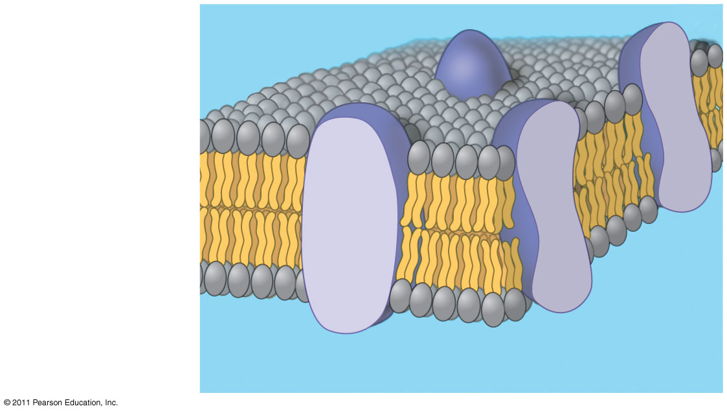
Figure 7.3
Phospholipid bilayer
Hydrophobic regions of protein
Hydrophilic regions of protein
Notes:
Figure 7.3 The original fluid mosaic model for membranes.

Slide 35
Cell Membrane Diagram Color!

Slide 36
Membrane Functions
Transport-to maintain homeostasis
Enzymatic activity-enzymes embedded in membranes that do metabolic processes (ATP synthase in bacteria)
Signal transduction-a binding site on a receptor may chemically change when bound, transmitting the signal to the inside of the cell
Intercellular joining-proteins link cells together (desmosomes)
Recognition-glycoproteins on cell surfaces may bind to sites on adjacent membrane proteins so that the cells may recognize one another

Slide 37
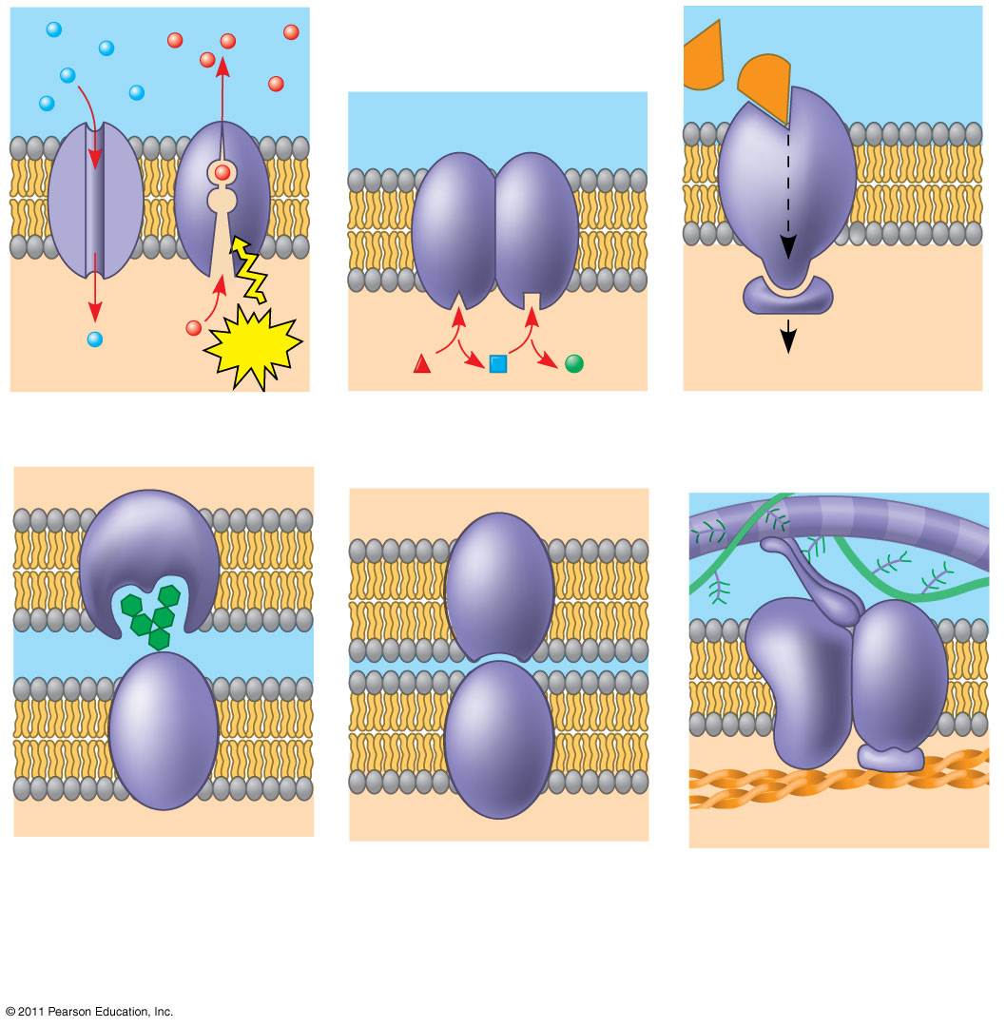
Figure 7.10
Signaling molecule
Enzymes
Receptor
ATP
Signal transduction
(a) Transport
(b) Enzymatic activity
(c) Signal transduction
Glyco- protein
(d) Cell-cell recognition
(e) Intercellular joining
(f) Attachment to the cytoskeleton and extracellular matrix (ECM)
Notes:
Figure 7.10 Some functions of membrane proteins.

Slide 38
Surface Area & Volume Activity/ Classwork
All materials needed by cells have to enter through plasma(cell) membrane
When volume increases, surface area cannot keep up even though demand for resources increases
Restricts cell size
Smaller cells have more favorable surface area to volume ratio
Examples:
Plant root hairs-increase surface area of root epidermis for increased absorption of minerals & water
Microvilli-increase surface area of intestines for increased absorption of nutrients

Slide 39
Osmosis/Diffusion Lab Part I:“party gel”
Purpose/Question: Determine if shape and size affect the diffusion rate of HCl into agarose.
Sample Data
Work on the Transport and Osmosis Review while you are waiting on your data.
Shape/ Size | 2 minutes observation | 4 minutes | 6 minutes | 8 minutes | 10 minutes | 12 minutes | 14 minutes

Slide 40
Transport across membranes
Hydrophobic core-
Barrier for most polar substances (except very small, really important ones. Do you know a molecule like that?)
Small non-polar molecules like oxygen gas, carbon dioxide, and hydrocarbons, and nitrogen gas can pass though
Large polar molecules & ions must use embedded channel or transport proteins to get in.
Water passes freely through lipids http://www.stolaf.edu/people/giannini/flashanimat/lipids/membrane%20fluidity.swf
or moves through specialized proteins areas called aquaporins.

Slide 41
Concentration and transport Rules
Concentration gradient= difference in concentrations
Diffusion rule= particles move from _High_ to _Low__ concentration until they reach _dynamic equilibrium__ (movement with a concentration gradient)
Osmosis=Is the diffusion of WATER with a concentration gradient
Diffusion of solid particles and diffusion of water (Osmosis) are both forms of PASSIVE TRANSPORT. Require no energy.

Slide 42
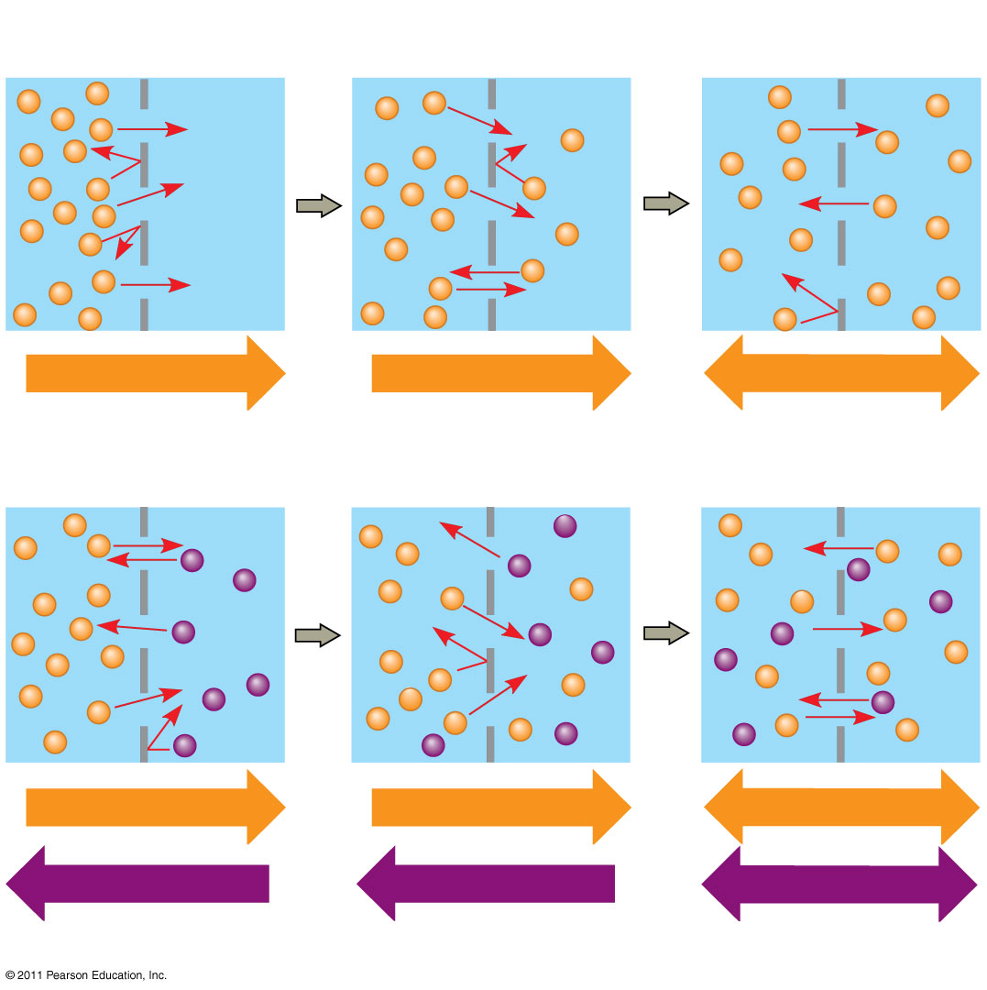
Figure 7.13
Molecules of dye
Membrane (cross section)
WATER
Net diffusion
Net diffusion
Equilibrium
(a) Diffusion of one solute
Net diffusion
Net diffusion
Equilibrium
Net diffusion
Net diffusion
Equilibrium
(b) Diffusion of two solutes
Notes:
Figure 7.13 The diffusion of solutes across a synthetic membrane.

Slide 43
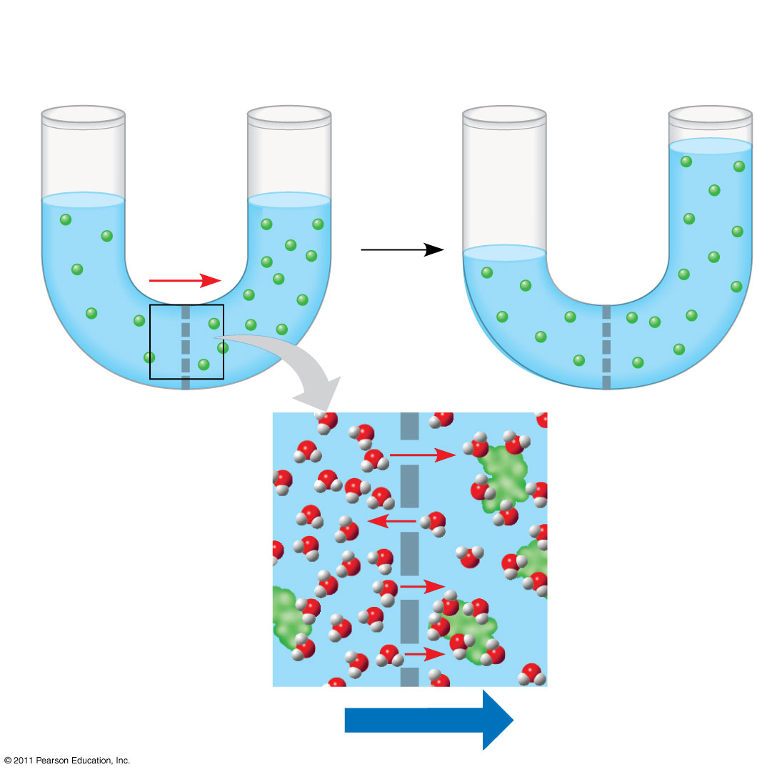
Figure 7.14
Lower concentration of solute (sugar)
Higher concentration of solute
Same concentration of solute
Sugar molecule
H₂O
Selectively permeable membrane
Osmosis
Notes:
Figure 7.14 Osmosis.

Slide 44
Concentration descriptors
Hypertonic solutions= concentration of solute is higher outside the cell than inside (water potential is lower)
Ex: Salt water
Hypotonic solutions= concentrations of solute is lower outside the cell than inside (water potential is higher)
Isotonic solutions= concentrations of solutes are equal inside & outside the cells (water potential is equal to cell)
Remember, Hypotonic and hypertonic work in pairs! If the cell’s environment is hypotonic to the cell, the cell is hypertonic to the environment (and vice-versa)

Slide 45
Examples
Cell’s cytoplasm is 12% salt.
Place the cell in a solution of 20% salt. What type of environment have you created?
Place the cell in a solution of 5 % salt. What type of environment have you created?
Place the cell in a solution of 12% salt. What type of environment have you created?

Slide 46
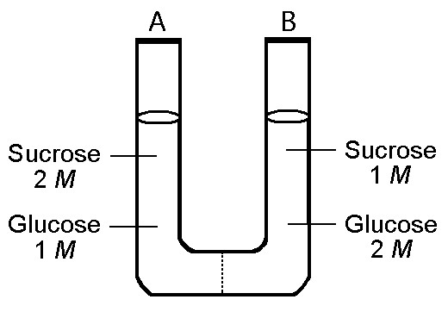
Draw/ Discuss this diagram with your table.
What is the initial tonicity of side A in respect to side B?
If the membrane is permeable to Sucrose Only, how will the solid molecules move? Eventually, which side will have a higher volume of water.

Slide 47
Osmoregulation
Cells have to constantly regulate water uptake and loss or there are consequences
Lysis occurs if too much water flows in (some cells have contractile vacuoles to cope with this) Animal cells only. https://www.youtube.com/watch?v=iG6Dd3COug4
Shriveling and dehydration occur if too much water is lost from the cell (plasmolysis in plant cells occurs when this happens and the PM pulls away from the cell wall)
SAT word: Crenation

Slide 48
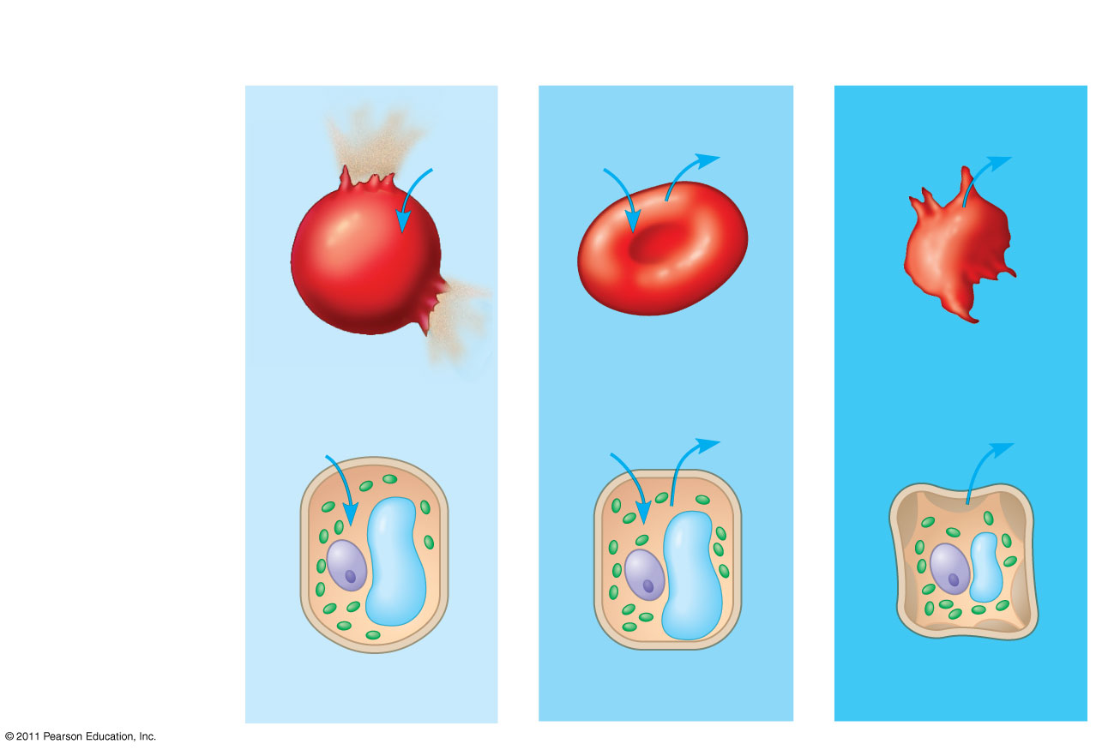
Figure 7.15
Hypotonic solution
Isotonic solution
Hypertonic solution
(a) Animal cell
H₂O
H₂O
H₂O
H₂O
Lysed
Normal
Shriveled
H₂O
Cell wall
H₂O
H₂O
H₂O
(b) Plant cell
Turgor Pressure
Plasmolysis
Osmosis
Notes:
Figure 7.15 The water balance of living cells.

Slide 49
Protein-Facilitated Diffusion
Some proteins can change shape (enzyme-style) when molecules that need transport bind to specific sites
Moves charged & large polar molecules through membrane
Carrier Proteins
Channel proteins are like tunnels connecting the outside of the cell with the inside
This is done with a concentration gradient and therefore requires no energy (passive transport)
Ex: Glucose movement

Slide 50
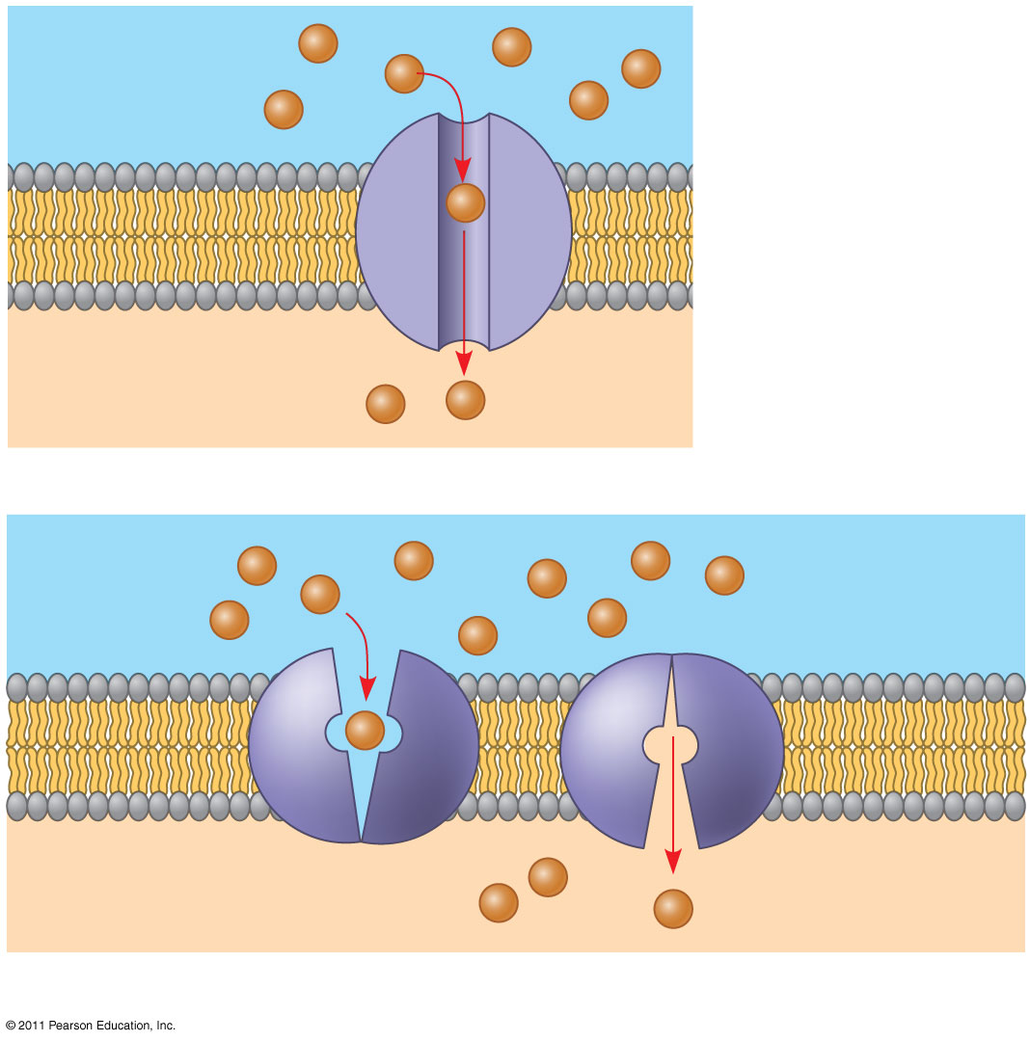
Figure 7.17
EXTRACELLULAR FLUID
(a) A channel protein
Channel protein
Solute
CYTOPLASM
Carrier protein
Solute
(b) A carrier protein
Notes:
Figure 7.17 Two types of transport proteins that carry out facilitated diffusion.

Slide 51
Active Transport
Goes against a concentration gradient
Moves things from areas of low concentration to high
Requires energy
May use proteins to move molecules OR vessicles
Ex:
Sodium/Potassium Pump (Na/K)
Exchanges Na for K
Endocytosis-cell takes in macromolecules & other particles by forming vesicles from the PM
Exocytosis-cell releases particles using internal vesicles (made by the Golgi) that fuse with PM to release contents out of cell

Slide 52
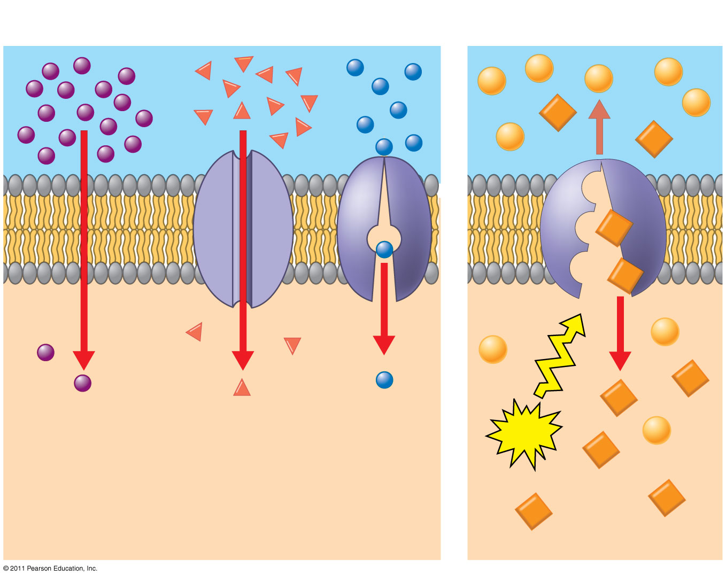
Figure 7.19
Passive transport
Active transport
Diffusion
Facilitated diffusion
ATP
Notes:
Figure 7.19 Review: passive and active transport.

Slide 53
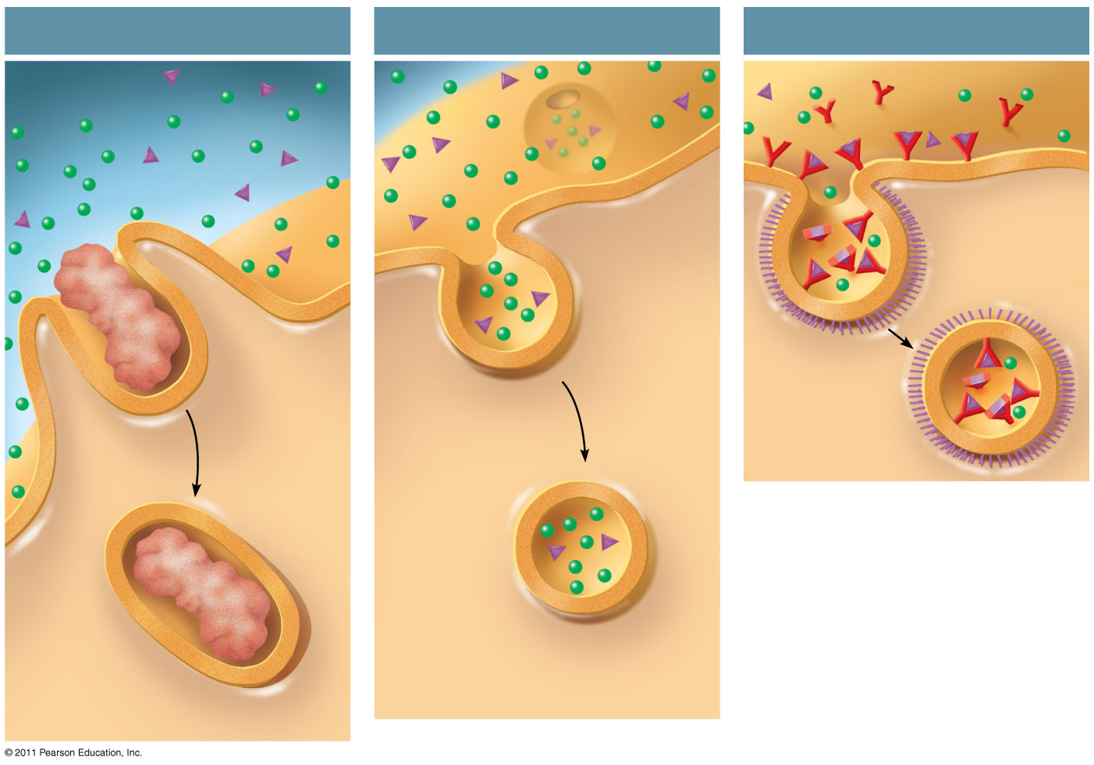
Figure 7.22
Phagocytosis
Pinocytosis
Receptor-Mediated Endocytosis
EXTRACELLULAR FLUID
Solutes
Pseudopodium
Receptor
Plasma membrane
Ligand
Coat proteins
Coated pit
“Food” or other particle
Coated vesicle
Vesicle
Food vacuole
CYTOPLASM
Notes:
Figure 7.22 Exploring: Endocytosis in Animal Cells

Slide 54
Water Potential
Water movement depends on the ‘water potential’- Water potential is the free energy per mole of water.
When water has a lot of
solids it does not want
to move.
When water has few
solids it is free
to move.
Solids “hold water back”. The solids make water potential more negative.

Slide 55
Water potential is calculated with two components:
Solute potential
= - iCRT
i=ionization constant-opportunity to ionize
C=molar concentration
R=pressure constant (.0831)
T=temperature in K (C + 273)
NEGATIVE!!!
Why? Because the more solids that are in water the less likely the water is to move. Think about a cell in salty water….
Pressure potential
Solutions in an open beaker have a pressure potential of zero.
Plant cells begin with a low pressure potential that increases as water moves into the cell due turgor pressure.
Add these factors to determine the water potential of a solution.
Pure water in an open beaker has a water potential = 0.
Water moves from higher potential to lower potential.

Slide 56
Practice #1
What is the solute potential of a 0.15 M solution of glucose at 25° C?
What is the water potential of the 0.15 M glucose solution in an open container with an atmospheric pressure of zero?

Slide 57
Practice #2
Calculate the solute potential of a 0.1 M NaCl solution at 25° C.
What is the water potential of this solution in an open beaker?
If the concentration of NaCl inside a plant cell is 0.15M, what is the water potential of that cell with a pressure potential of zero?
Which way will the water diffuse if this cell is placed into the 0.1 M NaCl solution?
If the water potentials are equal, the system will be at dynamic equilibrium. What must the turgor pressure in the cell build to if there is to be no net osmosis between the solution and the cell?

Slide 58
Lab Part II
Design your experiment! Have Mrs. Handest approve.
Set up to run over night. 24 hours.
We will collect data tomorrow and finish with Cell Communication for the QUEST.

Slide 59
Osmosis/Diffusion Lab Part 2: Solutions in Disguise
Day Two:
Collect data.
Put solutions in order and compare to Mrs. Handest’s concentrations.
Calculate Water Potential of all solutions.
Discuss lab posting.

Slide 60
Cell Communication Notes/ Interactions
Pathways with Friends
Summarize the activity by thinking about some of these conclusion questions:
How did you recognize where to go?
How does this model cell communication?
What effect did joining the pathway have on you?
What problems did you encounter?
What would have happened if someone did not do their job or simply were not present?

Slide 61
Cell Communication
Involves transduction of stimulatory or inhibitory signals from other cells, organisms or the environment
Believed to have evolved in prokaryotes and single-celled eukaryotes
Single-celled organisms
Bacteria use communication in quorum sensing
Short distance communication using local regulators
Secrete small moelcules that other bacteria can detect
Allows monitoring of local density of cells
Bacteria can then coordinate activities that are beneficial for a large number of cells
Ex: Fuzzy teeth(biofilm)

Slide 62
Cell Communication Articles: read like a detective/ Interactions
Highlight information on your articles that could be used to write a FULL answer the questions below. Paste the highlighted articles into your notebook
“What is Biofilm?”
Question: Why is it difficult to treat periodontal disease with
antibiotics? How could scientists adjust antibiotics to more completely address the problem?
“How can adrenaline help you lift a 3,500-pound car?”
Question: How has adrenaline production helped multicellular organisms survive?
AS A TABLE discuss the questions and your highlights. Write a group answer to both questions using the evidence from the articles, notes and your reasoning.
Put all names on the sheet and turn in to the substitute teacher.

Slide 63
Multicellular Organisms
Coordinate activities of individual cells to support function of organism as a whole
Ex: Epinephrine (adrenaline) stimulation of glycogen breakdown in animals
Epinephrine activates an enzyme for glycogen breakdown by contact with the cells
Provides immediate energy for cells
Allows for “fight or flight” response to take place
Cells communicate by cell-to-cell contact
Plasmodesmata of plant cells, gap junctions, surface of immunity cells
Have evolved the ability to do distance signaling
Endocrine system, Nerve synapse, Cell secretions
Ex: Insulin, HGH, Thyroid hormone, testosterone and estrogen

Slide 64
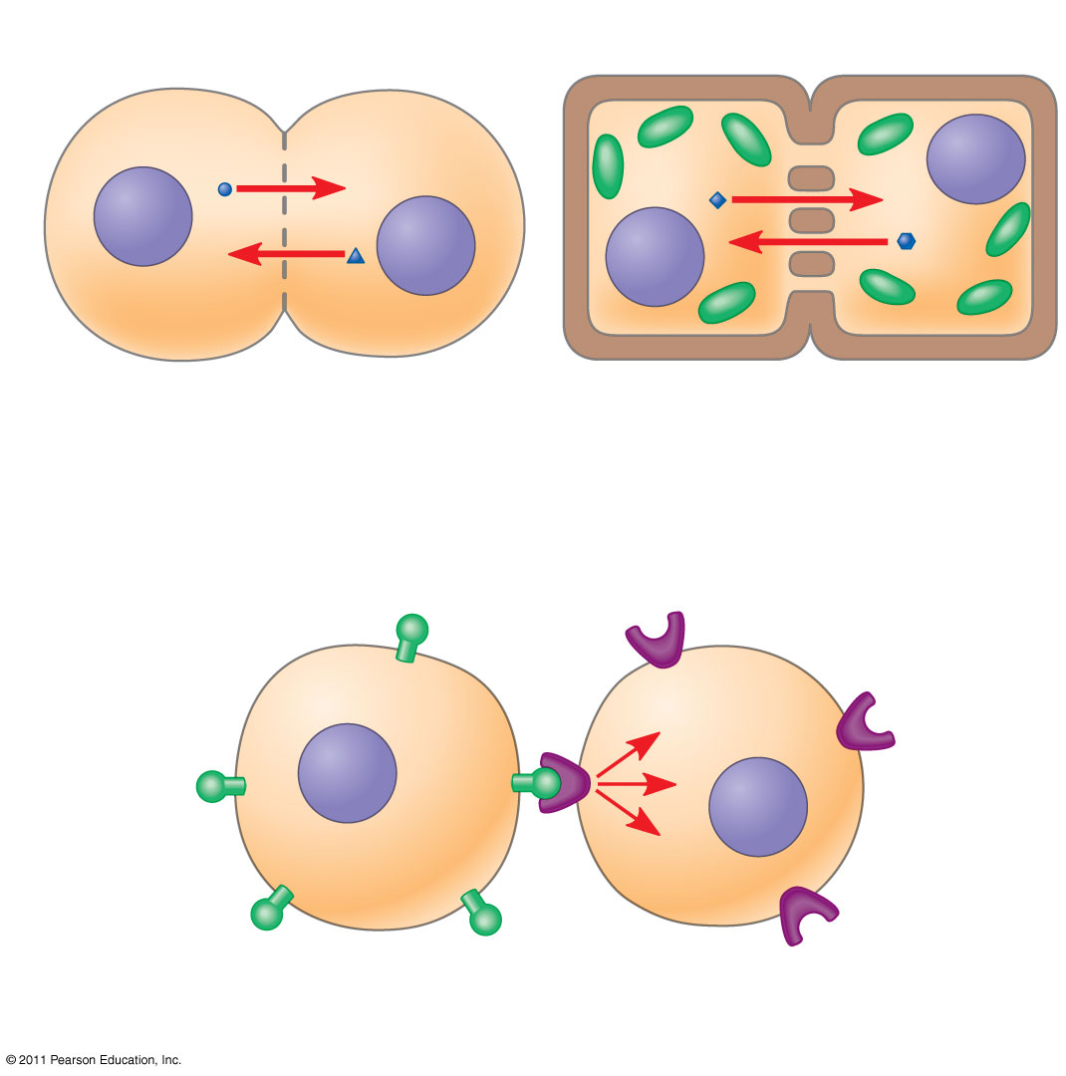
Figure 11.4
Plasma membranes
Gap junctions between animal cells
Plasmodesmata between plant cells
(a) Cell junctions
(b) Cell-cell recognition
Notes:
Figure 11.4 Communication by direct contact between cells.

Slide 65
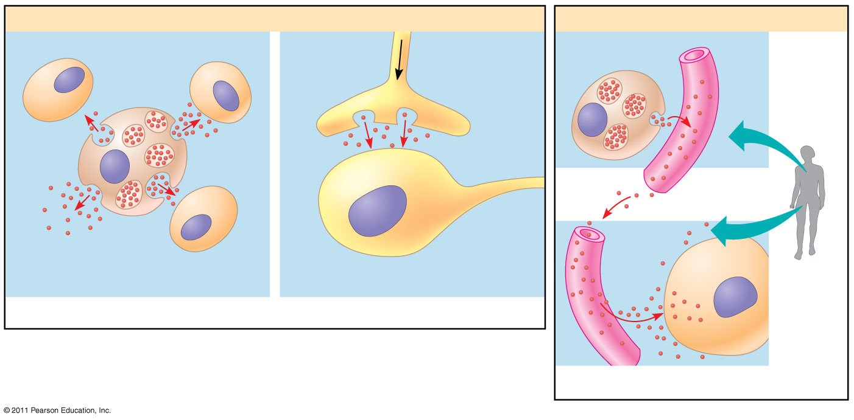
Figure 11.5
Local signaling
Long-distance signaling
Target cell
Electrical signal along nerve cell triggers release of neurotransmitter.
Endocrine cell
Blood vessel
Secreting cell
Secretory vesicle
Neurotransmitter diffuses across synapse.
Hormone travels in bloodstream.
Target cell specifically binds hormone.
Local regulator diffuses through extracellular fluid.
Target cell is stimulated.
(a) Paracrine signaling
(b) Synaptic signaling
(c) Endocrine (hormonal) signaling
Notes:
Figure 11.5 Local and long-distance cell signaling by secreted molecules in animals.

Slide 66
The 3 Stages of Cell Signaling
Reception
Signal is detected, usually by the membrane
Some receptors are found within the cell, so the signal molecule has to pass through the membrane to dock with the receptor (ex: testosterone)
Transduction (change)
The surface binding causes a change in the integral protein which initiates transduction inside the cell (can be 1-step, but more often involves multiple steps in a biochemical pathway)
Response
The signal triggers a cell’s response(usually some type of enzyme activity)
Ex: Lactose present in the body needs lactase to break it down

Slide 67
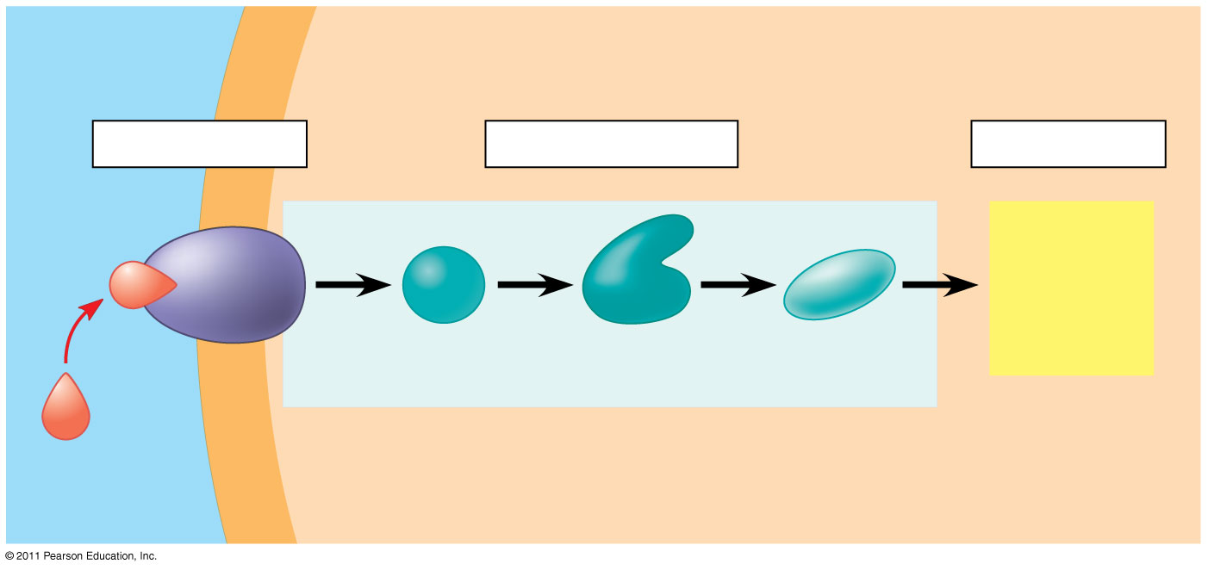
Figure 11.6-3
EXTRACELLULAR FLUID
CYTOPLASM
Plasma membrane
1
Reception
2
Transduction
3
Response
Receptor
Activation of cellular response
Relay molecules in a signal transduction pathway
Signaling molecule
Notes:
Figure 11.6 Overview of cell signaling.

Slide 68
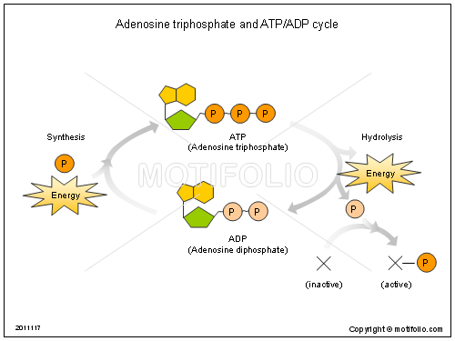
Pause to review ATP-needed for energy and to alter molecules in the pathway.

Slide 69
Receptors
Just as with enzymes, signaling molecule and receptor shape must be complimentary
Most receptors are plasma membrane proteins
Ligand=molecule that specifically binds to another molecule
This ligand binding generally causes a change in the shape of the protein receptor, enabling it to react with other cellular molecules
G- protein is a common type of protein receptor for cell signaling found in the membrane.
Some receptors are found within the cell, so the signal molecule has to pass through the membrane to dock with the receptor (ex: testosterone)

Slide 70
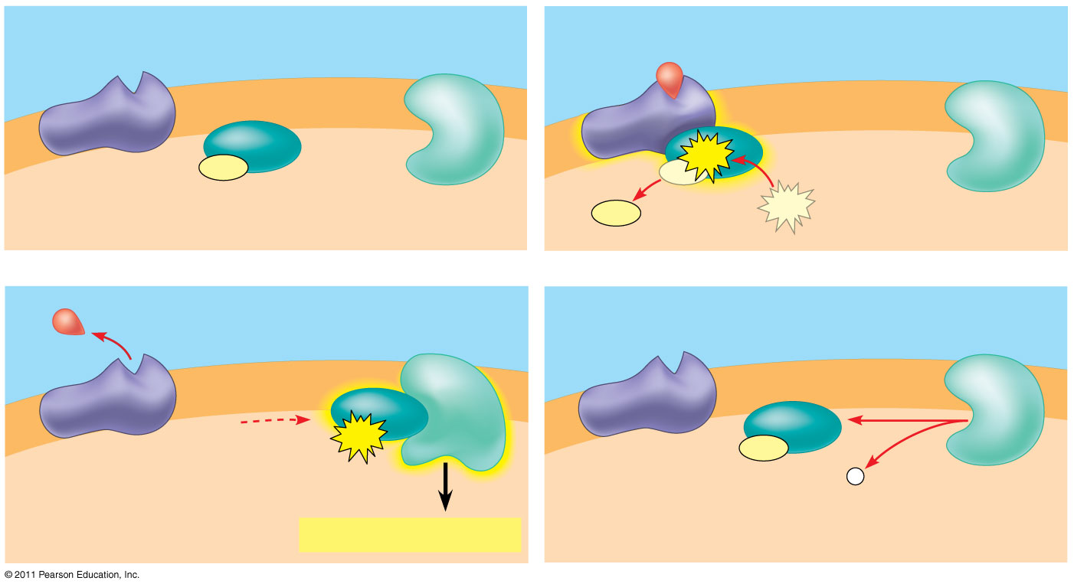
Figure 11.7b
G protein-coupled receptor
Plasma membrane
Activated receptor
Signaling molecule
Inactive enzyme
GDP
GTP
CYTOPLASM
GDP
G protein (inactive)
Enzyme
GDP
GTP
1
2
Activated enzyme
GTP
GDP
P _{i}
3
Cellular response
4
Notes:
Figure 11.7 Exploring: Cell-Surface Transmembrane Receptors

Slide 71
Pause to review ATP-needed for energy and to alter molecules in the pathway.

Slide 72
Signal Transduction Pathways
Protein Phosphorylation and Dephosphorylation (moving phosphorous)
Protein kinase transfers phosphate groups from ATP(energy) to a protein which activates the protein, causing the next step in the pathway until the correct protein is activated
Turned off by special enzymes called protein phosphatases, which later remove the phosphates from the protein
Second Messengers
Small molecules or ions that are not proteins in the pathway and can be triggered inside the cell once reception occurs
Ex: cAMP (in the liver cells for the breakup of glycogen), Ca ²⁺ (muscle cell contractions, secretion, cell division)

Slide 73
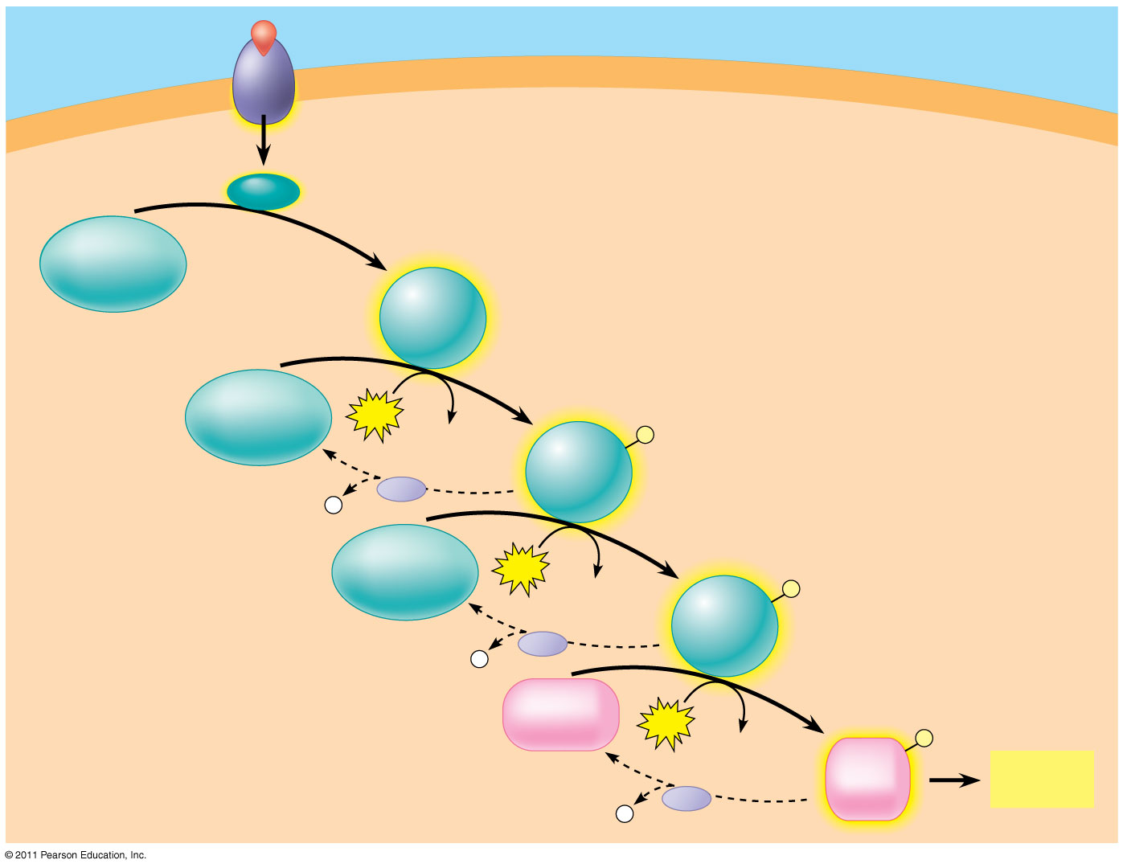
Figure 11.10
Signaling molecule
Receptor
Activated relay molecule
Inactive protein kinase 1
Active protein kinase 1
Inactive protein kinase 2
ATP
Phosphorylation cascade
ADP
Active protein kinase 2
P
P _{i}
PP
Inactive protein kinase 3
ATP
ADP
Active protein kinase 3
P
P _{i}
PP
Inactive protein
ATP
P
ADP
Active protein
Cellular response
P _{i}
PP
Notes:
Figure 11.10 A phosphorylation cascade.

Slide 74
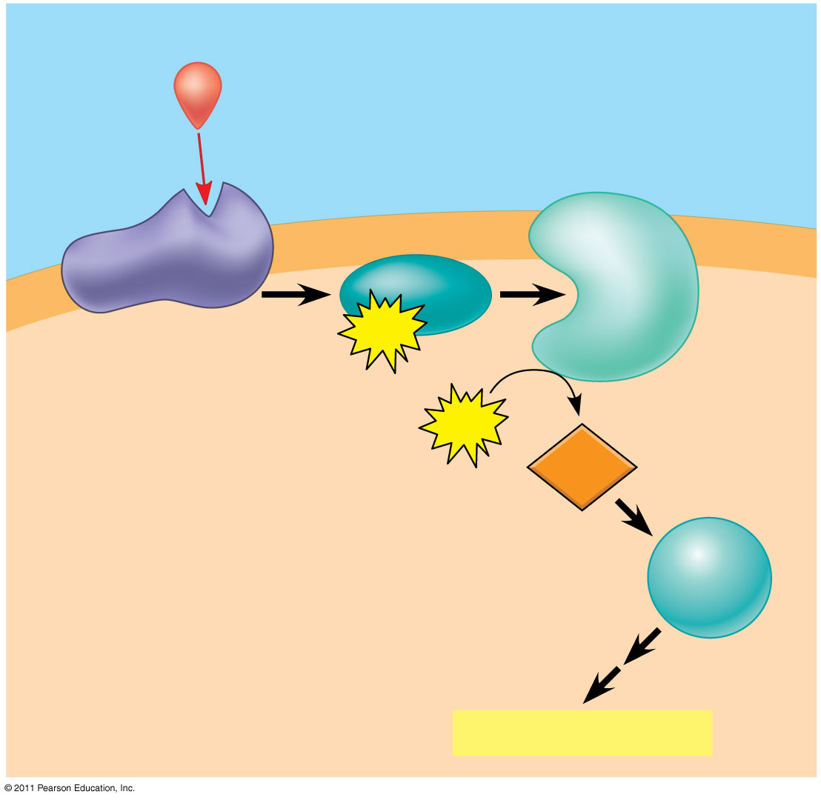
Figure 11.12
First messenger (signaling molecule such as epinephrine)
Adenylyl cyclase
G protein
G protein-coupled receptor
GTP
ATP
Second messenger
cAMP
Protein kinase A
Cellular responses
Notes:
Figure 11.12 cAMP as a second messenger in a G protein signaling pathway.

Slide 75
Signal Problems
If signal reception or transduction is blocked or defective:
Diseases can result
Diabetes, heart disease, autoimmune diseases, cancer
Drugs, toxins, poisons, pesticides, UV radiation can alter signal reception and/or transduction
Ex: anesthetics, antihistamines, venomous snake bites, illicit drugs

Slide 76
Cell Signaling Activity- 25 pts. (not in notebook)
Each person selects one activity to complete:
Create a comic strip demonstrating either cell-to-cell contact OR an example of distance signaling. Comic must be informational.
Writing! Write about a time when one action triggered a chain of events. Describe the stimulus and the events that followed. Be specific. What was the ultimate outcome? Diagram the story using pictures to show each event. Relate each section of your story to the 3 stages of cell signaling.
Create a “how to” poster for an endocrine hormone such as adrenaline that is new to the system. This poster should describe the function, pathway and response for your selected hormone. Specific hormone research may be needed.

Slide 77
Cellular Responses
Responses are triggered either in the nucleus (triggering transcription-making proteins) or cytoplasm (regulating the proteins’ activities)
Fine-tuning the response
Amplification-cascades where each step produces a greater concentration of activated products
Specificity of proteins-
Ex: Epinephine has one effect on the heart and another on the liver because each cell type has different proteins that respond to epinephrine
Liver breaks down glycogen, heart contracts muscles

Slide 78
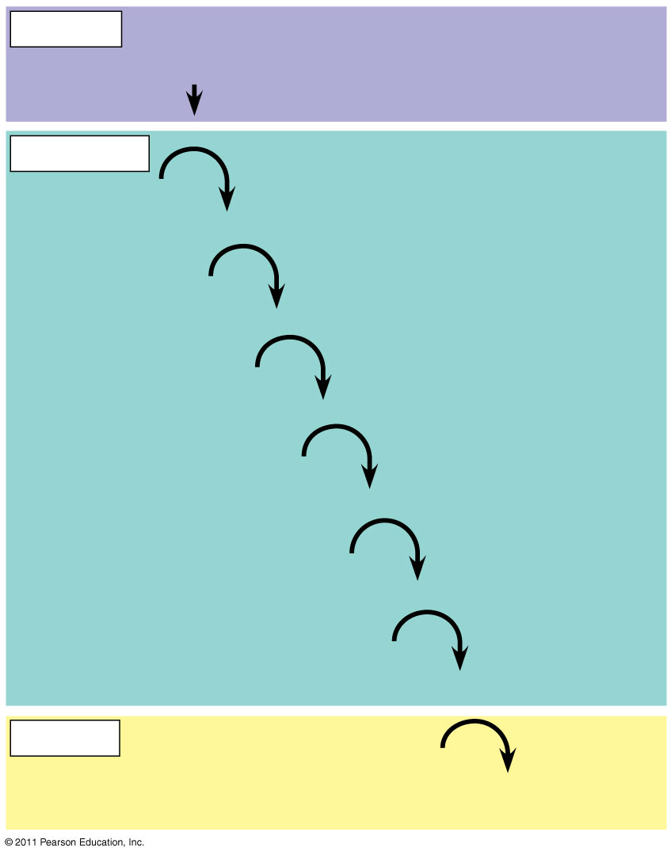
Figure 11.16
Reception
Binding of epinephrine to G protein-coupled receptor (1 molecule)
Transduction
Inactive G protein
Active G protein (10² molecules)
Inactive adenylyl cyclase
Active adenylyl cyclase (10²)
ATP
Cyclic AMP (10⁴)
Inactive protein kinase A
Active protein kinase A (10⁴)
Inactive phosphorylase kinase
Active phosphorylase kinase (10⁵)
Inactive glycogen phosphorylase
Active glycogen phosphorylase (10⁶)
Response
Glycogen
Glucose 1-phosphate (10⁸ molecules)
Notes:
Figure 11.16 Cytoplasmic response to a signal: the stimulation of glycogen breakdown by epinephrine.

Slide 79
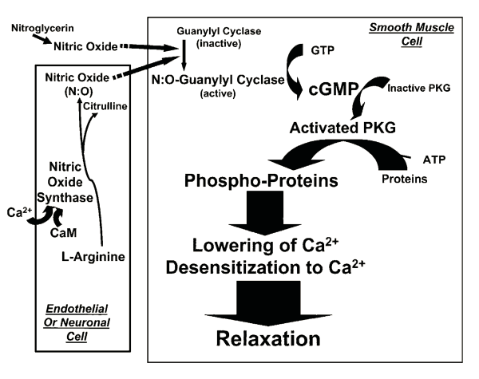
Figure 11.12
First messenger (signaling molecule such as epinephrine)
Adenylyl cyclase
G protein
GTP
ATP
G protein-coupled receptor
cAMP
Second messenger
Protein kinase A
Cellular response
My dog is broken.
Notes:
Figure 11.12 cAMP as a second messenger in a G protein signaling pathway.

Slide 80
Homework for tonight:
Use one of the following websites, edmodo notes or your book to draw a cell in each stage of mitosis.
Cellsalive.com
Biology.arizona.edu
Add these pictures to your cell cycle pie chart page.

Slide 81
The Cell Cycle
Interphase
Cell growth
Replication of chromosomes in prep for Mitosis
DNA replicated
More cell growth and prep for mitosis
Mitosis
Helps with growth, repair and asexual reproduction in cells
Alternates with Interphase
Mitotic spindle fibers form (centrioles in animal cells only) and attach at kinetochore (centromere and corresponding DNA Segment)
Chromosomes migrate to the equator of the cell(metaphase plate)
Kinetochore microtubules shorten, pulling chromosomes apart
Ends with pinching in of plasma membrane, new nuclei form(2 daughter nuclei, each has 2n l-shaped chromosomes & is identical to parent cell)
Cytokinesis-final stage. In plants, a cell plate forms between the daughter cells, dividing them (results in 2 identical cells)

Slide 82
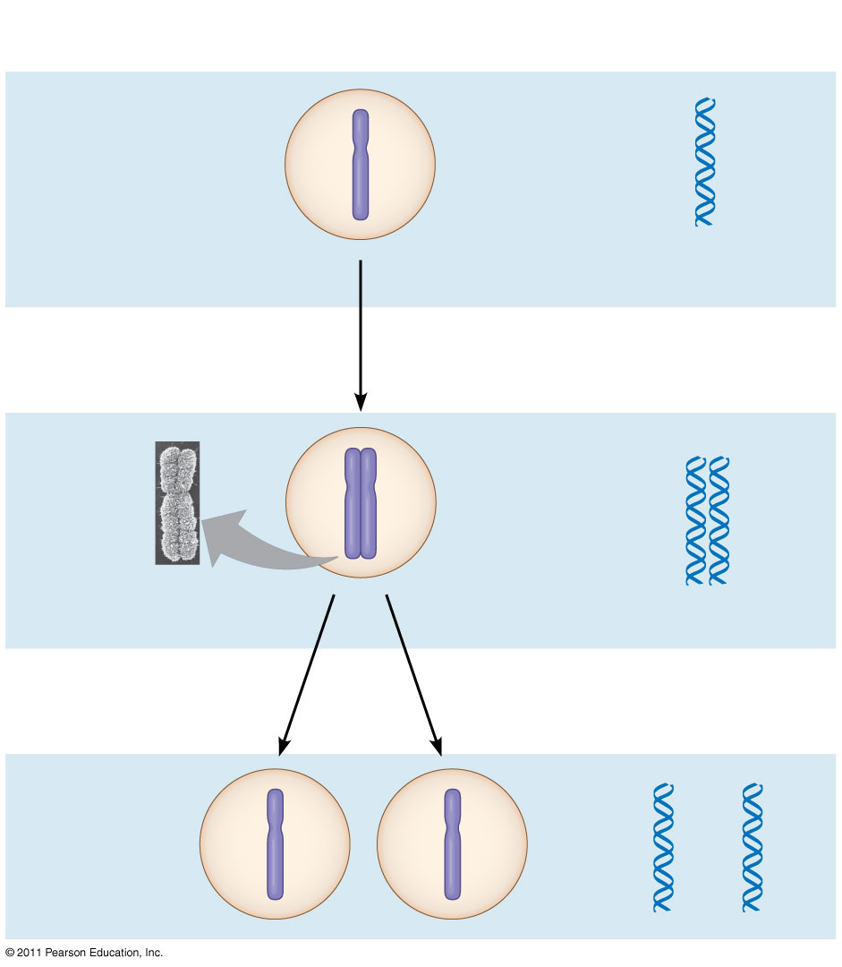
Figure 12.5-3
Chromosomal DNA molecules
Chromosomes
1
Centromere
Chromosome arm
Chromosome duplication (including DNA replication) and condensation
2
Sister chromatids
Separation of sister chromatids into two chromosomes
3
Notes:
Figure 12.5 Chromosome duplication and distribution during cell division.

Slide 84
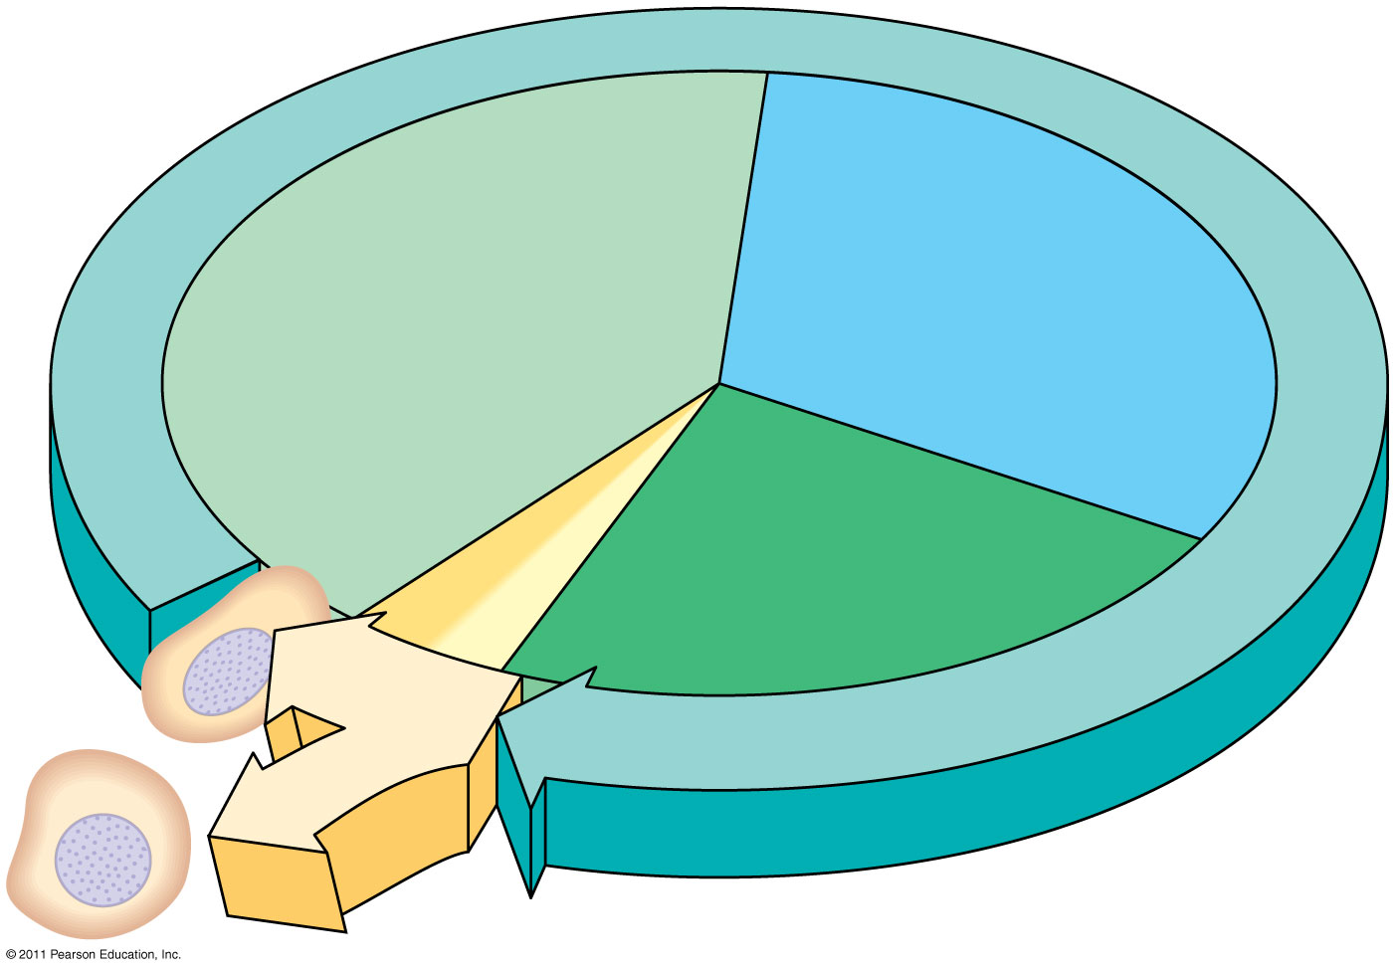
INTERPHASE
S (DNA synthesis)
G₁
G₂
Cytokinesis
Mitosis
MITOTIC (M) PHASE
Notes:
Figure 12.6 The cell cycle.

Slide 85
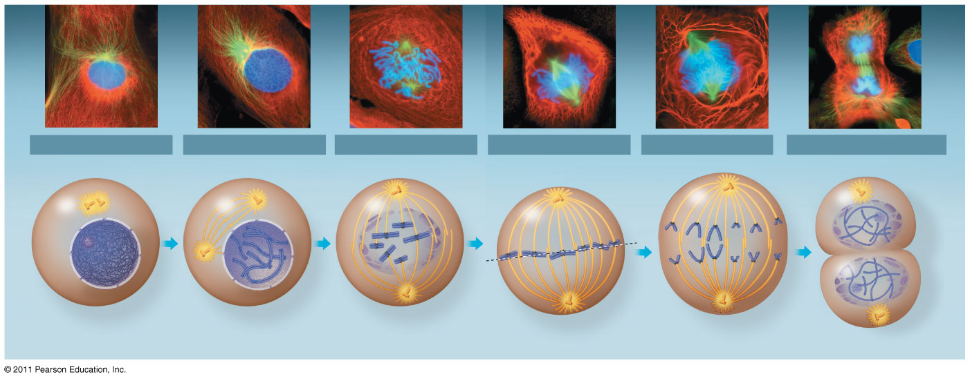
Figure 12.7
10 μm
G₂ of Interphase
Prophase
Prometaphase
Metaphase
Anaphase
Telophase and Cytokinesis
Centrosomes (with centriole pairs)
Chromatin (duplicated)
Early mitotic spindle
Aster
Fragments of nuclear envelope
Nonkinetochore microtubules
Metaphase plate
Cleavage furrow
Nucleolus forming
Centromere
Nucleolus
Nuclear envelope
Plasma membrane
Chromosome, consisting of two sister chromatids
Kinetochore
Kinetochore microtubule
Nuclear envelope forming
Spindle
Centrosome at one spindle pole
Daughter chromosomes
Notes:
Figure 12.7 Exploring: Mitosis in an Animal Cell

Slide 86
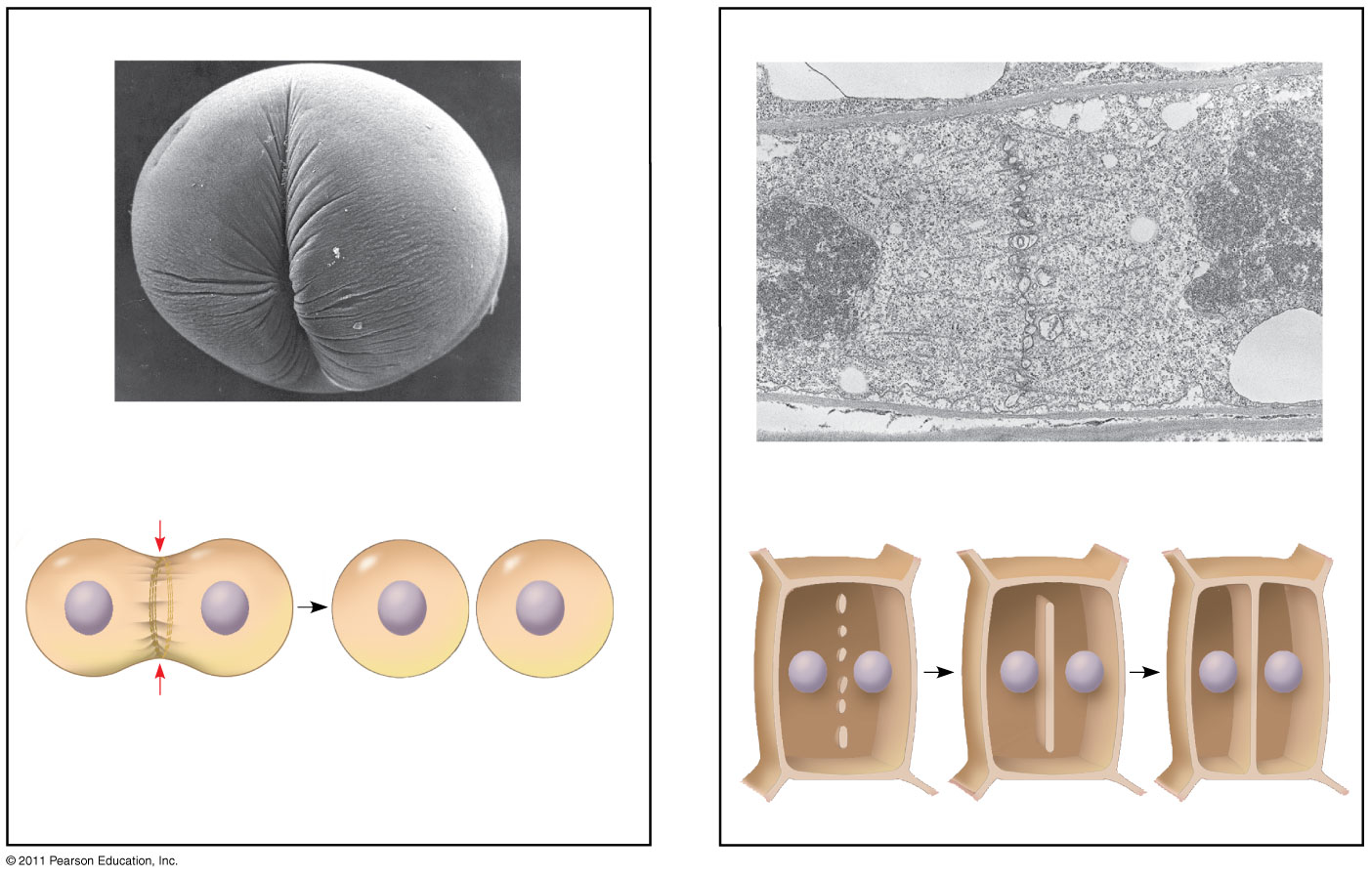
Figure 12.10
(a) Cleavage of an animal cell (SEM)
(b) Cell plate formation in a plant cell (TEM)
100 μm
Cleavage furrow
Vesicles forming cell plate
Wall of parent cell
1 μm
Cell plate
New cell wall
Contractile ring of microfilaments
Daughter cells
Daughter cells
Notes:
Figure 12.10 Cytokinesis in animal and plant cells.

Slide 87
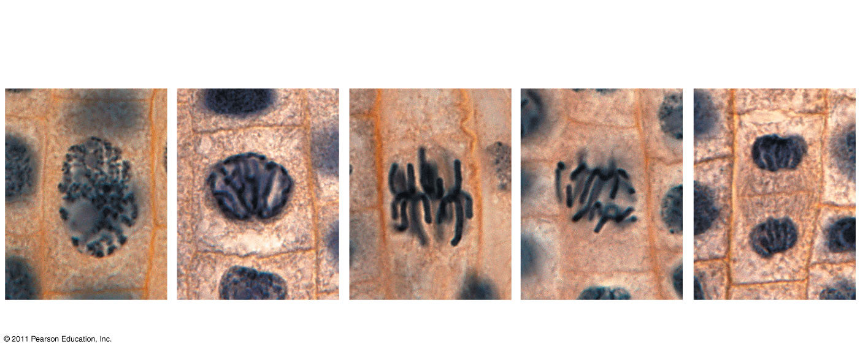
Figure 12.11
Chromatin condensing
Nucleus
Nucleolus
Chromosomes
10 μm
Cell plate
1
Prophase
2
Prometaphase
3
Metaphase
4
Anaphase
5
Telophase
Notes:
Figure 12.11 Mitosis in a plant cell.

Slide 88
Controlling the cell cycle
Cells divide at different rates. Some cells do not divide regularly but can enter cell cycle when given appropriate signals
Ex: Liver Cells
Internal Controls or Checkpoints
Molecule cycling system for regulation
Checkpoints-points in the cycle where the cell is halted until the “go ahead” chemical signal is given
Also, called the “cell cycle clock”
Cell Cycle clock
Cyclin-dependent kinases (Cdks): enzymes for cell division that need cyclin (another protein) to be active
Mitosis activity rises & falls with changes in concentration of cyclin
MPF (mitosis promoting factor): Cyclins accumulate during interphase, making Cdks activate which initiate Mitosis. This is turned off during mitosis when proteolytic enzymes break down the cyclin, allowing the cell to proceed through telophase.

Slide 89
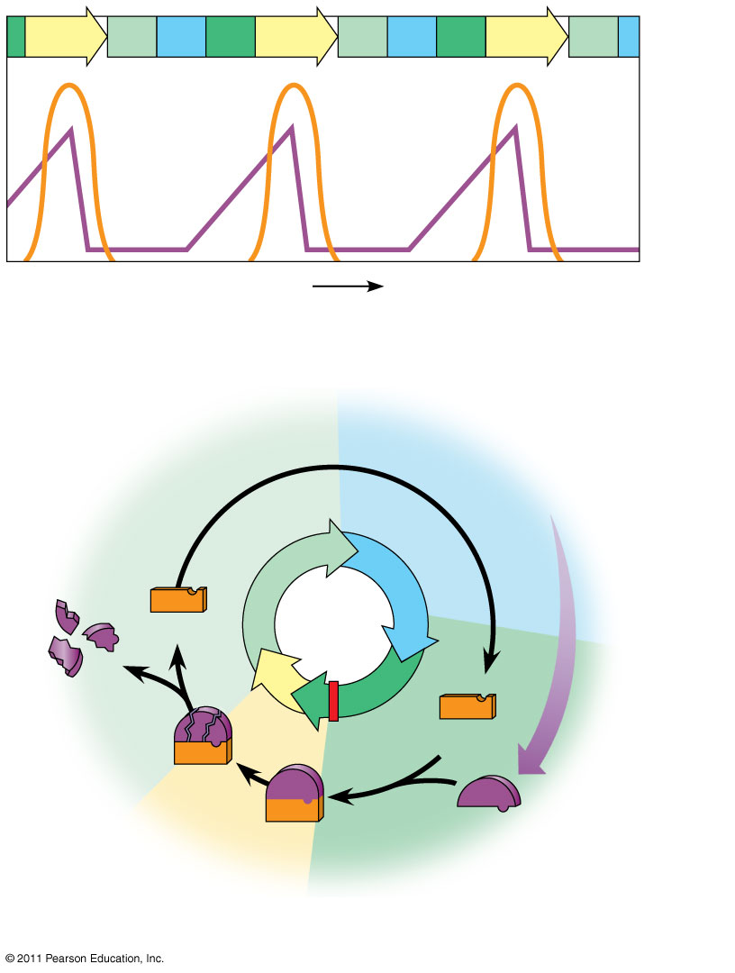
Figure 12.17
M
G₁
S
G₂
M
G₁
S
G₂
M
G₁
MPF activity
Cyclin concentration
Time
(a) Fluctuation of MPF activity and cyclin concentration during the cell cycle
G₁
S
Cdk
Cyclin accumulation
Degraded cyclin
M
G₂
G₂ checkpoint
Cdk
Cyclin is degraded
MPF
Cyclin
(b) Molecular mechanisms that help regulate the cell cycle
Notes:
Figure 12.17 Molecular control of the cell cycle at the G₂ checkpoint.

Slide 90
Where do the signals come from???
Internal Cues: Cyclin is produced on a regular basis within the cell based on the DNA utilized in that cell.
External Cues
Growth factors released from other body cells
Ex: PDGF (platelet-derived growth factor)
Experiments have shown it is necessary for division of connective tissue cells
Cells have receptors on surface that bind PDGF molecules
Density-dependent inhibition
Crowded cells stop dividing
Binding of cell surface protein to another cell send growth inhibition signal to both cells

Slide 91
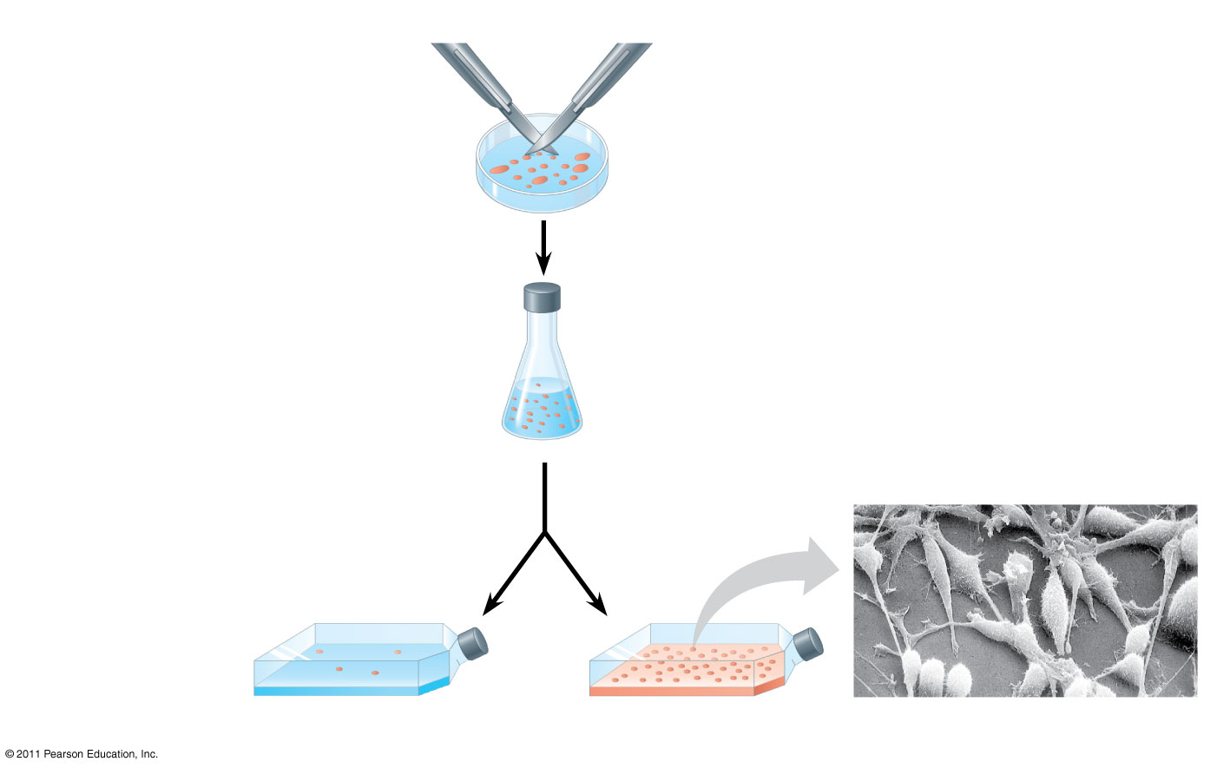
Figure 12.18
1
A sample of human connective tissue is cut up into small pieces.
Scalpels
Petri dish
2
Enzymes digest the extracellular matrix, resulting in a suspension of free fibroblasts.
4
PDGF is added to half the vessels.
10 μm
3
Cells are transferred to culture vessels.
Without PDGF
With PDGF
Notes:
Figure 12.18 The effect of platelet-derived growth factor (PDGF) on cell division.

Slide 92
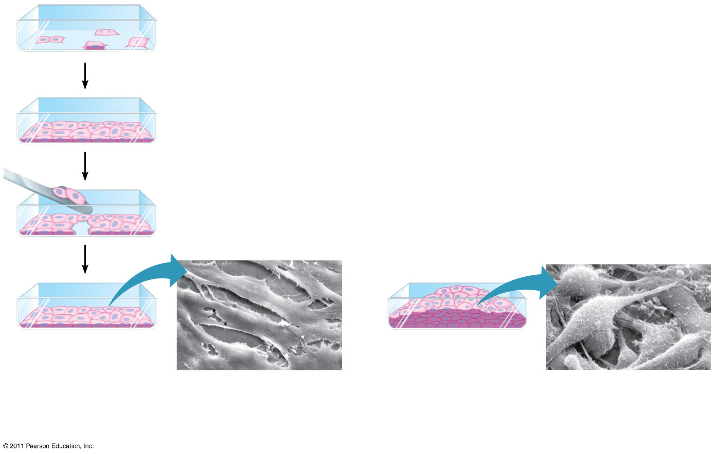
Figure 12.19
Anchorage dependence
Density-dependent inhibition
Density-dependent inhibition
20 μm
20 μm
(a) Normal mammalian cells
(b) Cancer cells
Notes:
Figure 12.19 Density-dependent inhibition and anchorage dependence of cell division.

Slide 93
Cancer
Cells that are cancerous do not respond to the cell’s normal controls of the cell cycle
Usually involves a change in genes that regulate the necessary proteins
Some cancerous cells divide continuously and spread easily, while others stop completely at one of the various checkpoints
Cancers can transform adjacent cells to form tumors
Benign=cells remain unchanged within the tumor
Malignant=tumor becomes invasive and impairs the organ’s function
If cells break away from the tumor and spread through the blood stream, we say they metastasize
If a tumor appears localized it is treated with radiation, once it has metastasized chemotherapy is usually used

Slide 94
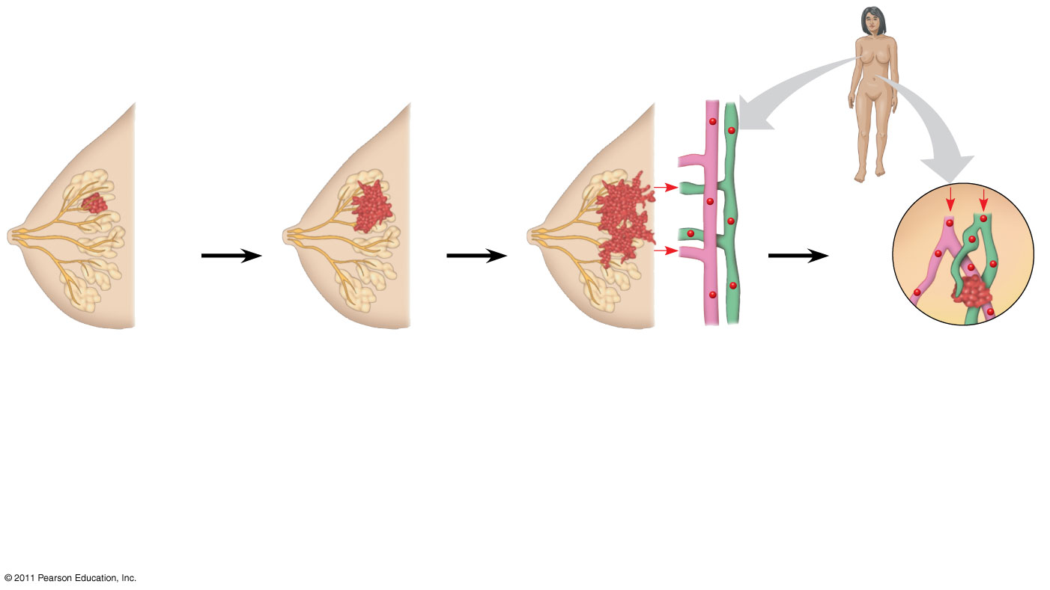
Figure 12.20
Lymph vessel
Tumor
Blood vessel
Glandular tissue
Cancer cell
Metastatic tumor
1
A tumor grows from a single cancer cell.
2
Cancer cells invade neighboring tissue.
3
Cancer cells spread through lymph and blood vessels to other parts of the body.
4
Cancer cells may survive and establish a new tumor in another part of the body.
Notes:
Figure 12.20 The growth and metastasis of a malignant breast tumor.

Slide 95
Cancer Across Cultures Part B
As a table, make a cancer awareness poster for the ethnic group that your table was assigned. Be sure to include the most common types of cancer(s) for that ethnic group, list signs/symptoms of that cancer, risk factors for that type of cancer, and what people can do to minimize the risks of life-threatening cancers.
Posters should be informative, intriguing and appealing while also being respectful to the focus group.

