Slide 1
Cell Communication
Involves transduction of stimulatory or inhibitory signals from other cells, organisms or the environment
Believed to have evolved in prokaryotes and single-celled eukaryotes
Single-celled organisms
Bacteria use communication in quorum sensing
Short distance communication using local regulators
Secrete small molecules that other bacteria can detect
Allows monitoring of local density of cells
Bacteria can then coordinate activities that are beneficial for a large number of cells
Ex: Fuzzy teeth(biofilm)

Slide 2
Cell Communication Articles: Read like a detective/ Interactions
Highlight information on your articles that could be used to write a FULL answer the questions below.
“What is Biofilm?”
Question: Why is it difficult to treat periodontal disease with
antibiotics? How could scientists adjust antibiotics to more completely address the problem?
“How can adrenaline help you lift a 3,500-pound car?”
Question: How has adrenaline production helped multicellular organisms survive?
10 minutes

Slide 3
AS A TABLE discuss the questions and your highlights.
Write a group answer to both questions using the evidence from the articles, notes and your reasoning.
Put all names on the sheet, staple to the articles, turn in!
“What is Biofilm?”
Question: Why is it difficult to treat periodontal disease with
antibiotics? How could scientists adjust antibiotics to more completely address the problem?
“How can adrenaline help you lift a 3,500-pound car?”
Question: How has adrenaline production helped multicellular organisms survive?
10 minutes

Slide 4
Multicellular Organisms
Coordinate activities of individual cells to support function of organism as a whole
Ex: Epinephrine (adrenaline) stimulation of glycogen breakdown in animals
Epinephrine activates an enzyme for glycogen breakdown by contact with the cells
Provides immediate energy for cells
Allows for “fight or flight” response to take place
Cells communicate by cell-to-cell contact
Plasmodesmata of plant cells, gap junctions, surface of immunity cells
Have also evolved the ability to do distance signaling
Endocrine system, Nerve synapse, Cell secretions
Ex: Insulin, HGH, Thyroid hormone, testosterone and estrogen

Slide 5
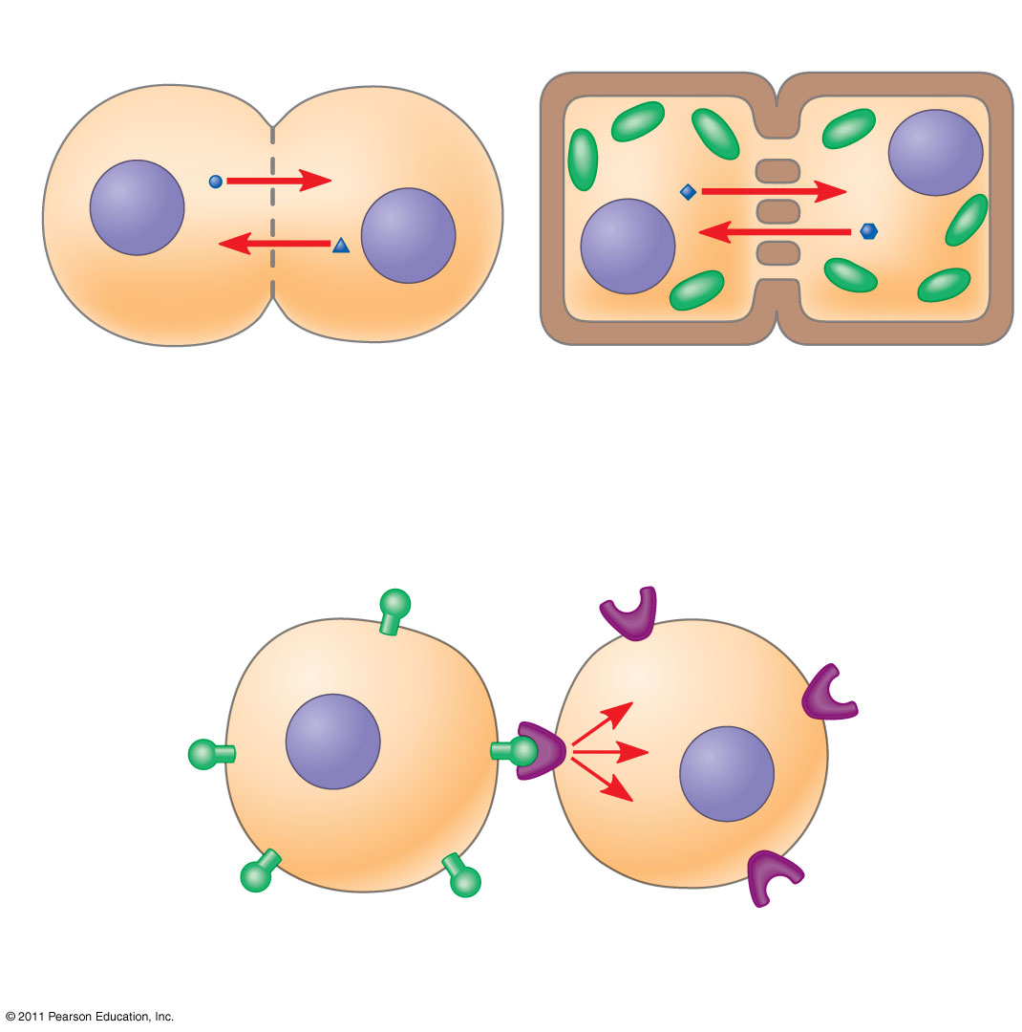
Figure 11.4
Plasma membranes
Gap junctions between animal cells
Plasmodesmata between plant cells
(a) Cell junctions
(b) Cell-cell recognition
Notes:
Figure 11.4 Communication by direct contact between cells.

Slide 6
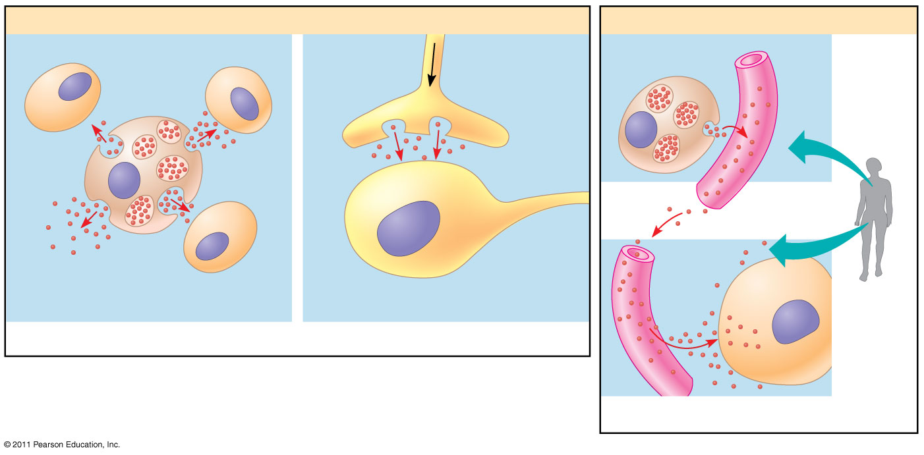
Figure 11.5
Local signaling
Long-distance signaling
Target cell
Electrical signal along nerve cell triggers release of neurotransmitter.
Endocrine cell
Blood vessel
Secreting cell
Secretory vesicle
Neurotransmitter diffuses across synapse.
Hormone travels in bloodstream.
Target cell specifically binds hormone.
Local regulator diffuses through extracellular fluid.
Target cell is stimulated.
(a) Paracrine signaling
(b) Synaptic signaling
(c) Endocrine (hormonal) signaling
Notes:
Figure 11.5 Local and long-distance cell signaling by secreted molecules in animals.

Slide 7
The 3 Stages of Cell Signaling
Reception
Signal is detected, usually by the membrane
Transduction (change)
The surface binding causes a change in the integral protein which initiates transduction inside the cell (can be 1-step, but more often involves multiple steps in a biochemical pathway)
Response
The signal triggers a cell’s response(usually some type of enzyme activity)
Ex: Lactose present in the environment needs lactase to break it down

Slide 8
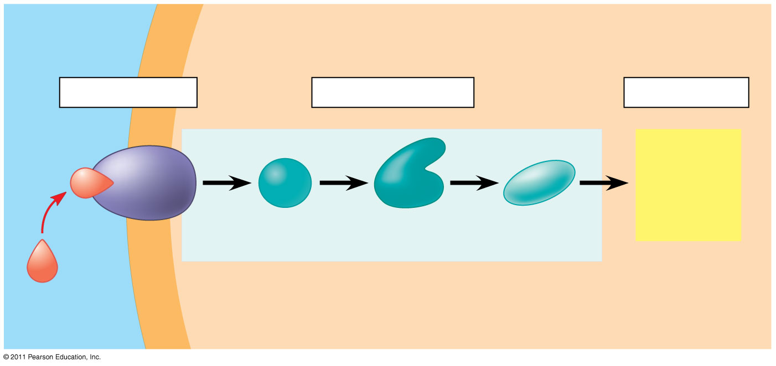
Figure 11.6-3
EXTRACELLULAR FLUID
CYTOPLASM
Plasma membrane
1
Reception
2
Transduction
3
Response
Receptor
Activation of cellular response
Relay molecules in a signal transduction pathway
Signaling molecule
Notes:
Figure 11.6 Overview of cell signaling.

Slide 9
Pathways with Friends
Conclusion Questions:
How did you recognize where to go?
How does this model cell communication?
What effect did joining the pathway have on you?
What problems did you encounter?
What would have happened if someone did not do their job or simply were not present?

Slide 10
Receptors
Just as with enzymes, signaling molecule and receptor shape must be complimentary
Most receptors are plasma membrane proteins
This binding generally causes a change in the shape of the protein receptor, enabling it to react with other cellular molecules
G- protein is a common type of protein receptor for cell signaling found in the membrane.
Some receptors are found within the cell, so the signal molecule has to pass through the membrane to dock with the receptor (ex: testosterone)

Slide 11
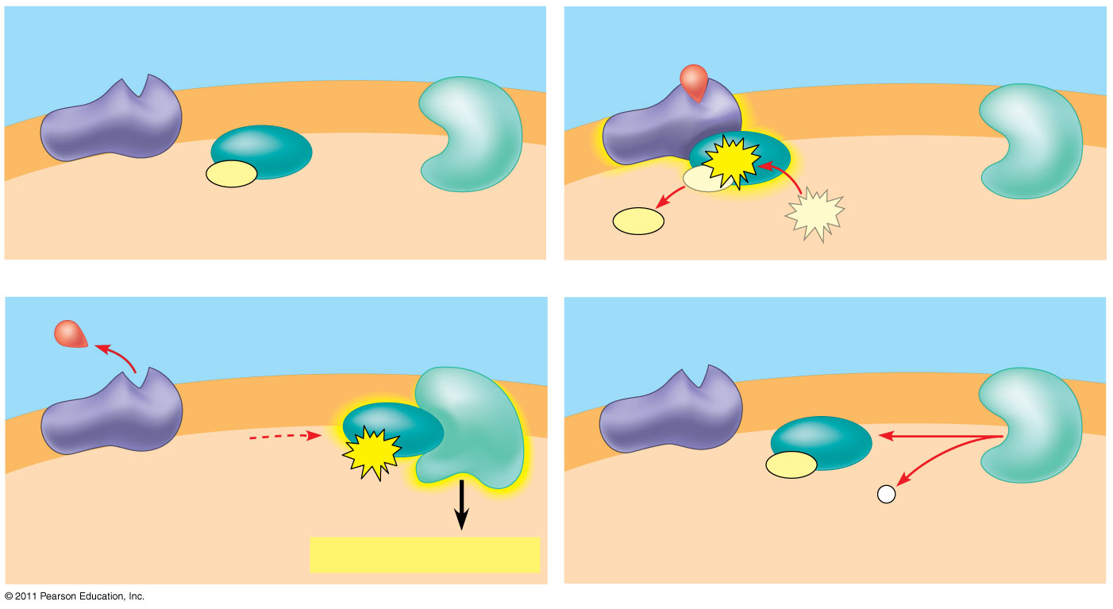
Figure 11.7b
G protein-coupled receptor
Plasma membrane
Activated receptor
Signaling molecule
Inactive enzyme
GDP
GTP
CYTOPLASM
GDP
G protein (inactive)
Enzyme
GDP
GTP
1
2
Activated enzyme
GTP
GDP
P _{i}
3
Cellular response
4
Notes:
Figure 11.7 Exploring: Cell-Surface Transmembrane Receptors

Slide 12
Signal Transduction Pathways
Protein Phosphorylation and Dephosphorylation (moving phosphorous) usually for energy.
Breaking down and creating molecules in a pathway until a desired product is created.(remember enzyme diagrams?)
May Use…
Second Messengers
Small molecules or ions that are not proteins in the pathway and can be triggered inside the cell once reception occurs
Ex: cAMP (in the liver cells for the breakup of glycogen), Ca ²⁺ (muscle cell contractions, secretion, cell division)

Slide 13
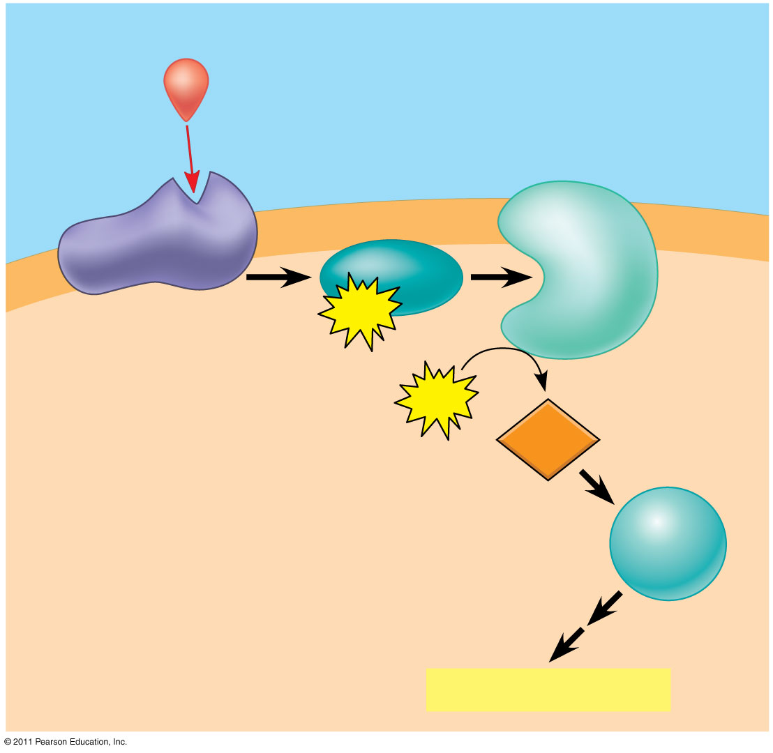
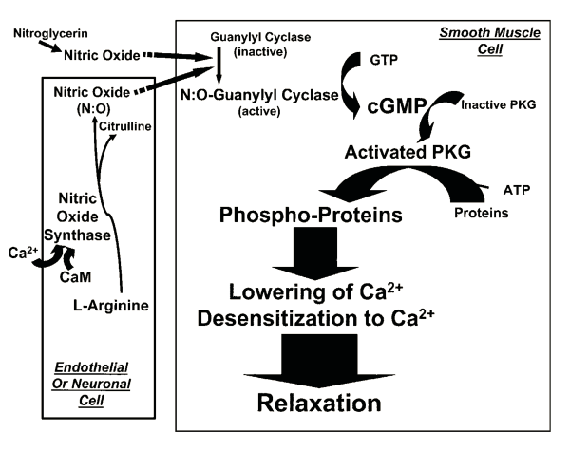
Figure 11.12
First messenger (signaling molecule such as epinephrine)
Adenylyl cyclase
G protein
GTP
ATP
G protein-coupled receptor
cAMP
Second messenger
Protein kinase A
Cellular response
My dog is broken.
Notes:
Figure 11.12 cAMP as a second messenger in a G protein signaling pathway.

Slide 14
Signal Problems
If signal reception or transduction is blocked or defective:
Diseases can result
Diabetes, heart disease, autoimmune diseases, cancer
Drugs, toxins, poisons, pesticides, UV radiation can alter signal reception and/or transduction
Ex: anesthetics, antihistamines, venomous snake bites, illicit drugs

Slide 15
Cell Signaling Activity- 25 pts.
Each person selects one activity to complete:
Create a comic strip demonstrating either cell-to-cell contact OR an example of distance signaling. Comic must be informational.
Writing! Write about a time when one action triggered a chain of events. Describe the stimulus and the events that followed. Be specific. What was the ultimate outcome? Diagram the story using pictures to show each event. Relate each section of your story to the 3 stages of cell signaling.
Create a “how to” poster for an endocrine hormone such as adrenaline that is new to the system. This poster should describe the function, pathway and response for your selected hormone.

