Slide 1
Atomic Interactions
Bonding, to get the octet
The interactions that make bonds are called chemical reactions and have reactants (left side of the arrow) and products (right side of the arrow)
Molecule= simplest part of a compound
Chemical formula: ex: CH₄
Ionic bonds=Ions are formed due to sharing of electrons. ATTRACTION!
Covalent bonds= Sharing electrons
Involve only 1 type of atom b/c have the same electron affinity
Polar-covalent bonds= Sharing electrons
Involve different types of atoms b/c have different electronegativities (attraction of an atom for e- of a covalent bond)

Slide 2
Weak Atomic Interactions
Necessary for most chemical signaling between cells
Ionic Bond
Hydrogen bond=Occurs when H is covalently bonded to N or O (usually) and is attracted to the electronegative part of another molecule
Van der Waals interactions=as electrons move, even in non-polar molecules, attraction points occur because of temporary polarity
EX: Gecko walking up walls

Slide 3
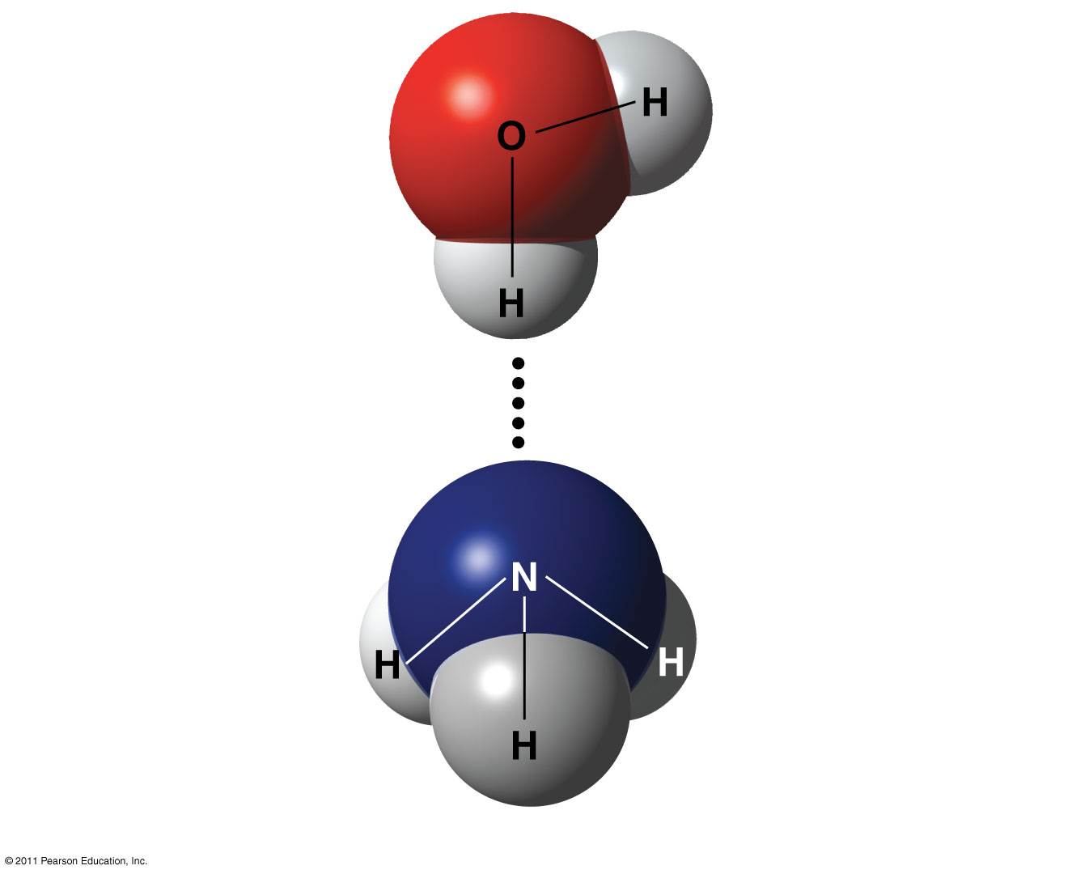
Figure 2.16
δ–
δ+
Water (H₂O)
δ+
Hydrogen bond
δ–
Ammonia (NH₃)
δ+
δ+
δ+
Notes:
Figure 2.16 A hydrogen bond.

Slide 4
Consequences of Weak Atomic interactions-Water Properties
Water is a polar molecule
Overall charge is unevenly distributed
Water’s “bent” geometry allows for hydrogen bonding-Note: this is NOT a covalent bond! It’s a special case of an interaction in which the partial + H is attracted to the electrons orbiting the O on the other water molecule (just as Na+ is attracted to Cl-)
This tends to make water “sticky,” giving it unique properties

Slide 5
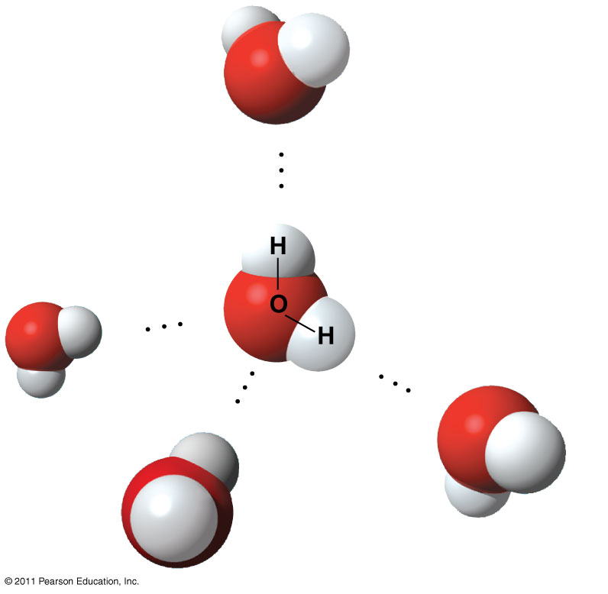
Figure 3.2
δ
−
Hydrogen
bond
δ
+
Polar covalent
bonds
δ
+
δ
−
δ
−
δ
+
+
δ
−
δ
Notes:
Figure 3.2 Hydrogen bonds between water molecules.

Slide 6
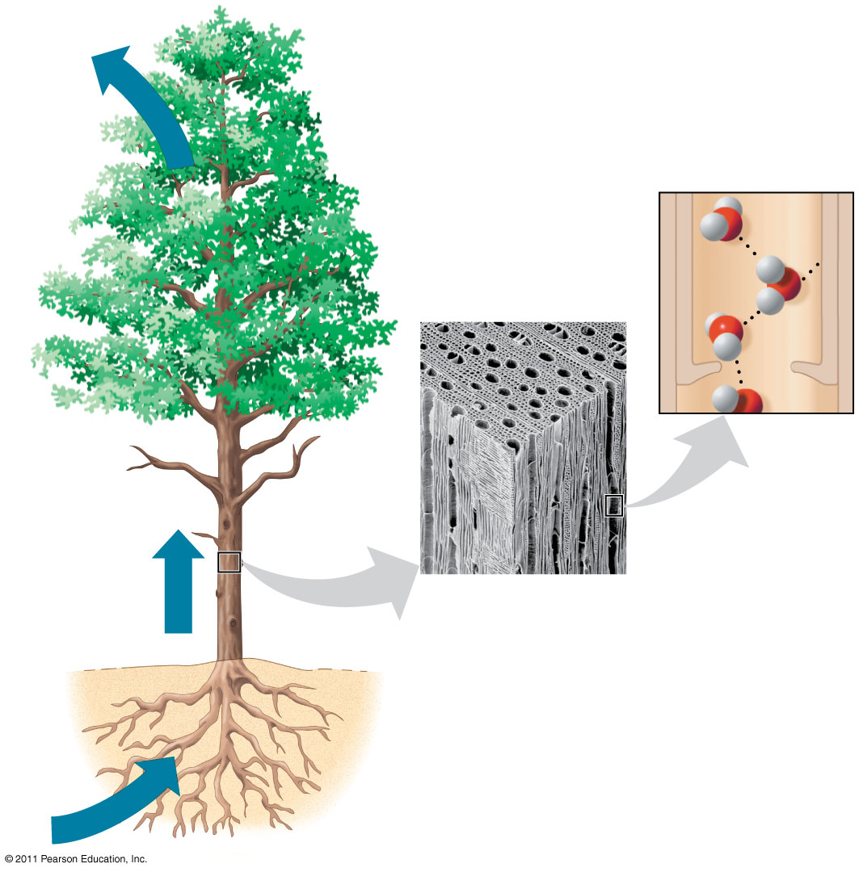
Figure 3.3
Adhesion
Two types of
water-conducting
cells
Cohesion
Direction
of water
movement
300 μm
Notes:
Figure 3.3 Water transport in plants.

Slide 7
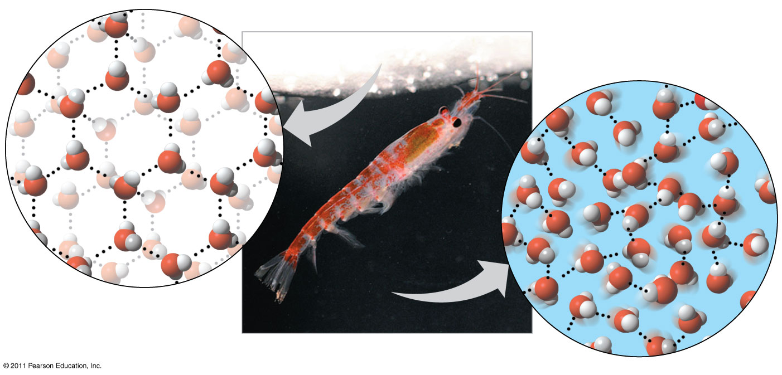
Figure 3.6
Hydrogen bond
Liquid water:
Hydrogen bonds
break and re-form
Ice:
Hydrogen bonds
are stable
Notes:
7
Figure 3.6 Ice: crystalline structure and floating barrier.

Slide 8
AP Biology
Biochemistry

Slide 9
Carbon’s versatility
Valence=?
Capable of single bonds (-ane), double bonds (-ene), and triple bonds (-yne)
Readily forms hydrocarbons (organic molecules of only C & H), which are the backbones of biochemicals
Carbon molecules often form isomers (same formula, different architecture)
Isomers can be chains vs. rings, cis-trans (variation around a double bond), or enantiomers (mirror images which vary around a central carbon)
Real world applications: vision affected by cis -trans, trans fats, pharmaceuticals)

Slide 10
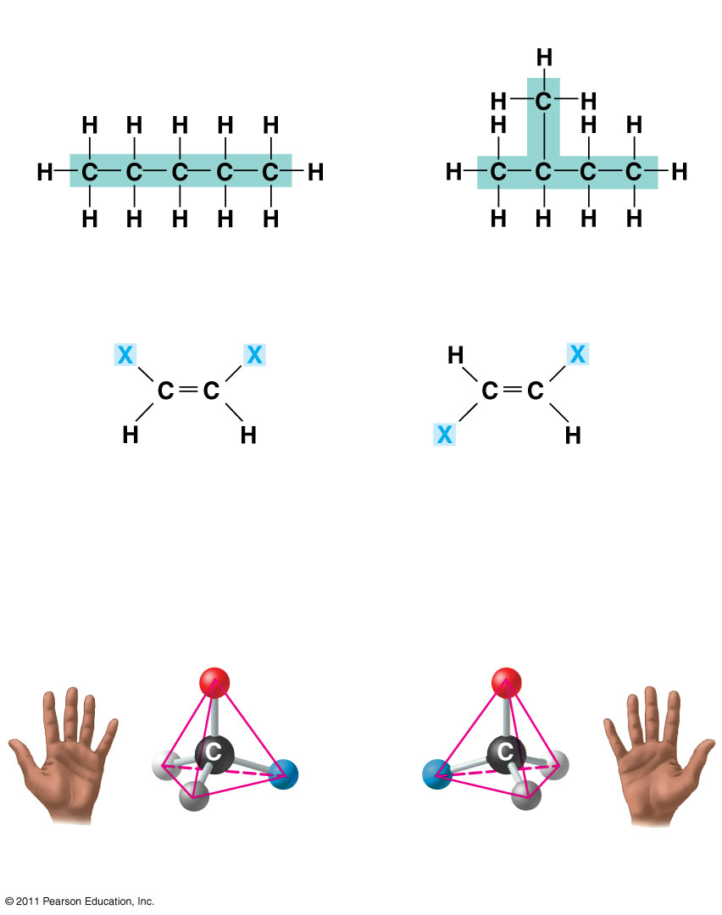
Figure 4.7
(a) Structural isomers
(b) Cis-trans isomers
cis isomer: The two Xs are on the same side.
trans isomer: The two Xs are on opposite sides.
(c) Enantiomers
CO2H
CO2H
H
NH2
NH2
H
CH3
CH3
L isomer
D isomer
Notes:
Figure 4.7 Three types of isomers, compounds with the same molecular formula but different structures.

Slide 11
Origin of Biochemicals
Miller & Urey experiment
Concluded complex molecules could arise spontaneously from conditions on early earth
Amino acids, hydrocarbons

Slide 12
Distinguishing between hydrocarbons
Functional groups are used to distinguish molecules made up of C, H, O, since these groups cause the molecules to behave differently:
Hydroxyl group (OH-)=alcohols, forms H bonds
Carbonyl group (C=O)=aldehyde or ketone/ different sugars
Carboxyl group (COOH)=organic acid
Amino group (NH₂ )=amine (organic base)
Sulfhydryl group (SH)=Stabilize proteins
Phosphate group (PO₄)=energy transfer group (ATP)
Methyl (CH₃ )=methylated compounds-mark DNA, distinguish hormones

Slide 13
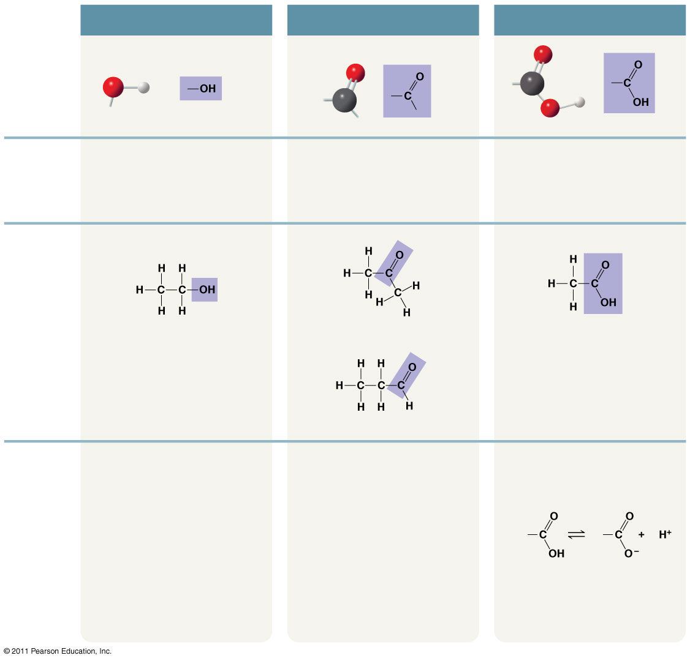
Figure 4.9_a
CHEMICAL
GROUP
Hydroxyl
Carbonyl
Carboxyl
STRUCTURE
(may be written HO—)
NAME OF
COMPOUND
Alcohols (Their specific names usually end in -ol.)
Ketones if the carbonyl group is within a carbon skeleton
Carboxylic acids, or organic acids
Aldehydes if the carbonyl group is at the end of the carbon skeleton
EXAMPLE
Ethanol
Acetone
Acetic acid
Propanal
FUNCTIONAL
PROPERTIES
• Is polar as a result of the electrons spending more time near the electronegative oxygen
atom.
• A ketone and an aldehyde may be structural isomers with different
properties, as is the case for acetone and propanal.
• Acts as an acid; can donate an
H⁺ because the covalent bond
between oxygen and hydrogen
is so polar:
• Can form hydrogen bonds with water molecules, helping dissolve
organic compounds such as sugars.
• Ketone and aldehyde groups are also found in sugars, giving rise to two major groups of sugars:
ketoses (containing ketone
groups) and aldoses (containing
aldehyde groups).
Nonionized
Ionized
• Found in cells in the ionized form
with a charge of 1− and called a
carboxylate ion.
Notes:
Figure 4.9 Exploring: Some Biologically Important Chemical Groups

Slide 14
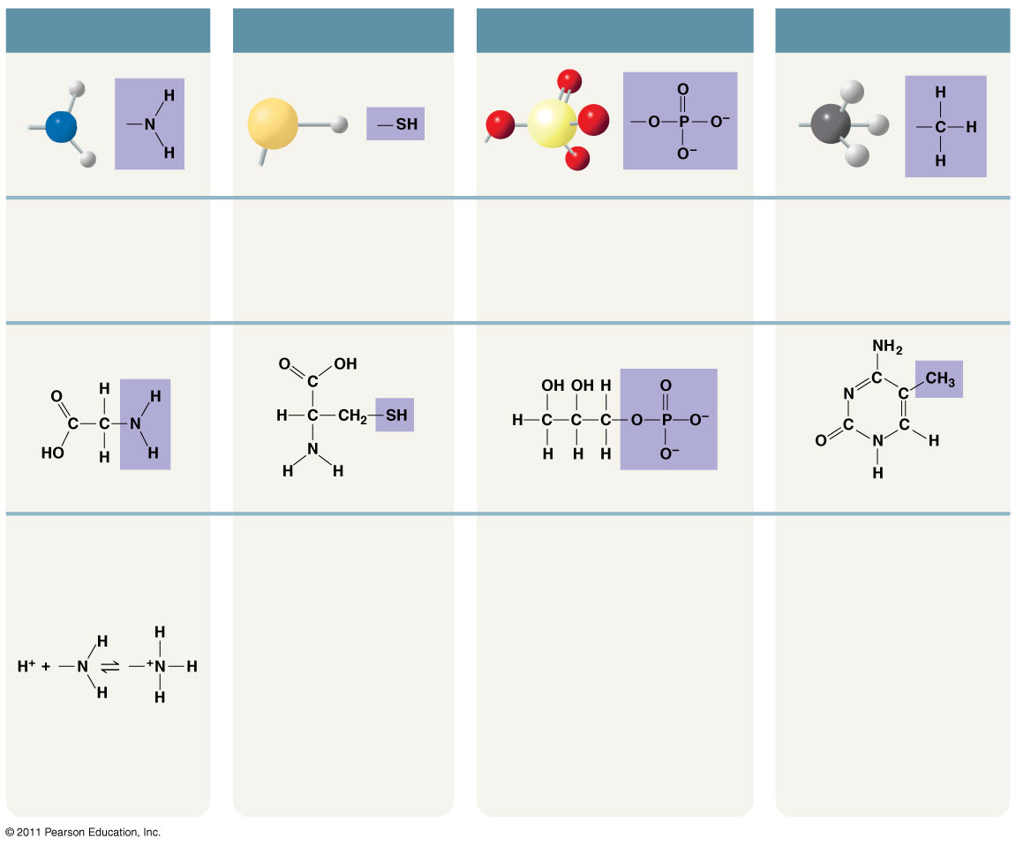
Figure 4.9_b
Amino
Sulfhydryl
Phosphate
Methyl
(may be written HS—)
Amines
Thiols
Organic phosphates
Methylated compounds
Glycine
Cysteine
Glycerol phosphate
5-Methyl cytidine
• Acts as a base; can
pick up an H⁺ from the
surrounding solution (water, in living
organisms):
• Two sulfhydryl groups can react, forming a covalent
bond. This “cross-linking”
helps stabilize protein
structure.
• Contributes negative charge to
the molecule of which it is a part
(2– when at the end of a molecule,
as above; 1– when located
internally in a chain of
phosphates).
• Addition of a methyl group
to DNA, or to molecules
bound to DNA, affects the
expression of genes.
• Arrangement of methyl
groups in male and female
sex hormones affects their
shape and function.
• Cross-linking of cysteines
in hair proteins maintains
the curliness or straightness
of hair. Straight hair can be
“permanently” curled by
shaping it around curlers
and then breaking and
re-forming the cross-linking
bonds.
• Molecules containing phosphate
groups have the potential to react
with water, releasing energy.
Nonionized
Ionized
• Found in cells in the
ionized form with a
charge of 1+.
Notes:
Figure 4.9 Exploring: Some Biologically Important Chemical Groups

Slide 15
Modeling Carbon’s Versatility
Demonstrate
what 2 carbons look like when single-bonded (complete the valence with Hydrogens).
Write the chemical formula for this molecule.
Draw the molecule.
a molecule of 2 carbons double-bonded.
Write the chemical formula and draw this molecule.
a 2-carbon molecule that is triple-bonded.

Slide 16
Modeling Carbon’s Versatility
Discuss
What happens to the hydrogen atoms when you go from a single to double bond? From a double to a triple?
What does “saturated” have to do with the 3 types of bonds? Which molecule is considered saturated?

Slide 17
Life is Chemical –Long Form FRQ
30 point Minor Classwork
Talk to Text Reading (10)
Model and Discuss
Questions A-C (15)
Peer Rubric & Comments (5)

Slide 18
Polymers and Monomers
Monomer=1 subunit (link in a chain)
Polymer=a chain of small subunits
Polymers are put together by dehydration synthesis reactions
Monomers joined covalently losing a water molecule
Polymers are taken apart by hydrolysis (hydro=water, lysis=splitting)
Broken down in to monomers
Digestion is an example of this happening in our bodies
All Biochemicals are polymers

Slide 19
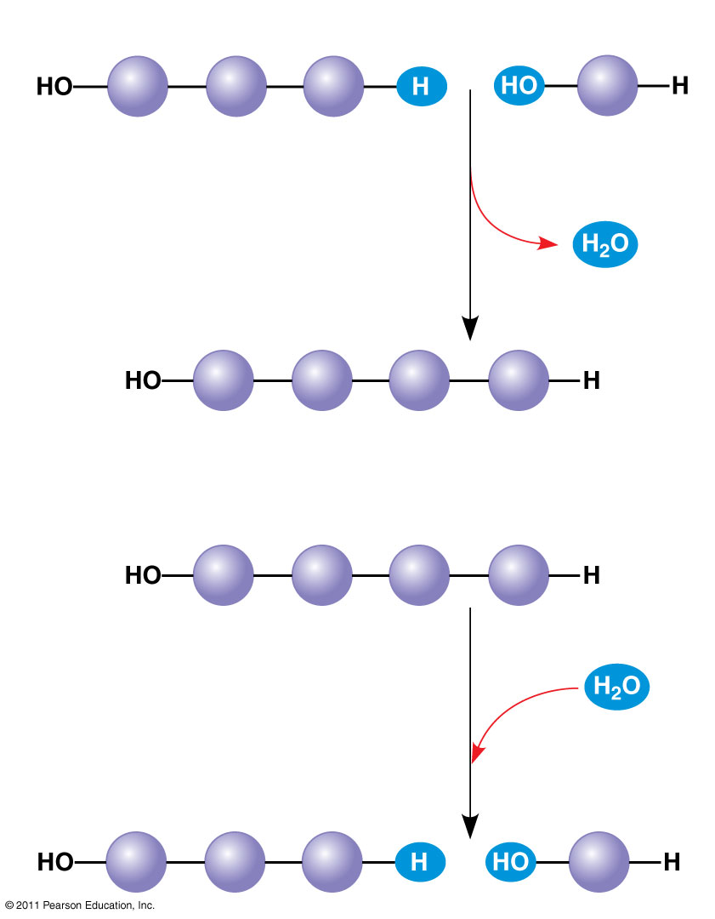
Figure 5.2
(a) Dehydration reaction: synthesizing a polymer
1
2
3
Short polymer
Unlinked monomer
Dehydration removes a water molecule, forming a new bond.
1
2
3
4
Longer polymer
(b) Hydrolysis: breaking down a polymer
1
2
3
4
Hydrolysis adds a water molecule, breaking a bond.
1
2
3
Notes:
Figure 5.2 The synthesis and breakdown of polymers.

Slide 20
Carbohydrates
Sugars are mono- or disaccharides
Ex: glucose(mono), sucrose (di)
Disaccharides-joined by glycosidic linkage (covalent bond formed btwn 2 monos)
Used for energy
Polysaccharides
Have hundreds-thousands of monosaccharides joined
Used for energy storage or structure
Animals store glycogen for energy and chitin for structure
Plants use cellulose for structure and store amylose or amylopectin (starch) for energy
Difference is in the types of linkage between the monomers and the degree of branching within the molecules

Slide 21
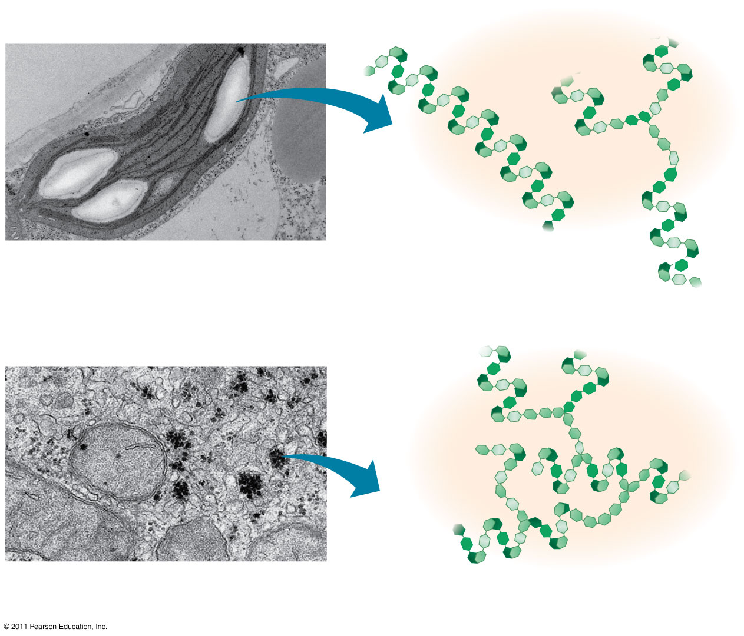
Figure 5.6
Chloroplast
Starch granules
Amylopectin
Amylose
(a) Starch: a plant polysaccharide
1 μm
Mitochondria
Glycogen granules
Glycogen
(b) Glycogen: an animal polysaccharide
0.5 μm
Notes:
Figure 5.6 Storage polysaccharides of plants and animals.

Slide 22
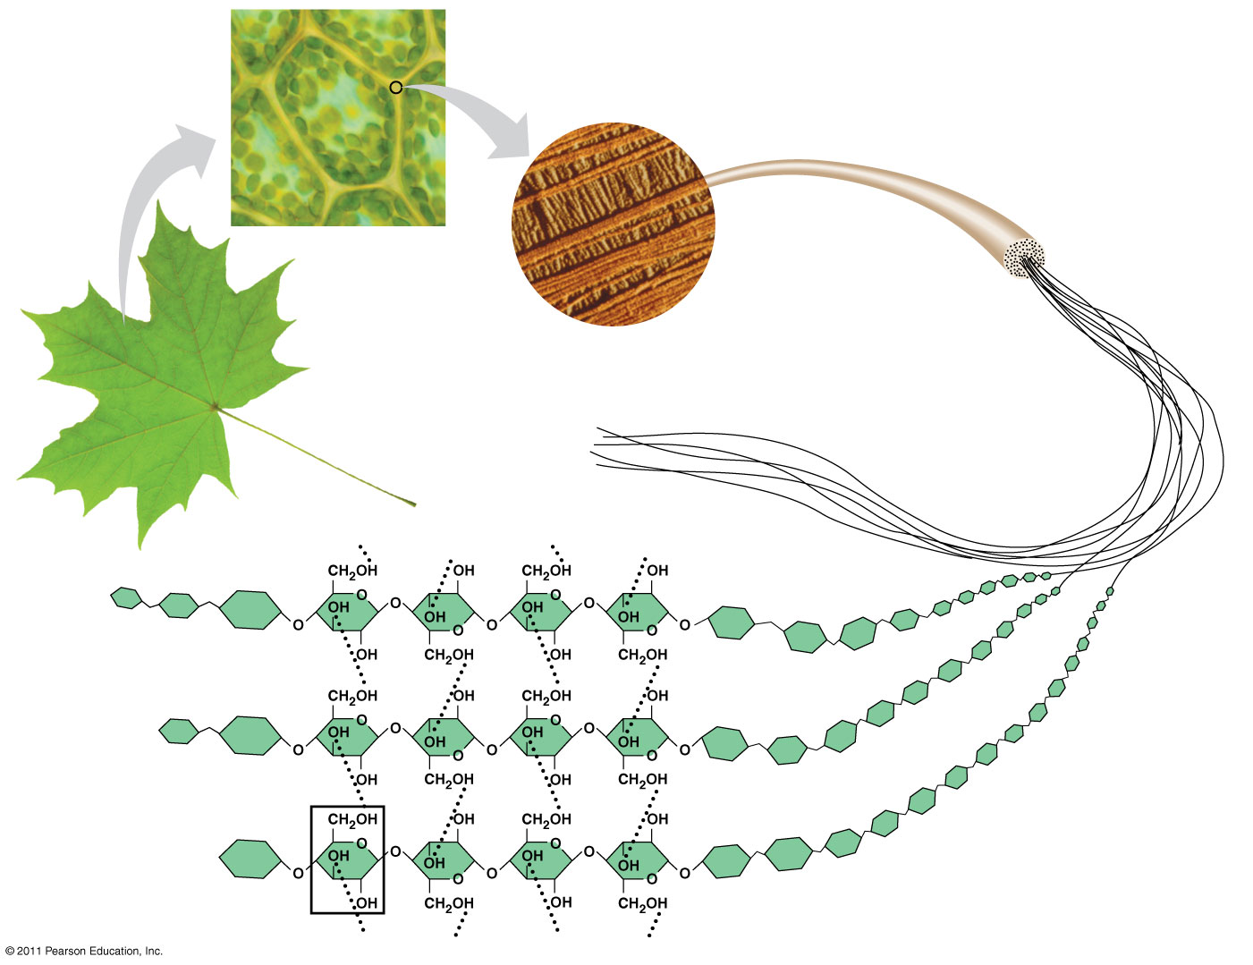
Figure 5.8
Cell wall
Cellulose microfibrils in a plant cell wall
Microfibril
10 μm
0.5 μm
Cellulose molecules
β Glucose monomer
Notes:
Figure 5.8 The arrangement of cellulose in plant cell walls.

Slide 23
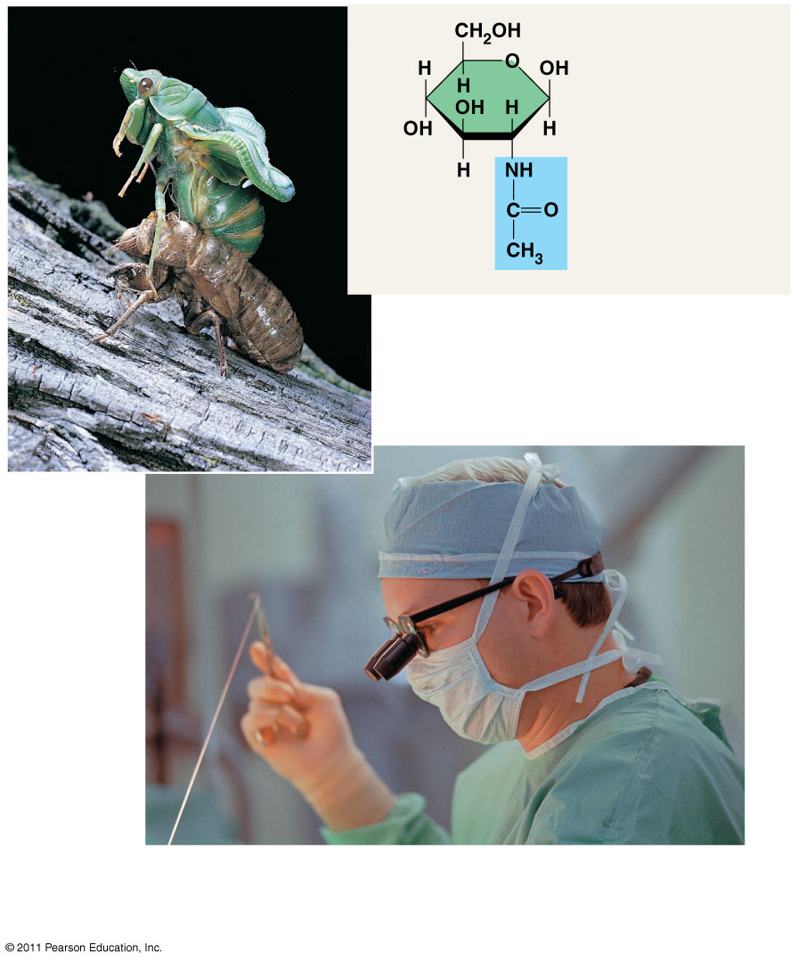
Figure 5.9
The structure of the chitin monomer
Chitin forms the exoskeleton of arthropods.
Chitin is used to make a strong and flexible surgical thread that decomposes after the wound or incision heals.
Notes:
Figure 5.9 Chitin, a structural polysaccharide.

Slide 24
Lipids
Fats, oils, waxes (sterols)
Non-polar
Exception: phospholipids (part hydrophilic, part hydrophobic)
Energy storage-savings account (chemically stable, takes a lot to break them apart)
1 g fat stores more than 2x energy of polysaccharide
Triglyceride is a typical lipid structure consisting of a glycerol and 3 fatty acid chains.
Saturated vs. Unsaturated

Slide 25
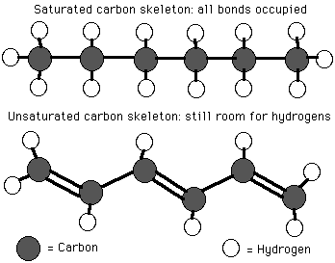
Saturated | Unsaturated
Maximum # of hydrogen atoms | Fewer hydrogen atoms
Single bonds | Double and Triple bonds
Ex. Butter | Ex. Canola Oil
Unhealthy | Healthy

Slide 26
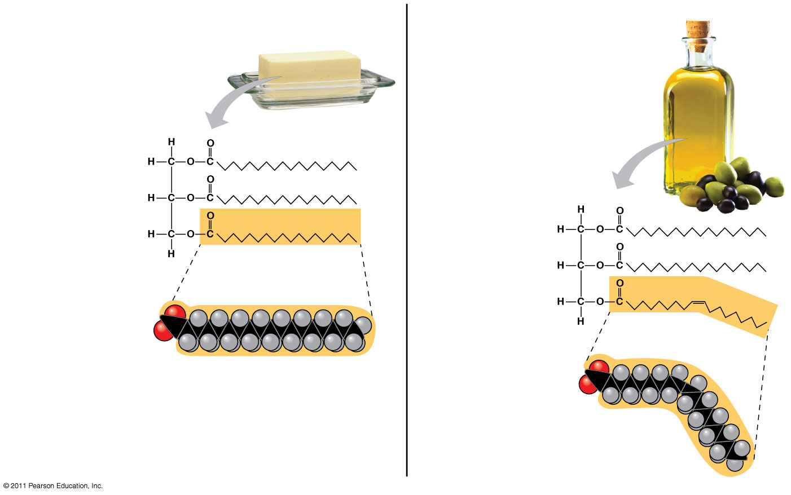
Figure 5.11
(a) Saturated fat
(b) Unsaturated fat
Structural formula of a saturated fat molecule
Structural formula of an unsaturated fat molecule
Space-filling model of stearic acid, a saturated fatty acid
Space-filling model of oleic acid, an unsaturated fatty acid
Cis double bond causes bending.
Notes:
Figure 5.11 Saturated and unsaturated fats and fatty acids.

Slide 27
Proteins
Held together by peptide bonds, and are therefore sometimes called polypeptides (special case of condensation where N is bonded to C)
Have an amino end & a carboxyl end
Workhorses of cells, doing a variety of tasks such as communication, structure, movement, storage, transport, defense and enzymes
Monomer is the amino acid (20 amino acids exist in living things, distinguished by their R groups)
Physical & chemical properties of the functional group determine unique characteristics of the amino acid
some are hydrophobic, some hydrophilic, some positive, some negative

Slide 28
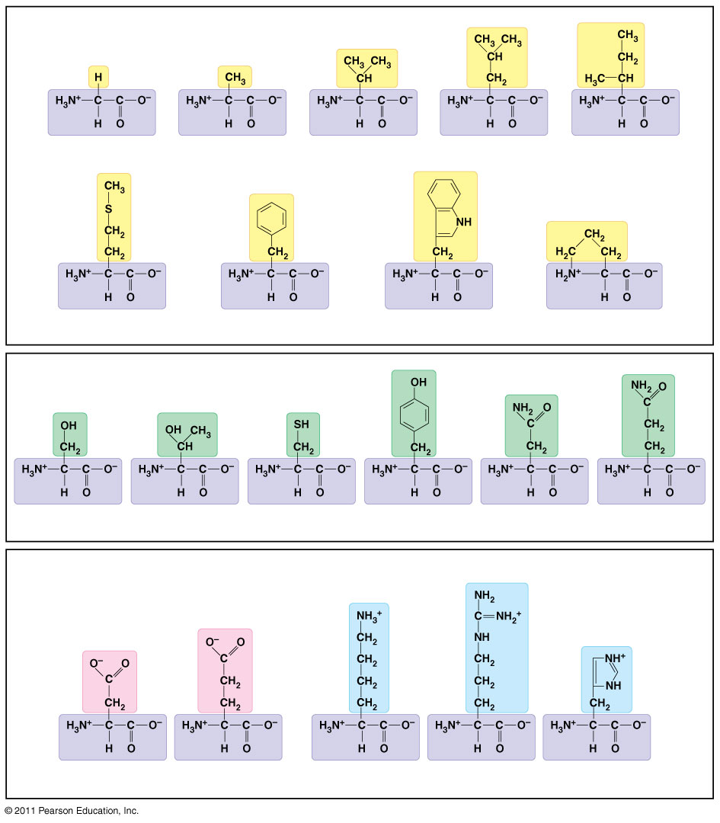
Figure 5.16
Nonpolar side chains; hydrophobic
Side chain (R group)
Glycine (Gly or G)
Alanine (Ala or A)
Valine (Val or V)
Leucine (Leu or L)
Isoleucine (Ile or I)
Methionine (Met or M)
Phenylalanine (Phe or F)
Tryptophan (Trp or W)
Proline (Pro or P)
Polar side chains; hydrophilic
Serine (Ser or S)
Threonine (Thr or T)
Cysteine (Cys or C)
Tyrosine (Tyr or Y)
Asparagine (Asn or N)
Glutamine (Gln or Q)
Electrically charged side chains; hydrophilic
Basic (positively charged)
Acidic (negatively charged)
Aspartic acid (Asp or D)
Glutamic acid (Glu or E)
Lysine (Lys or K)
Arginine (Arg or R)
Histidine (His or H)
Notes:
Figure 5.16 The 20 amino acids of proteins.

Slide 29
Levels of protein structure
Shape determines how the molecule works and is extremely important
Primary structure=sequence of amino acids (read from amino terminus to carboxyl terminus)
Secondary structure=coiling or folding of the molecule b/c of hydrogen bonds between backbone molecules (therefore, these are regular ex: alpha helices and pleated sheets)
Tertiary structure=contortion of the molecule due to attractions (van der Waals and H bonding) between R groups. Because each protein has a unique AA sequence, these are irregular patterns that are unique to each protein (ex=disulfide bridges between sulfhdryl groups, hydrophobic clustering)
Quaternary structure=overall protein structure resulting from multiple polypeptides (ex=hemoglobin has 4 polypeptide chains held together with heme groups consisting of Fe)
High temperature, extreme salinity and pH changes can cause denaturating of proteins=protein becomes misshapen because the forces controlling the levels of structure above have been interfered with

Slide 30
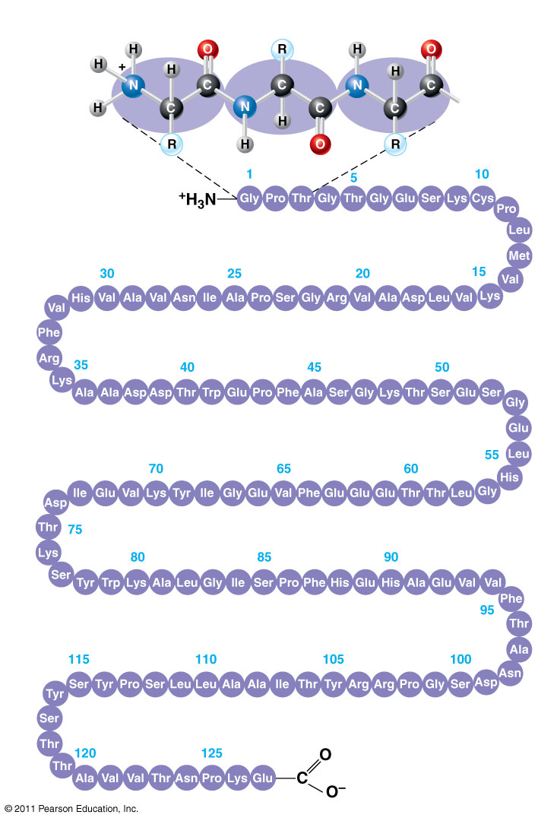
Figure 5.20a
Primary structure
Amino acids
Amino end
Primary structure of transthyretin
Carboxyl end
Notes:
Figure 5.20 Exploring; Levels of Protein Structure

Slide 31
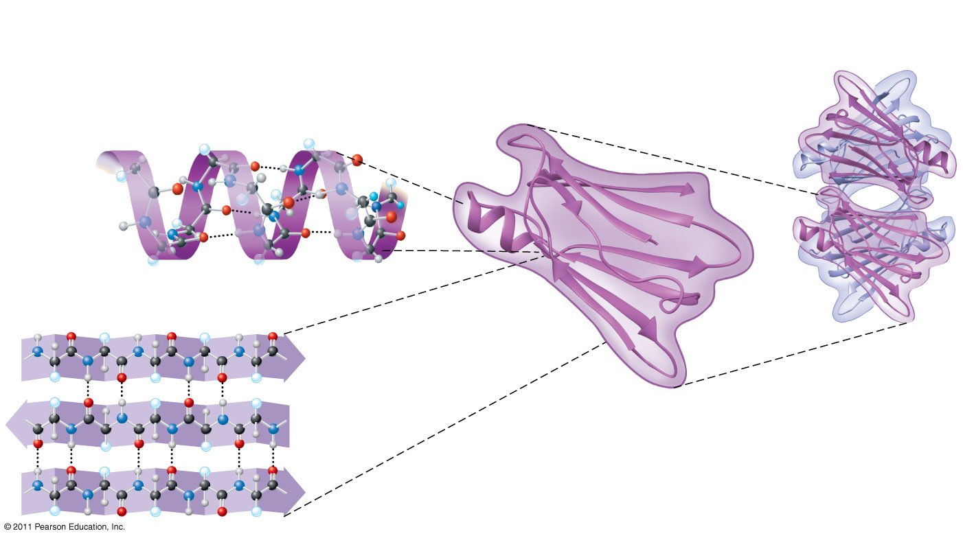
Figure 5.20b
Secondary structure
Tertiary structure
Quaternary structure
α helix
Hydrogen bond
β pleated sheet
β strand
Transthyretin protein
Hydrogen bond
Transthyretin polypeptide
Notes:
Figure 5.20 Exploring: Levels of Protein Structure

Slide 32
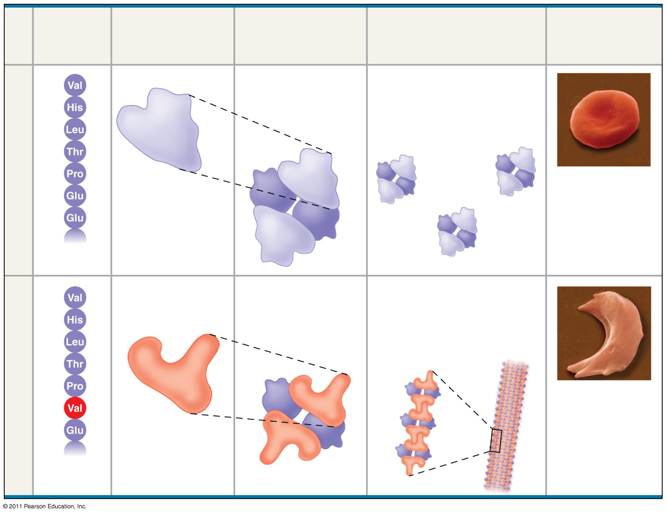
Figure 5.21
Primary Structure
Secondary and Tertiary Structures
Quaternary Structure
Red Blood Cell Shape
Function
1
Normal hemoglobin
Molecules do not associate with one another; each carries oxygen.
2
3
4
Normal hemoglobin
5
α
6
β subunit
β
10 μm
7
α
β
1
Exposed hydrophobic region
Sickle-cell hemoglobin
Molecules crystallize into a fiber; capacity to carry oxygen is reduced.
2
3
4
Sickle-cell hemoglobin
5
α
6
β
10 μm
7
β subunit
α
β
Notes:
Figure 5.21 A single amino acid substitution in a protein causes sickle-cell disease.

Slide 33
Metabolism
Metabolism is the sum total of all Anabolic (putting together) and Catabolic (taking apart) chemical reactions in the body
Basic Cellular energy molecule fueling metabolism is ATP (adenosine triphosphate)
Releasing the last phosphate group releases 7.6 kcal of energy

Slide 34
Trans Fat Article-15 minutes
What is another name for trans fats?
How are they made?
Why do scientists make trans fats and why do we like to buy them?
Distinguish between LDL and HDL cholesterol. Use this to explain why trans fats are ‘worse than butter’.
What companies have worked to lower trans fats in their foods?
True or False: It is mandatory for food labels to list trans fat amounts.

Slide 35
Nucleic Acids
Information storage molecules=DNA and RNA
Monomers are nucleotides
Phosphate group (held in phosphodiester linkage with the sugar to form the backbone)
Sugar (deoxyribose in DNA, ribose in RNA)
Nitrogenous base (purines=A and G pyrimidines=T, C, and U) that bond purine to pyrimidine based on the number of H-bonds each wants to make
Sequential changes in different species are used as an evolutionary clock (more on this in the Evolution unit)

Slide 36
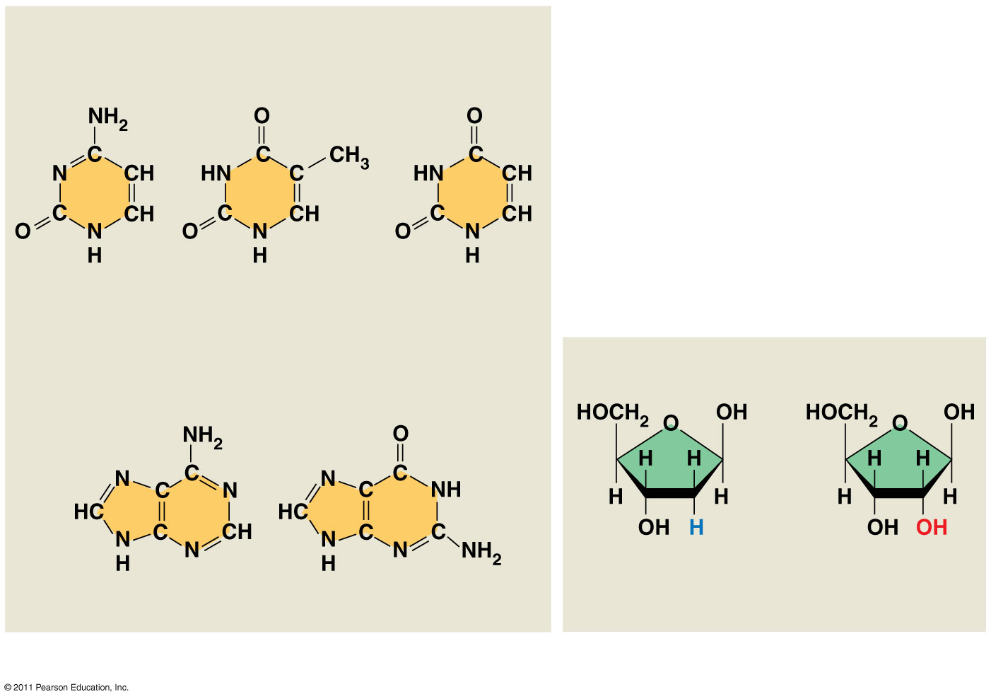
Figure 5.26b
Nitrogenous bases
Pyrimidines
Cytosine (C)
Thymine (T, in DNA)
Uracil (U, in RNA)
Sugars
Purines
Deoxyribose (in DNA)
Ribose (in RNA)
Adenine (A)
Guanine (G)
(c) Nucleoside components
Notes:
Figure 5.26 Components of nucleic acids.

